Slide 1




2024 Troop Cookie Manager Training

Slide 2
Today’s Training Agenda
2024 Cookie Program:
  Available varieties
  GSCM pricing
  Basics
DC24 overview of changes
Cookie Program Resources for Volunteers
2024 Cookie Program Theme, Rewards and Proceeds
TCM Responsibilities and Next Steps
Depot Days
Cookie Cupboards
Smart Cookies Refresh Training
  Initial Order creation
  Reward order creation
  Cookie Transfers
  Planned Orders
  Cookie share
  Booth Sale functions

Slide 3
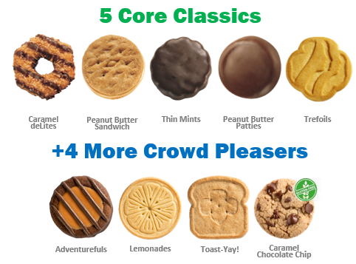
Your 2024 ABC cookie lineup

Slide 4
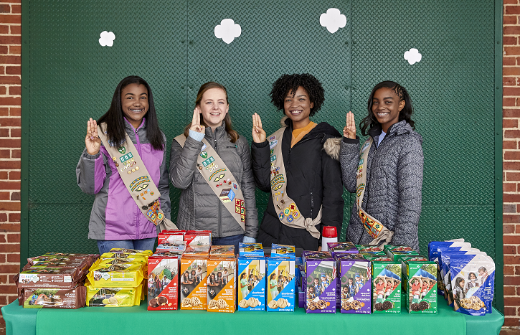
GSCM’s 2024 program pricing
NO CHANGE:
$5 per package
$6 per package Gluten Free
Cookie Box Selling Price - All regular 8 varieties of cookies sell for $5.00 per box. Gluten Free Caramel Chocolate Chip sells for $6.00. Troops are not permitted to set prices higher or lower for any reason.
The Council will distribute cookies to troops in full cases ONLY. There are 12 boxes to a case. Girl Scout Cookies are not returnable. Troops can transfer cookies by the box to other troops to help provide variety and reduce over stock.
Financial Responsibility - The Troop Cookie Manager (TCM) is responsible for all cookies received by the Troop. All delinquent parent accounts must be reported to GSCM; the appropriate paperwork (T-6) must be signed and submitted. Interest and fees apply to all accounts turned over to collections. No Troop or individual may pursue legal matters on behalf of GSCM.

Slide 5
GSCM 2024 Cookie Program Basics
Cookie program dates October 1st through January 14th, 2024
  October 1st – paper order card orders ONLY, enter in Smart Cookies. No Smart Cookies mobile app due to DC24 system migration.
All girls must be registered for 2023-2024 season
TCM’s must be registered and background checked for the season
Troops access Smart Cookies after completing T-3 and T-1 forms in the VTK, available online at www.gscm.org
November 13th - start date for ALL DC24 online orders, including marketing emails to customers, Shipped Only orders and social link/QR code
We want girls to be safe, have fun and reach their goals. GSCM asks adults to use their best judgement and common sense to support participating girls!

Slide 6
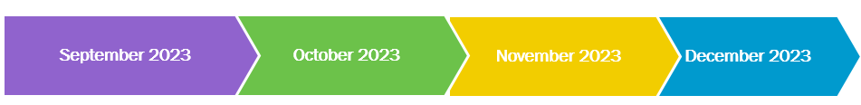
GSCM’s Important Program Dates
September 1: Troops complete T-3 & T-1 forms online at www.gscm.org
SUCM Cookie Training:
IN PERSON
September 12 & 14
6:30-9:30pm
September 16,
9am – 11am
Troop Training: ZOOM
September 23 & 30
9-11am
September 27 & 28
6:30-8:30pm
October 1: Girls Begin Sales, PAPER ORDER CARDS ONLY
October 29: Troop Initial Orders and Reward selections due in Smart Cookies by 11:59pm
November 13th: Online Sales begin through the DC24 platform
November 15 – 20:
Service Unit Depot Days
November 17: Booth Sales Begin
November 19 & 26: Planned Orders for upcoming week are due in Smart Cookies by 11:30pm
December 1st
ACH #1 @50% Troop Initial Order due as of this day
December 3, 10, 17:
Planned Orders for upcoming week are due in Smart Cookies by 11:30pm
December 21st:
ACH #2 @ 50% of balance due as of December 18th

Slide 7
GSCM’s Program Dates Continued
January 2024
January 7:
FINAL Planned Order entry for upcoming week by 11:30pm
January 14: COOKIE SALE ENDS.
Troop FINAL main recognition order must be entered in Smart Cookies by 11:59pm or Troop forfeits all items, including patches. Opt out Troops must create a reward order to receive patches only. NO EXCEPTIONS
January 16: SUCM’s must review and submit the main recognition order to Council no later than 9am EST
January 22: ACH #3 All remaining balances due
Troop Cookie Share Pickup Schedule
January 23, Council office 10am – 3pm
January 24, Council office from 10am to 3pm
January 27, Council office from 9am to 1pm

Slide 8
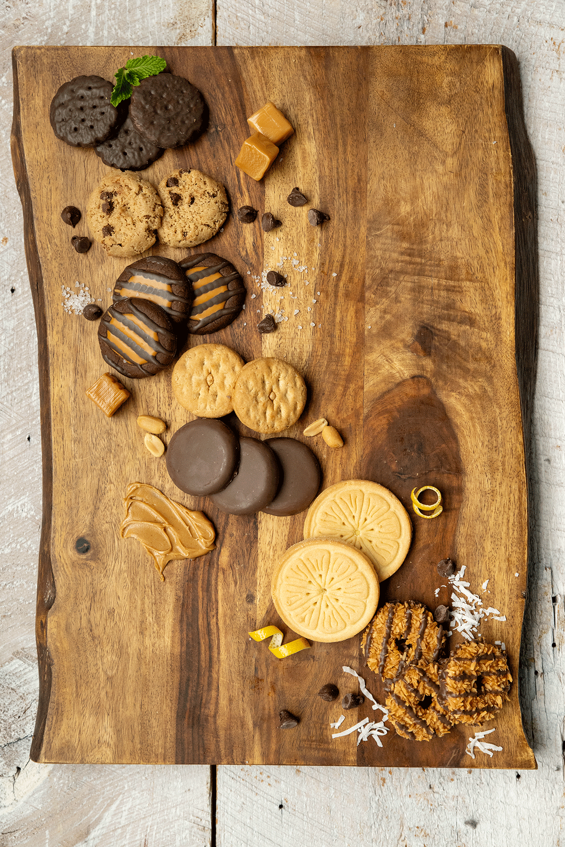
DC24 System Integration Changes

Slide 9
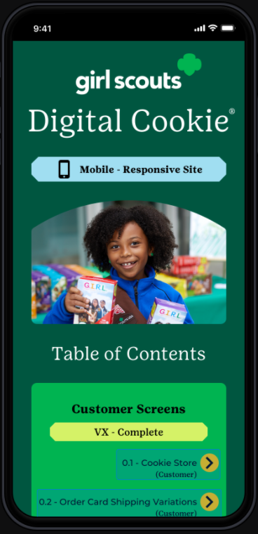
All online selling moves to DC24
All online sales are moving to DC24:
November 3rd: Volunteer access
November 6th: Caregiver access
November 13th: Open for Girl sales
Girl online sales features, plus all credit card payments
Girl online sales reporting features, by sales channel
Virtual booth process
Girl/Troop credit card transactions, sales and refund ability
Girl delivery credit card financial settlement
Girl, Troop and Direct Ship support
Direct ship financial settlement

Slide 10
DC24 Training Tools and Key Dates
Parent/caregivers will receive registration emails from DC24 when they are given access on November 6th.
Sales open for girls on November 13th
There will be a mobile app for sales, compatible with both Android and Apple devices
Please continue checking back at www.gscm.org, under the Cookies section, for a full listing of DC24 tip sheets. Council will continue to add tip sheets and videos as GSUSA releases them

Slide 11
DC24 migration benefits:
Customizable girl and troop sites that let customers see photos, videos, and her story/sales pitch directly on the girl or troop’s order page
  Cookie Business badges and Family Entrepreneur Pin requirements that are integrated into the system, reinforcing the importance of badge work and the girl experience within our cookie program
  The ability for caregivers to turn delivery on/off and cookie varieties on/off to match their family participation goals and available inventory
  Customizable shipping promotions
  A streamlined Mobile App for ease in collecting sales

Slide 12


2024 Theme and Mascot
Every Girl Scout has their own magic skills they can unlock during cookie season! Girls can have fun while building upon what they already know and have yet to learn. Just like Lottie the axolotl, every girl has the magic skill of regeneration and growth!

Slide 13











Sample clip art
Notes:
ANNE
We work very closely with GSUSA on marketing and product development.
On November 2 they announced the unified theme and mascot for the 2024 season.
In case you missed it we thought you might like a sneak peek!
Here is our version. Girls voted for the axolotl and ABC provided the tagline and artwork.
And the axolotl provides a great opportunity for girls and adults to learn about this unique and critically endangered animal.
And the Own Your Magic theme is about celebrating the unique things that make each of us special.
Every girl has their own special magic, and they are all unique in some way – just like the axolotl.
Axolotls has the special skill of regenerating themselves. Girls do that too as they learn and grow in Girl Scouting!
Cookie time is a great opportunity to make magic and skill build.
It is going to be a lot of fun in the 2024 season.
And we’re already working on 2025!

Slide 14
2024 Online Resources
Resource | Location
Cookie theme information | https://www.flickr.com/photos/abcbakersvolunteergallery/albums
Selling safely video and tips and volunteer training tutorials | https://www.youtube.com/user/ABCCouncils
Cookie variety details | www.abcSmart Cookies.com
Social media tips & tricks to boost engagement | www.abcSmart Cookies.com
Rally Guide | www.abcSmart Cookies.com
Cookie Calculator | www.abcSmart Cookies.com
ABC Bakers Facebook Page | https://www.facebook.com/abcbakers/
Lemonades Facebook Page | https://www.facebook.com/LemonadesCookie/

Slide 15
Rewards and Proceeds

Slide 16

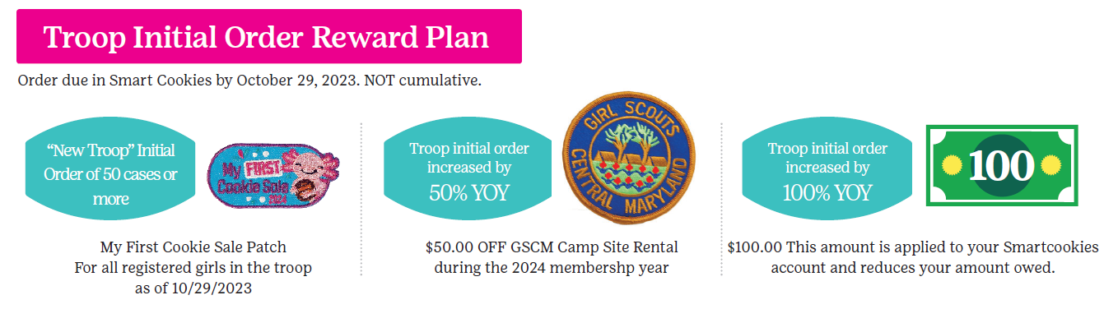
2024 Rewards: Initial Reward
Troop Initial Order Reward Plan
(non-cumulative)
New Troops - Order 50 cases or more and receive a “My First Cookie Sale” Patch for each girl in the troop as of 10/29/2023.
Troop increases initial order year over year by 50% - Receives $50.00 off a GSCM campsite rental.
Troop increases initial order year over year by 100% - Receives $100.00 applied to their Smart Cookies account.

Slide 17
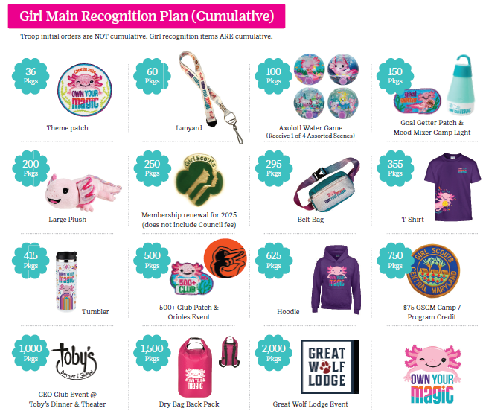
Cumulative Main Rewards
All Troops must create a Main reward order
Opt Out Troops must SUBMIT a main reward order by January 14th to receive patches only
500+ and 1,000+ club are based on individual girl sale totals, not troop proceeds. Girls in Opt out troops are eligible for these two club celebrations
Rewards are shipped in February 2024

Slide 18
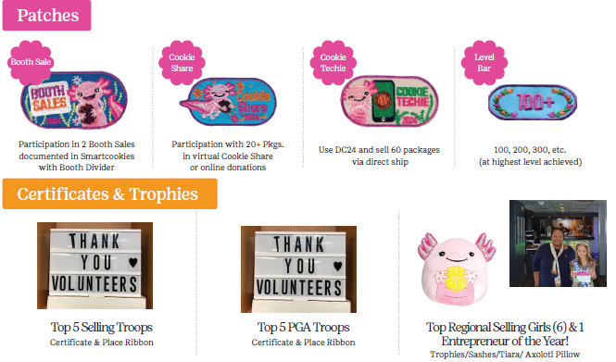
Patches, Certificates and Trophies
Booth Sale – Participate in 2 booth sales documented in Smart Cookies.
Cookie Share – Collect 20+ Pkgs in virtual cookie share.
Cookie Techie – Use DC24 and sell 60+ Pkgs via shipped only.
Level Bar – Attained at highest level sold. Increments of 100.

Slide 19
2024 Proceeds Structure
Troop proceeds = $0.70 for all 9 varieties
With the optional/earned $0.08 for Spring Renewal (Early Bird) and $0.05 for opt out, Junior and above
TCMs must regularly transfer packages to Girls in Smart Cookies for Girls to earn rewards
Parents will be able to track sales and money owed through the DC24 platform

Slide 20
GSCM Council Goals
Council Package Goal:
1,074,971 packages sold
Council PGA Goal: 153

Slide 21

TCM Program Responsibilities
Train Girls/Parents on the Cookie Sale using Council-provided training materials
Enter your Troop Initial Order, Early and Main Recognition Orders into Smart Cookies. Failure to meet system deadlines results in forfeiture of girl rewards and patches
Pick up initial order at the Depot
Make sure Troop inventories are showing 0 at end of cookie program/all cookies are transferred to Girls
Give out Recognitions to Girls as soon as you receive them
Support the girls and parents throughout the sale and encourage Girls to reach their goals!

Slide 22
Depot Days

Slide 23

Depot Day Reminders
Each TCM will sign up for the location they will pick up their troop’s initial order when they submit the initial order in Smart Cookies. Sign up for time with your Service Unit Cookie Manager if that option is not available in Smartcookies.
Bring enough vehicles to load all your initial ordered cookies in one trip.
Safety First – No tagalongs!
Please be patient and flexible.
Sort and count your cookies before loading car(s) or signing documents.
Your SUCM will have each TCM sign dot sheets or M-9 form.
TCM’s will sign for all cookies as they are received from the Depot or Cupboards.
Troop to Troop transfers should also obtain signatures from both troops involved by using the T-4 Troop to Troop transfer form.

Slide 24
Cookie Cupboards

Slide 25

Cookie Cupboards
Cookie Cupboards: A storage location, managed by a GS volunteer, where Troops pickup weekly Planned Orders after the Initial Order period
New Troops who miss Initial Order deadline will pickup their first order and Planned Orders from a Cupboard
Planned order entry in Smart Cookies is 11:30pm Sundays for following week pickup
Cupboard locations and availability are available in smart cookies
Cupboards will open the week of November 20th. Multiple locations are available throughout GSCM
Verify your cupboard location and arrive on time. No Walk ins!
No returns! Damages can be EXCHANGED at cupboards, package for package and variety for variety
Cupboard managers will approve Troop Planned Orders in Smart Cookies. A reminder that once your planned order is approved, it becomes a transfer in the system

Slide 26
Smart Cookies System

Slide 27

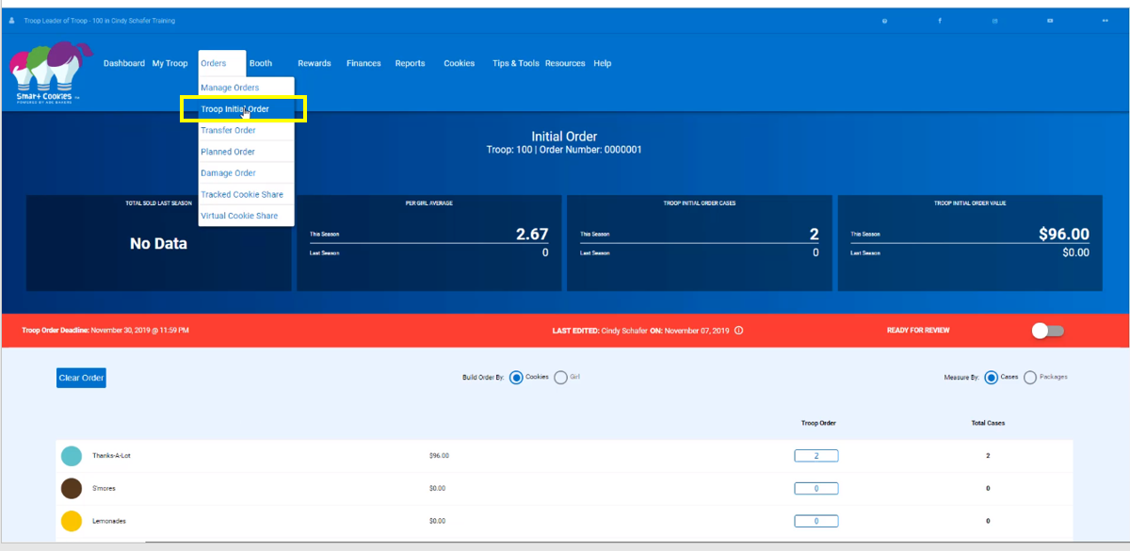
Initial Order Entry: by Girl, by Variety

Slide 28
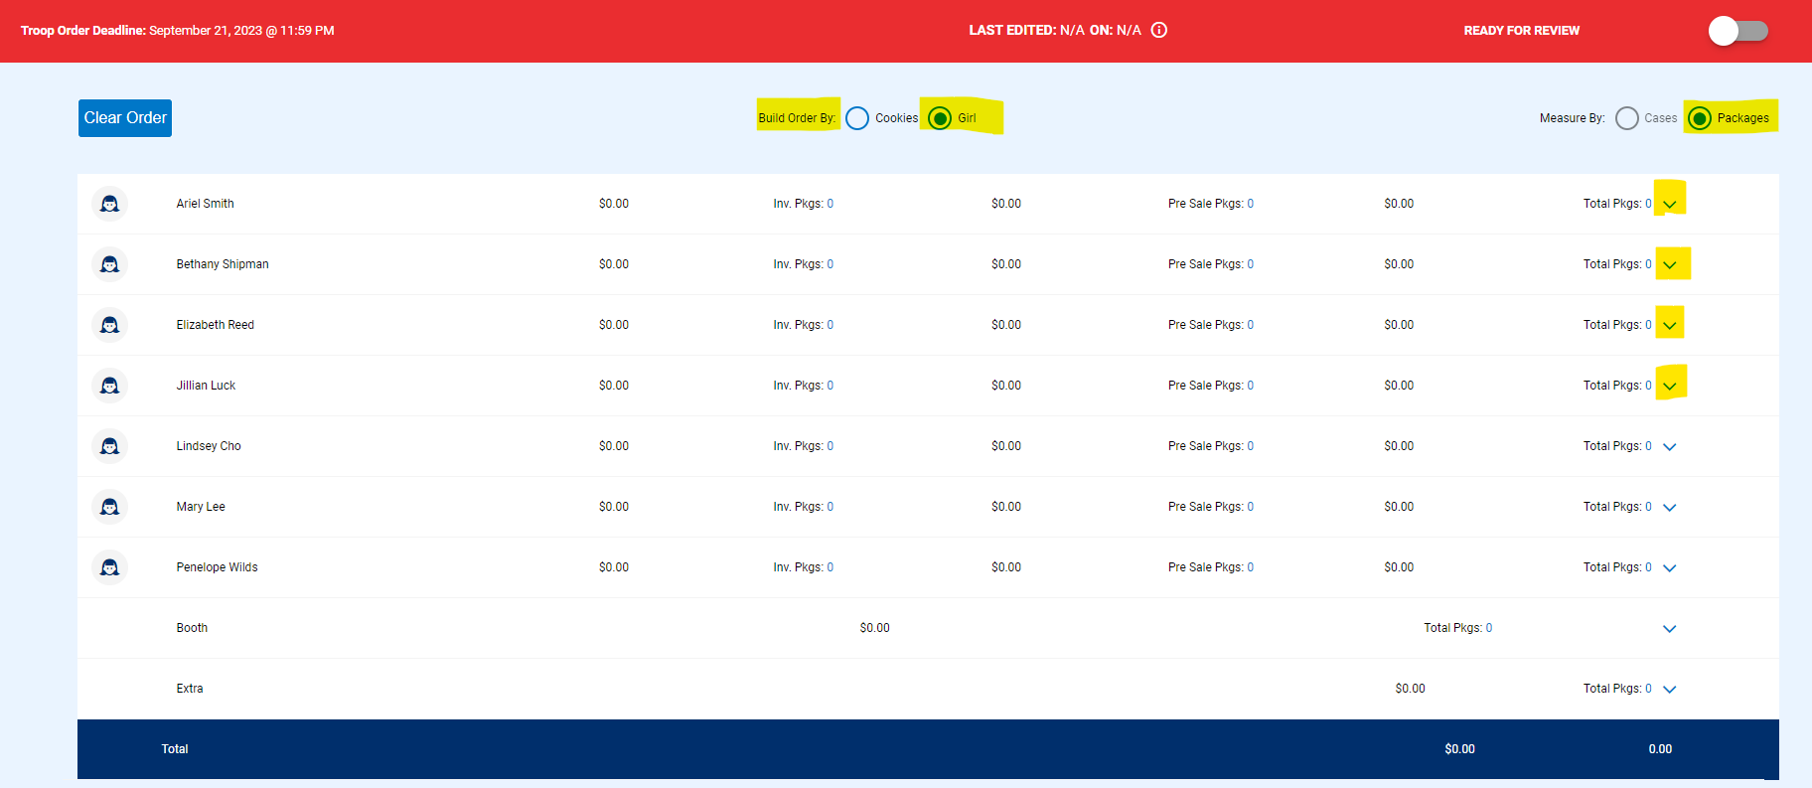
Initial Order guidelines
Troop initial orders are due in Smart Cookies October 29th by 11:30pm
Troops create Initial Orders by GIRL, by variety and in packages. Select the downward arrow to the far right of each girl name to enter packages by variety

Slide 29
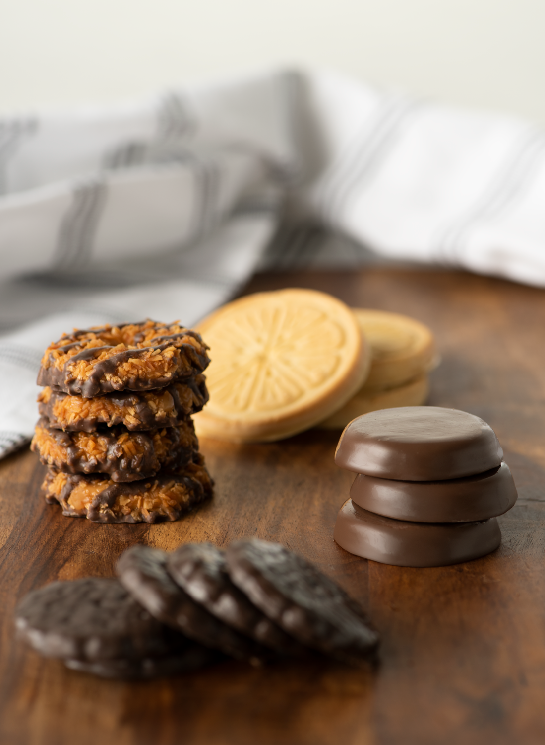


Creating
Recognition Orders

Slide 30

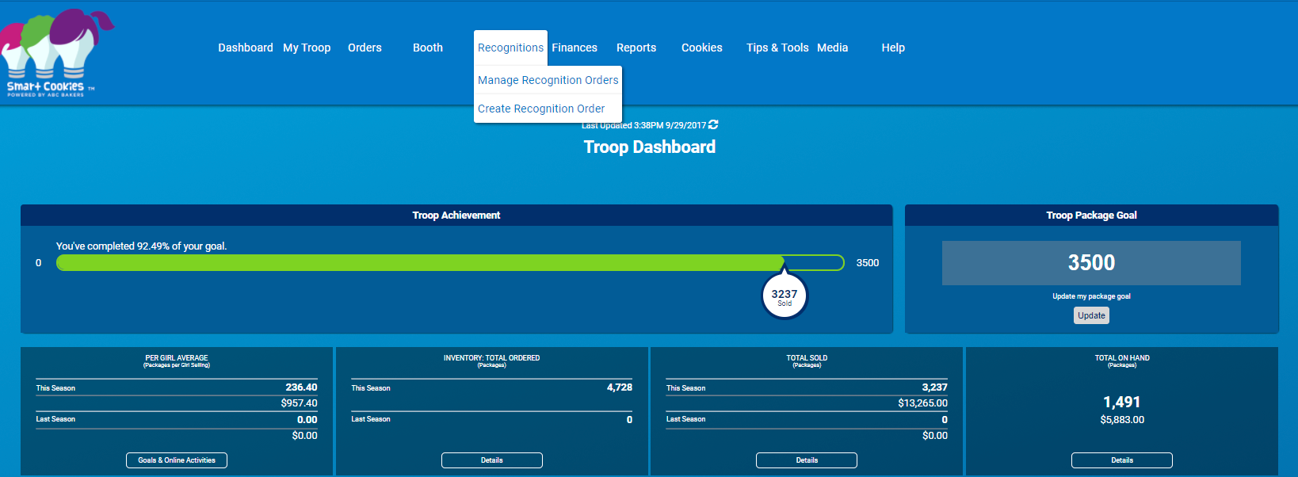
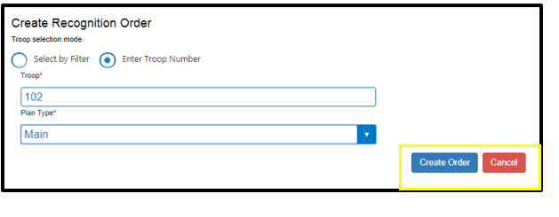
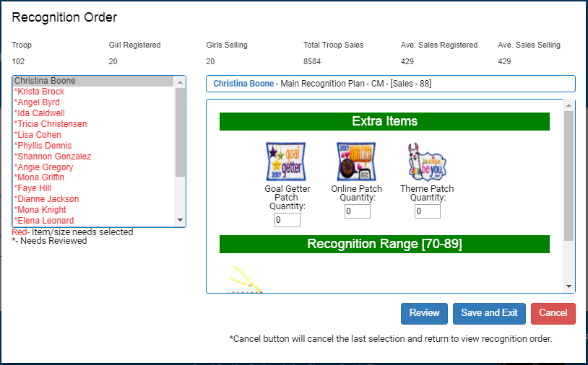
Navigate to Recognitions > Create Order
Notes:
Hover over the Recognitions tab and click on Create Recognition Order
Click on Enter Troop number and add troop number if needed, hit enter
Select Plan Type
Click Create Order
Once the Order has been created, as shown on the right will have the Girls names listed from that troop
The following items are listed at the top of the order:
Troop number
How many girls are registered in the Troop
How many girls are selling in the Troop
The total amount of packages sold to the Girls thus far
The Avg PGA of Registered Girls
The Avg PGA of Selling Girls
The names of the girls will be listed in either Blue or Red. Names in blue do not need to be reviewed. Names in red need to be reviewed.
To Review all Girls at once:
Click the Review button at the bottom of the order and all the girls orders will be reviewed. For the girls whose orders are complete, their name will be shown in blue
To Review each Girl individually:
If a girl’s name is in red, click on her name and scroll through her order. Choices may need to be made or sizes selected.
Once all names are in blue, click Save and Exit to complete the review

Slide 31
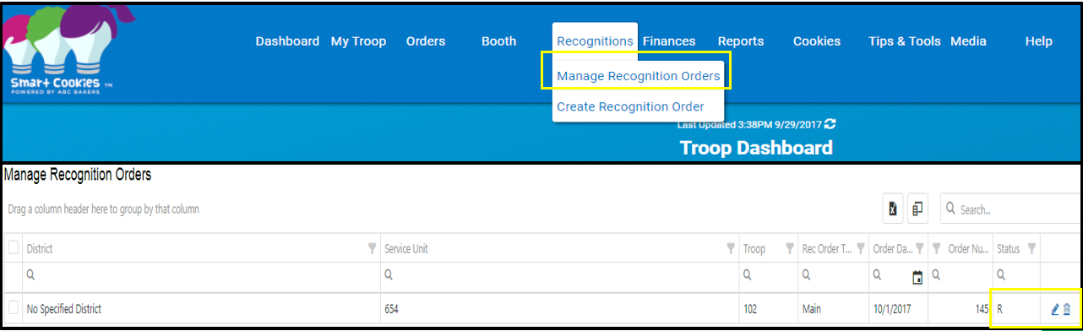
Create Vs. Manage Reward Orders
Notes:
Troops should create their recognition orders once the Girls have been credited for all packages sold
The Manage Recognition Order provides the following information:
District (if applicable)
Service Unit
Troop number
Recognition Order Type – Main
Order Date
Order Number
Status:
a “U” means Uncommitted and no need for review.
a “R” means to Review the order
a “T” means the order has been committed.
The Pencil Icon is for editing the order
The Trash Can Icon is for deleting the order
The Order can be exported into an Excel spreadsheet if needed.
When there is an “R” reviewing, click the pencil icon and the Recognition Order will appear.
The names of the girls will be listed in either Blue or Red.
Click on the individual girls name in red and verify their order
Once all names have been reviewed, click Save and Exit to complete the review

Slide 32
Troop to Girl Transfers

Slide 33

Transfers in Smart Cookies
ALL cookie transfers should be complete in Smart Cookies
Troop is financially responsible until entered into Smart Cookies
Single package transfers are allowed
Troop to Troop Transfers:
  Troops can transfer packages or cases of cookies out of inventory to another troop. (Check Smart Cookies before giving any cookies to another troop.)
  *T4 form is filled out
  * Entered into Smart Cookies in a timely manner by the giving troop
Troop to Girl Transfers:
  Cookies sold by Girls should be transferred frequently throughout the sale. Girls do not earn incentives until packages are transferred in Smart Cookies
  Troops create Troop to Girl transfer
  Cookie booth sales should be transferred to girls via Smart Cookies Booth Divider

Slide 34
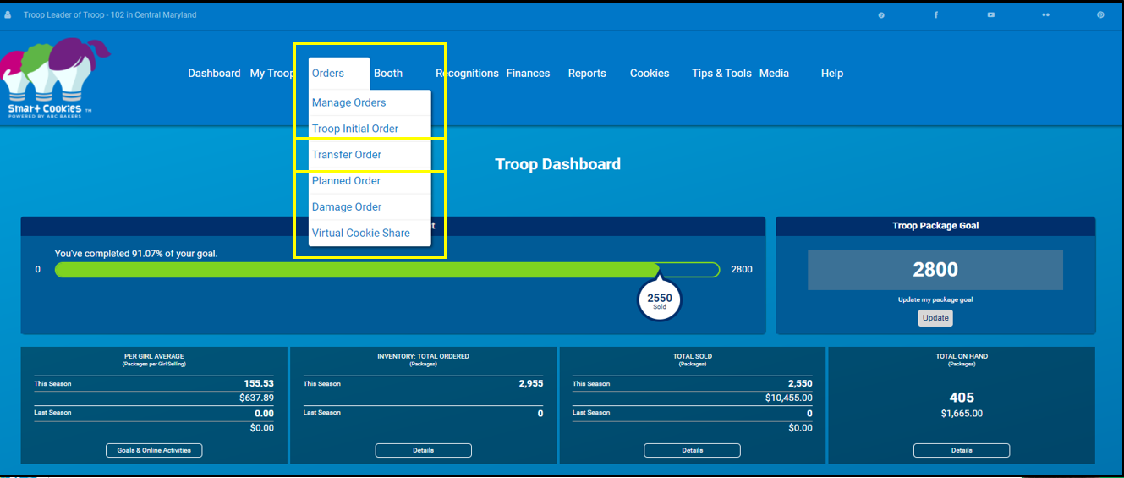
Navigate to Orders > Transfer Order
Notes:
The Five Essential Skills
The Cookie Sale supports learning in a fun environment. Girls learn by doing. The Girl Leadership Experience invites girls to make decisions around the Cookie Sale! Troops and girls set goals – both sales and learning goals. They practice business ethics by following the sale guidelines and selling dates. Money management takes the lead when girls make change or budget their cookie money to support troop activities. And we all know that girls practice and develop people skills as they interact with each other and their customers!
Let’s Review the 5 Skills
Goal Setting: At the start of the sale, girls will set a goal. And it’s not just about how many boxes of cookies she sells. Her goals should also be based on things she’ll learn, experiences she’ll have, and what she’ll be able to accomplish once she reaches her sales target.
Business Ethics: Throughout the sale, she’ll be making decisions, both with the group and as an individual. What will they do with the funds they generate? Where would be the best place for a booth sale? You’re here to help her sharpen her skills for making good choices.
Money Management: For many girls, this is the first time they’re responsible for handling money. Through the sale, they’ll learn all about accountability and the importance of accuracy and safety.
People Skills: The Cookie Sale is a great way to encourage positive interaction with people. You’ll be amazed at how much confidence can be built along the way.
Decision Making: Girls will learn that strong values should lead any business — including theirs. Good thing they have you as a role model.

Slide 35
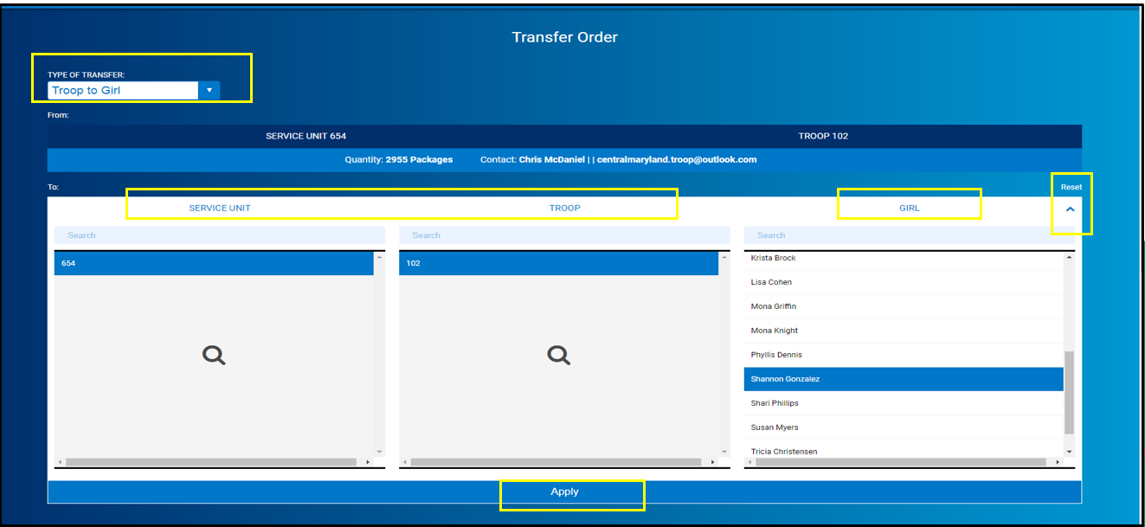
Select Troop to Girl Transfer from menu
Notes:
Type of Transfer: Select the Troop to Girl option from the drop down menu. The menu also shows these options: Girl to Girl, Girl to Troop, Troop to Troop
As a Troop User, the Service Unit and Troop number will already be pre-populated in the selection screen
Click on which girl in the Troop will receive the transfer or you can search by the Girl’s name in the Girl search field
Click the “Reset” arrow on the far right to reset your filters if necessary
Once filters are set, Click Apply.

Slide 36

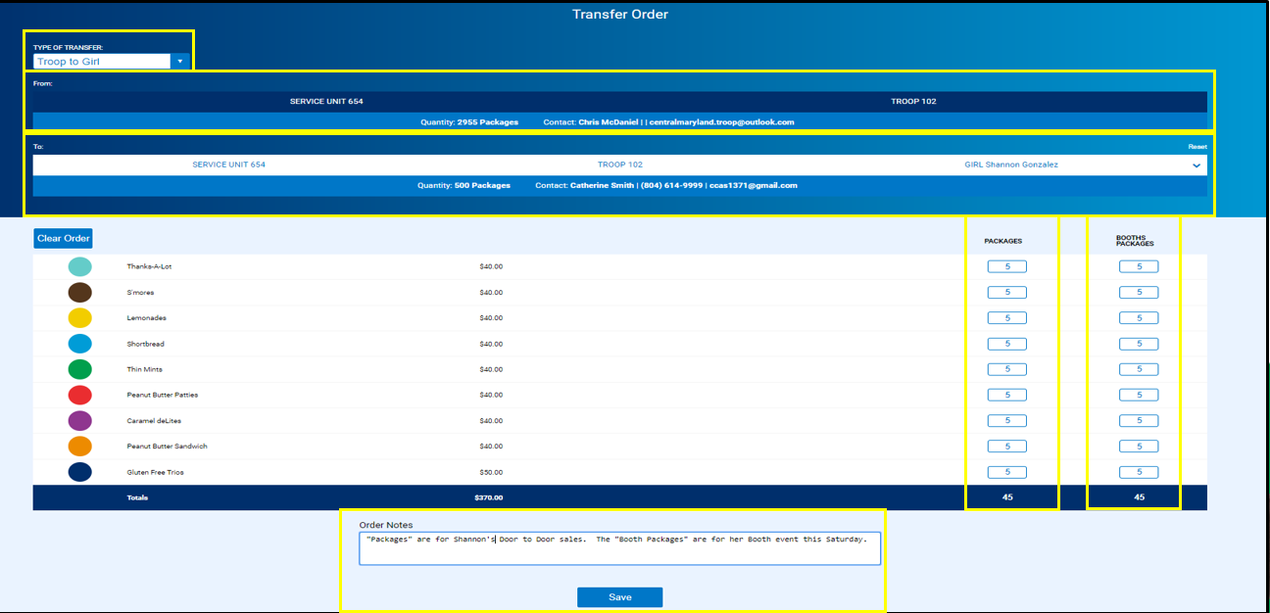
Note Booth Cookies Vs. Physical Packages
Notes:
Entering Transfer in Package Quantity
Two types of transfers can be entered on this page: “Packages” and “Booth Packages”
NOTE: we strongly recommend that you use the Smart Booth Divider to enter all Booth sales data and credit Girls accordingly. The Smart Booth Divider is an easy way to
distribute booth sale credit to multiple girls quickly and evenly. Use of the Smart Booth Divider also helps Council build a booth library that can provide important data
related to booth sale activity that can be used to help Troops prepare for future booth sales appropriately.
In the Package column, enter the number of packages being transferred to the girl by variety to fulfill her Girl delivery orders or for door to door sales.
The Girl will assume financial responsibility for these packages and the total transferred will be included in her total sales number for recognition calculation.
If you elect not to use the Smart Booth Divider to distribute booth sale credit to Girls, the “Booth Packages” column can be used to give credit to girls for packages sold at booth sales.
The girl will receive package credit towards her recognitions, but she does not assume financial responsibility for booth sales since the money is typically collected by the Troop at the time of the sale.
In the Booth Packages column, enter in the amount of booth packages to transfer to each Girl in package quantities for each variety needed.
Enter any “Order Notes” if needed
Click Save

Slide 37
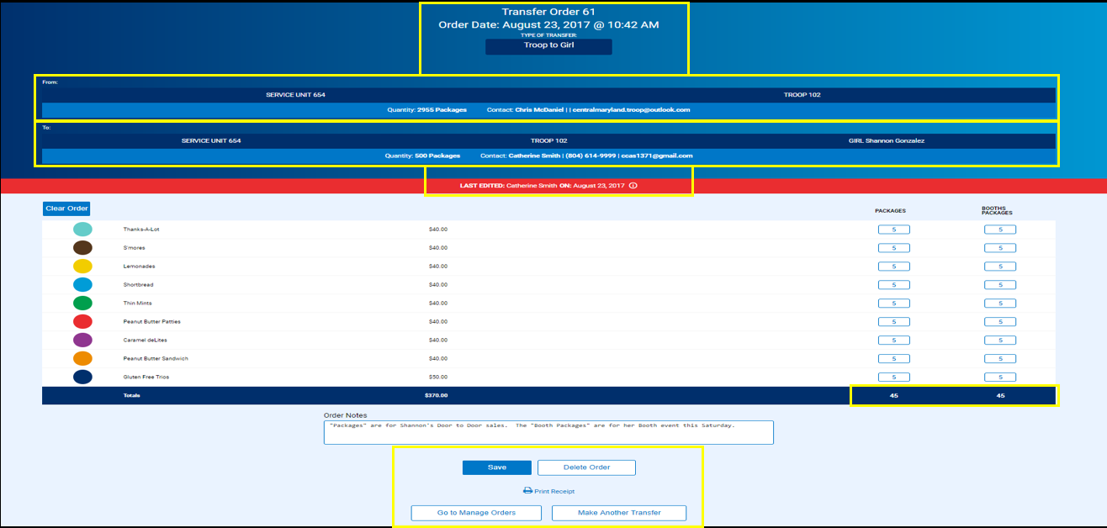
Successful transfer confirmation
Notes:
Once the transfer is saved, click Print Receipt at the bottom of the page to see a printable confirmation page containing the following information:
Date and Time of Transfer
Type of Transfer
Where the transfer came “From” and where its going “To”
The amount of each variety transferred in the variety section
Click Print to create a hardcopy of the transfer
You will see the option to “Delete Order”, “Go To Manage Orders” to view it or “Make Another Transfer” to Transfer more cookies.
Note that the numbers of packages of each variety that you have transferred to the Girl have been removed from the Troop inventory and credited to the Girl’s inventory
Financial responsibility of the non-booth packages transferred is now credited to the Girl (see the Girl Balance Summary report)
Troop to Girl transfers are indicated on the Manage Orders page with the order type of T2G

Slide 38
Creating
Planned Orders

Slide 39
Planned Orders:
Planned Orders definition: Troop opportunity to order more product from local Cupboards, by week, after the Initial Order period is over.
Planned Orders must be submitted in Smart Cookies no later than Sunday evening by 11:30pm for cupboard pickup the following week.
Planned Order due dates in Smart Cookies for pickup the following week are:
FIRST ORDER OPPORTUNITY Sunday 11/19
Sunday 11/26
Sunday 12/3
Sunday 12/10
Sunday 12/17
FINAL ORDER OPPORTUNITY Sunday 1/7

Slide 40
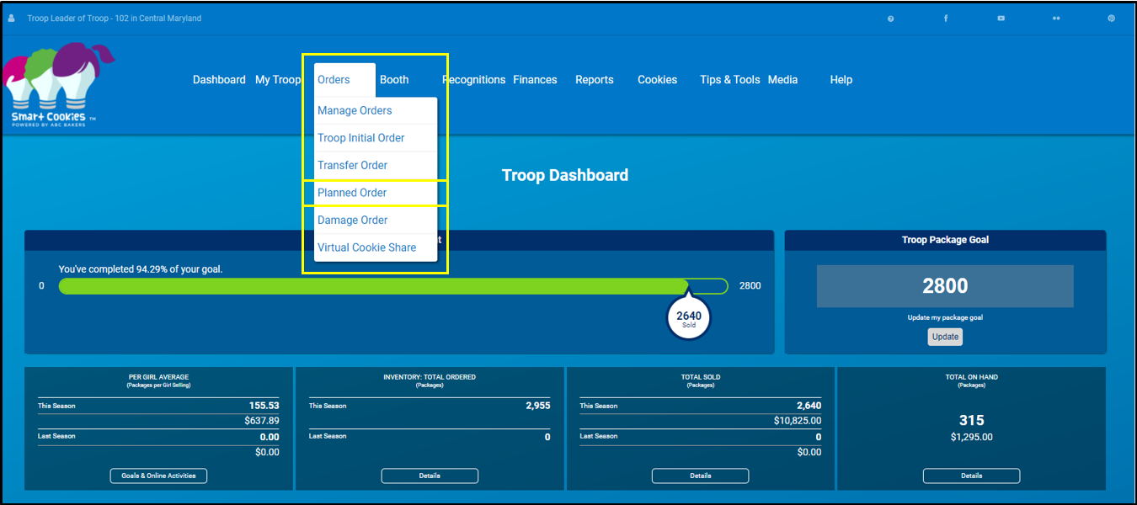
Navigate to Orders > Planned Orders
Notes:
The Five Essential Skills
The Cookie Sale supports learning in a fun environment. Girls learn by doing. The Girl Leadership Experience invites girls to make decisions around the Cookie Sale! Troops and girls set goals – both sales and learning goals. They practice business ethics by following the sale guidelines and selling dates. Money management takes the lead when girls make change or budget their cookie money to support troop activities. And we all know that girls practice and develop people skills as they interact with each other and their customers!
Let’s Review the 5 Skills
Goal Setting: At the start of the sale, girls will set a goal. And it’s not just about how many boxes of cookies she sells. Her goals should also be based on things she’ll learn, experiences she’ll have, and what she’ll be able to accomplish once she reaches her sales target.
Business Ethics: Throughout the sale, she’ll be making decisions, both with the group and as an individual. What will they do with the funds they generate? Where would be the best place for a booth sale? You’re here to help her sharpen her skills for making good choices.
Money Management: For many girls, this is the first time they’re responsible for handling money. Through the sale, they’ll learn all about accountability and the importance of accuracy and safety.
People Skills: The Cookie Sale is a great way to encourage positive interaction with people. You’ll be amazed at how much confidence can be built along the way.
Decision Making: Girls will learn that strong values should lead any business — including theirs. Good thing they have you as a role model.

Slide 41
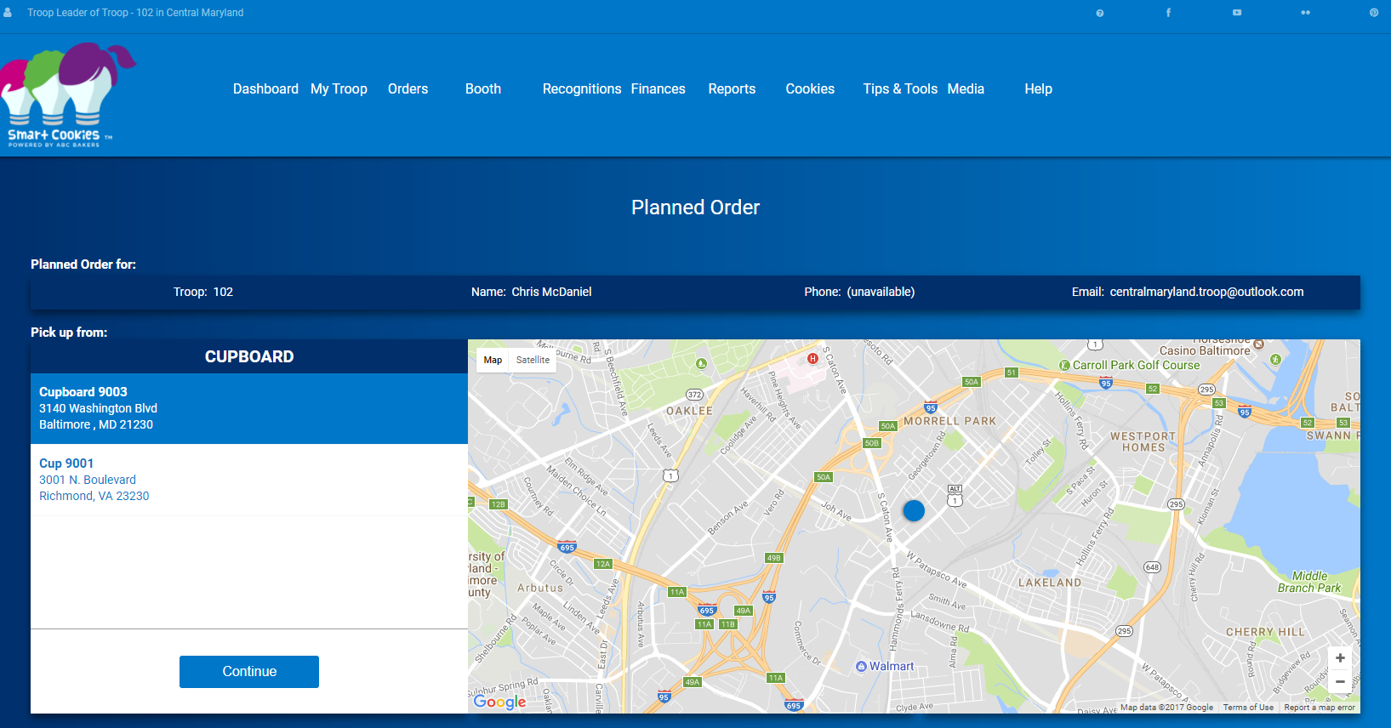
Step 1: Select a Cupboard Location
Notes:
The Five Essential Skills
The Cookie Sale supports learning in a fun environment. Girls learn by doing. The Girl Leadership Experience invites girls to make decisions around the Cookie Sale! Troops and girls set goals – both sales and learning goals. They practice business ethics by following the sale guidelines and selling dates. Money management takes the lead when girls make change or budget their cookie money to support troop activities. And we all know that girls practice and develop people skills as they interact with each other and their customers!
Let’s Review the 5 Skills
Goal Setting: At the start of the sale, girls will set a goal. And it’s not just about how many boxes of cookies she sells. Her goals should also be based on things she’ll learn, experiences she’ll have, and what she’ll be able to accomplish once she reaches her sales target.
Business Ethics: Throughout the sale, she’ll be making decisions, both with the group and as an individual. What will they do with the funds they generate? Where would be the best place for a booth sale? You’re here to help her sharpen her skills for making good choices.
Money Management: For many girls, this is the first time they’re responsible for handling money. Through the sale, they’ll learn all about accountability and the importance of accuracy and safety.
People Skills: The Cookie Sale is a great way to encourage positive interaction with people. You’ll be amazed at how much confidence can be built along the way.
Decision Making: Girls will learn that strong values should lead any business — including theirs. Good thing they have you as a role model.

Slide 42
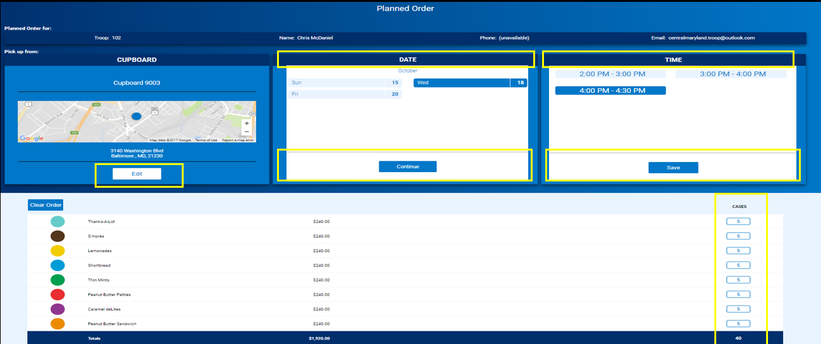
Step 2: Select Date and Time
Notes:
Once the Cupboard is chosen, the edit option is available if there are other locations to choose from and you want to pick a different Cupboard to pick up from.
To change locations click edit and select again.
When you select the Cupboard, you’ll see a list of dates indicating the days the Cupboard is available for pick ups.
Select a date and click continue.
You will see the time slots available on the date that you selected. Select a time that suits your schedule.
Click save.
You may edit your cupboard, date and time selections by clicking edit under the appropriate category
The varieties will be shown beneath the cupboard information.
Your council will determine the unit of measure that you can enter your planned orders in – cases, packages or case/packages. Enter the number of units in the designated unit of measure that you need to pick up.
There is a field for Order Notes available
Click Save

Slide 43
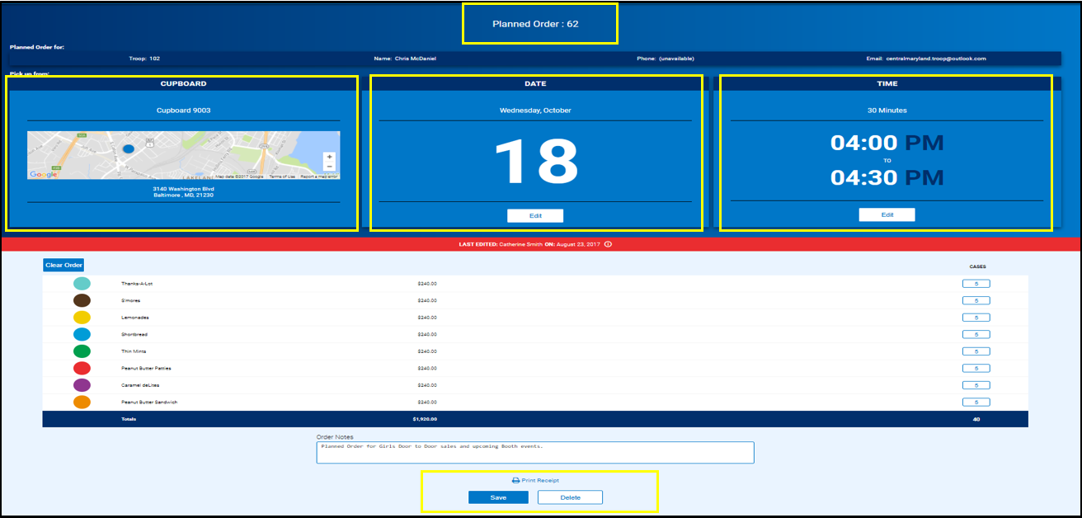
Step 3: Select quantity by variety; click Save
Notes:
Confirmation of the planned order appears when you click save and the planned order number will appear at the top of the page
The order can be printed by clicking on Print Receipt.
The top of the receipt will say ‘Planned Order Receipt’ Not APPROVED, indicating that the order has not yet been picked up from the cupboard and approved.
The receipt confirms the location, date and time you selected, along with your order details.
If you delete the order, you will see a confirmation to delete pop up. You can cancel, or continue with deletion.
Your Council will set the number of planned orders that can be entered per week by a Troop. When that limit has been reached you will see a message that says: “Cant Create Order. Maximum number of allowable planned orders is exceeded for the week.”
Go to the Manage Order screen to view, edit or delete the planned order
You can edit your order up until the Council designated deadline for placing planned orders for the upcoming week
Once you have picked up your planned order from the Cupboard, the Cupboard manager will approve your order and it will become a Cupboard to Troop transfer, and will show an ‘Approved Planned Order’ status on the receipt.

Slide 44
Cookie Share
Provides a customer donation option without purchasing physical packages
Girls who have 20 or more boxes donated virtually through “Cookies from the Heart”/CShare will receive a cookie share patch.
  Virtual donation = council program. Troops do not receive cookies but will receive proceeds in Smart Cookies
  Available through online sales
  Donation can be done at initial order and also during the sale through Smart Cookies by selecting the “Virtual Cookie Share ” tab under cookies or using the Virtual Cshare option on Smart Booth Divider.
Troops can pick-up their Cookie Share boxes from the Council office to deliver to chosen charities. Bring completed form with name and location address of the Troop’s charity/organization.
January 23rd and January 24th – 10am – 3pm
January 28th – 9am – 1pm

Slide 45
Booth Sales

Slide 46
2023-2024 Booth Sale Options
Type | Definition | What to Know:
Physical Booth Sale | Traditional, in person booth sales are back for the 2023-2024 cookie program! Please adhere to most recent Covid guidelines | Refer to Cookie Booth Etiquette agreement Troops transfer packages to Girls using Smart Booth Divider
Virtual Booth | Contactless ordering via link or QR code through DC24. Virtual Booths are no longer available through Smart Cookies, as all online sales functions have transitioned to DC24. Please refer to your DC24 Training on Central Maryland’s website for detailed information | More training will be coming for DC24 process. The ability to create a virtual booth in Smart Cookies is moving to DC24.
Troop Secured Booths | Troops request their own booth locations/dates/times and submit in Smart Cookies for approval. Troops may ONLY secure booths within the Service Unit Boundaries they are assigned. | Council will approve or deny the booth request. NOTE: All booths should go through the Service Unit Booth Coordinator or SUCM to avoid delays and have the booth show in the GSUSA Cookie Finder.

Slide 47
Booth functions in Smart Cookies
Securing a booth through First Come First Serve – YouTube Video
Using the Smart Booth Divider – YouTube Video
Creating a Troop Secured Booths for Council approval – YouTube Video

Slide 48
Reminders for Booths
Businesses can refuse booth sales. If a Troop is scheduled at a business and the manager says no, the Troop should be polite, leave the site, and contact their Booth Sale Coordinator.
No Booths on military bases, Ft. Meade & Aberdeen. These bases are located within a SU and they have very specific contracts and rules to follow.
Marc Train stations are contracted, and specific regulations apply. These bases are located within a SU and they have very specific contracts and rules to follow.
All booths should be listed and approved in Smart Cookies so they appear in the GSUSA National Cookie Finder

Slide 49

Thank you!

