Slide 1


2024 Cookie Program
Service Unit Cookie Training

Slide 2
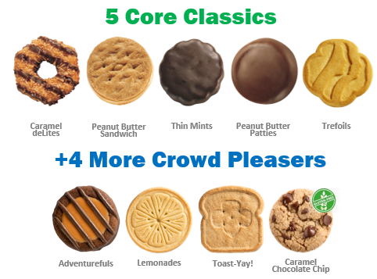
Your 2024 ABC cookie lineup

Slide 3
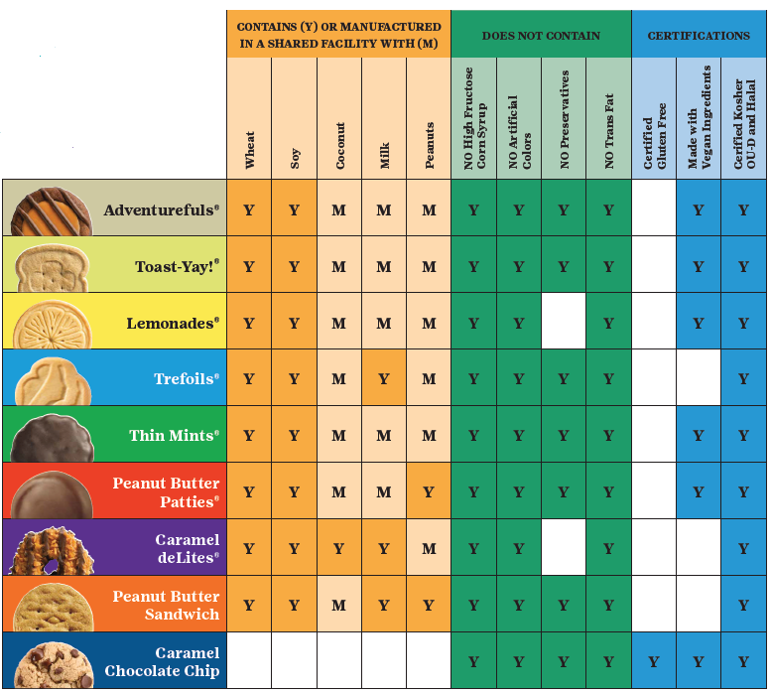
Nutritional and Allergen details
0g trans fat per serving
Have no preservatives
Contain no high fructose corn syrup
Kosher
Halal
Mass balance palm oil

Slide 4

Five varieties made with Vegan ingredients
GF Caramel
Chocolate Chip
Peanut Butter
Patties
Thin Mints
Lemonades
Toast-Yay!

Slide 5
GSCM 2024 Cookie Program Basics
Cookie program dates October 1st through January 14th, 2024
  October 1st – paper order card orders ONLY, enter in Smart Cookies. No mobile app due to DC24 system migration.
All girls must be registered for 2023-2024 season
TCM’s must be registered, and background checked for the season
Troops access Smart Cookies after completing T-3 and T-1 forms in the VTK, available online at www.gscm.org
November 13th - start date for ALL DC24 online orders, including marketing emails to customers, Shipped Only orders and social link/QR code
We want girls to be safe, have fun and reach their goals. GSCM asks adults to use their best judgement and common sense to support participating girls!

Slide 6
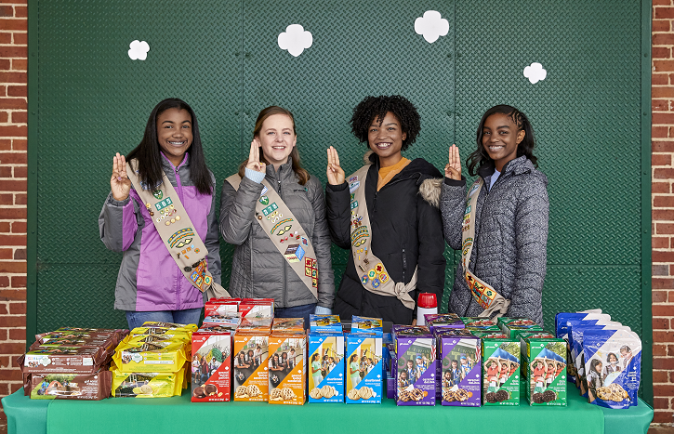
GSCM’s 2024 program pricing
NO CHANGE:
$5 per package
$6 per package Gluten Free
Cookie Box Selling Price - All regular 8 varieties of cookies sell for $5.00 per box. Gluten Free Caramel Chocolate Chip sells for $6.00. Troops are not permitted to set prices higher or lower for any reason.
The Council will distribute cookies to troops in full cases ONLY. There are 12 boxes to a case. Girl Scout Cookies are not returnable. Troops can transfer cookies by the box to other troops to help provide variety and reduce over stock.
Financial Responsibility - The Troop Cookie Manager (TCM) is responsible for all cookies received by the Troop. All delinquent parent accounts must be reported to GSCM; the appropriate paperwork (T-6) must be signed and submitted. Interest and fees apply to all accounts turned over to collections. No Troop or individual may pursue legal matters on behalf of GSCM.

Slide 7
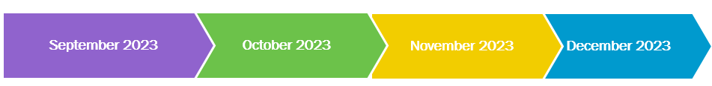
GSCM’s Important Program Dates
September 1: Troops complete T-3 & T-1 forms online at www.gscm.org
SUCM Cookie Training:
IN PERSON
September 12 & 14
6:30-9:30pm
September 16,
9am – 11am
Troop Training: ZOOM
September 23 & 30
9-11am
September 27 & 28
6:30-8:30pm
October 1: Girls Begin Sales, PAPER ORDER CARDS ONLY
October 29: Troop Initial Orders and Reward selections due in Smart Cookies by 11:59pm
November 13th: Online Sales begin through the DC24 platform
November 15 – 20:
Service Unit Depot Days
November 17: Booth Sales Begin
November 19 & 26: Planned Orders for upcoming week are due in Smart Cookies by 11:30pm
December 1st
ACH #1 @50% Troop Initial Order due as of this day
December 3, 10, 17:
Planned Orders for upcoming week are due in Smart Cookies by 11:30pm
December 21st:
ACH #2 @ 50% of balance due as of December 18th

Slide 8
GSCM’s Program Dates Continued
January 2024
January 7:
FINAL Planned Order entry for upcoming week by 11:30pm
January 14: COOKIE SALE ENDS.
Troop FINAL main recognition order must be entered in Smart Cookies by 11:59pm or Troop forfeits all items, including patches. Opt out Troops must create a reward order to receive patches only. NO EXCEPTIONS
January 16: SUCM’s must review and submit the main recognition order to Council no later than 9am EST
January 22: ACH #3 All remaining balances due
Troop Cookie Share Pickup Schedule
January 23, Council office 10am – 3pm
January 24, Council office from 10am to 3pm
January 27, Council office from 9am to 1pm

Slide 9
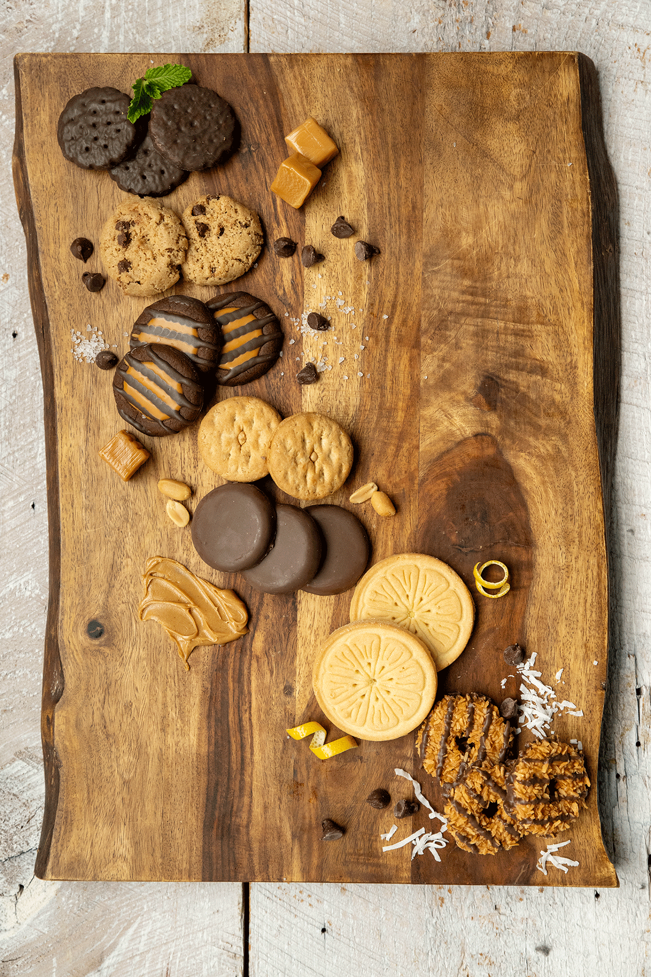
Rewards and Proceeds

Slide 10
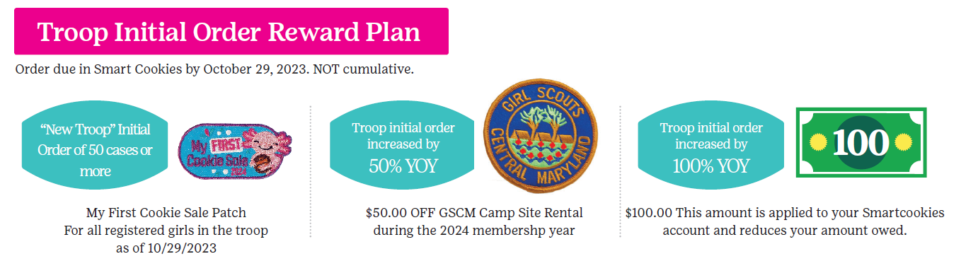
2024 Rewards: Initial Reward
Troop Initial Order Reward Plan
(non-cumulative)
New Troops - Order 50 cases or more and receive a “My First Cookie Sale” Patch for each girl in the troop as of 10/29/2023.
Troop increases initial order year over year by 50% - Receives $50.00 off a GSCM campsite rental.
Troop increases initial order year over year by 100% - Receives $100.00 applied to their Smart Cookies account.

Slide 11
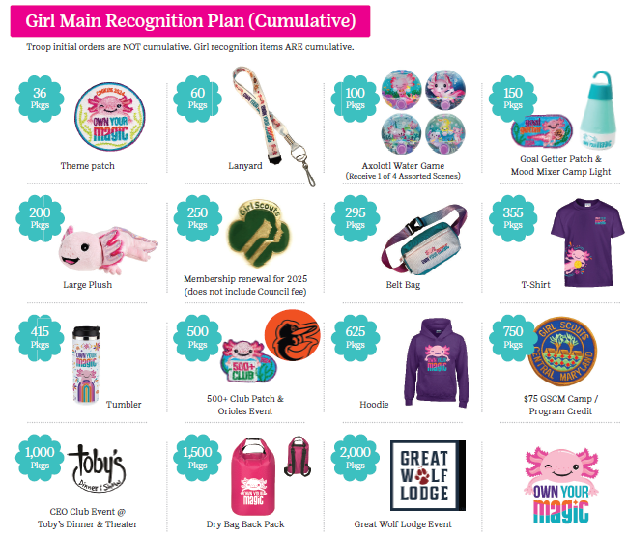
Cumulative Main Rewards
All Troops must create a Main reward order
Opt Out Troops must SUBMIT a main reward order by January 14th to receive patches only
500+ and 1,000+ club are based on individual girl sale totals, not troop proceeds. Girls in Opt out troops are eligible for these two club celebrations
Rewards are shipped in February 2024

Slide 12
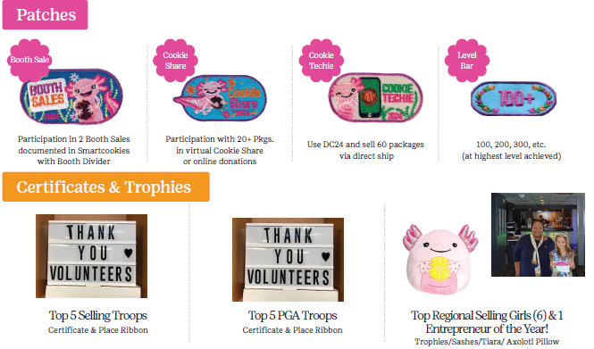
Patches, Certificates and Trophies
Booth Sale – Participate in 2 booth sales documented in Smart Cookies.
Cookie Share – Collect 20+ Pkgs in virtual cookie share.
Cookie Techie – Use DC24 and sell 60+ Pkgs via shipped only.
Level Bar – Attained at highest level sold. Increments of 100.

Slide 13
2024 Proceeds Structure
Troop proceeds = $0.70 for all 9 varieties
With the optional/earned $0.08 for Spring Renewal (Early Bird) and $0.05 for opt out, Junior and above
TCMs must regularly transfer packages to Girls in Smart Cookies for Girls to see their earn rewards
Parents will be able to track sales and money owed through the DC24 platform

Slide 14


2024 Theme and Mascot
Every Girl Scout has their own magic skills they can unlock during cookie season! Girls can have fun while building upon what they already know and have yet to learn. Just like Lottie the axolotl, every girl has the magic skill of regeneration and growth!

Slide 15











Sample clip art
Notes:
ANNE
We work very closely with GSUSA on marketing and product development.
On November 2 they announced the unified theme and mascot for the 2024 season.
In case you missed it we thought you might like a sneak peek!
Here is our version. Girls voted for the axolotl and ABC provided the tagline and artwork.
And the axolotl provides a great opportunity for girls and adults to learn about this unique and critically endangered animal.
And the Own Your Magic theme is about celebrating the unique things that make each of us special.
Every girl has their own special magic, and they are all unique in some way – just like the axolotl.
Axolotls has the special skill of regenerating themselves. Girls do that too as they learn and grow in Girl Scouting!
Cookie time is a great opportunity to make magic and skill build.
It is going to be a lot of fun in the 2024 season.
And we’re already working on 2025!

Slide 16


Sample patterns and borders

Slide 17
2024 Online Resources
Resource | Location
Cookie theme information | https://www.flickr.com/photos/abcbakersvolunteergallery/albums
Selling safely video and tips and volunteer training tutorials | https://www.youtube.com/user/ABCCouncils
Cookie variety details | www.abcSmart Cookies.com
Social media tips & tricks to boost engagement | www.abcSmart Cookies.com
Rally Guide | www.abcSmart Cookies.com
Cookie Calculator | www.abcSmart Cookies.com
ABC Bakers Facebook Page | https://www.facebook.com/abcbakers/
Lemonades Facebook Page | https://www.facebook.com/LemonadesCookie/

Slide 18

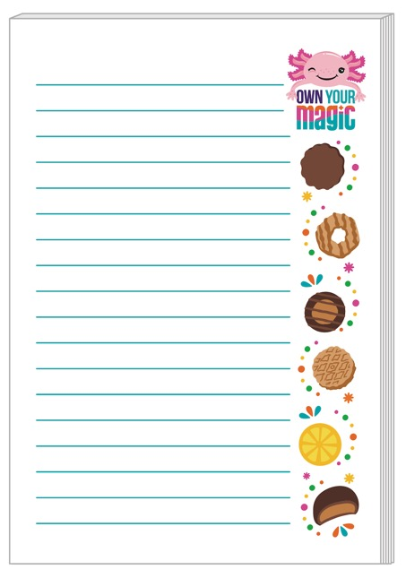
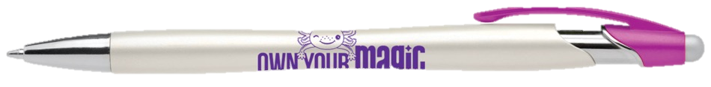
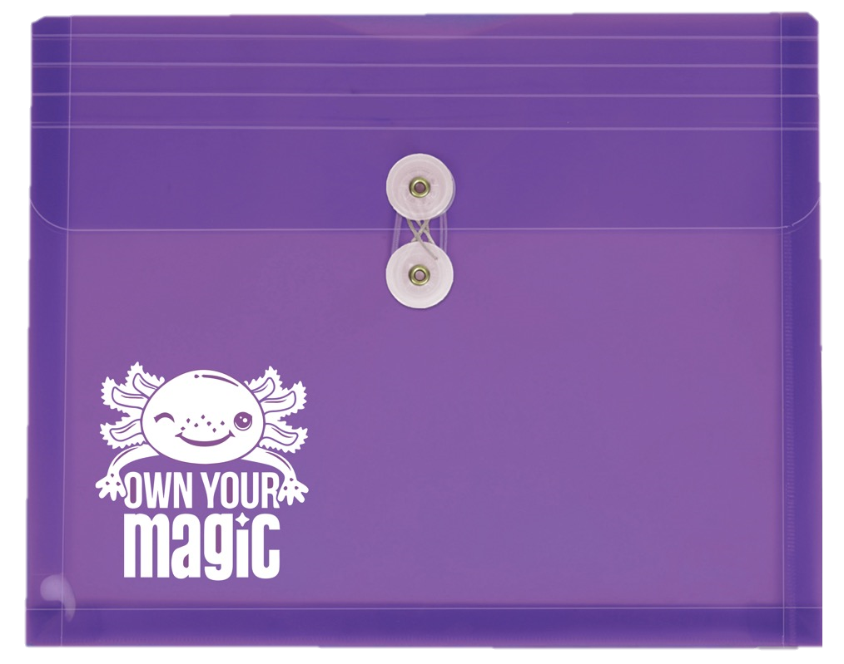
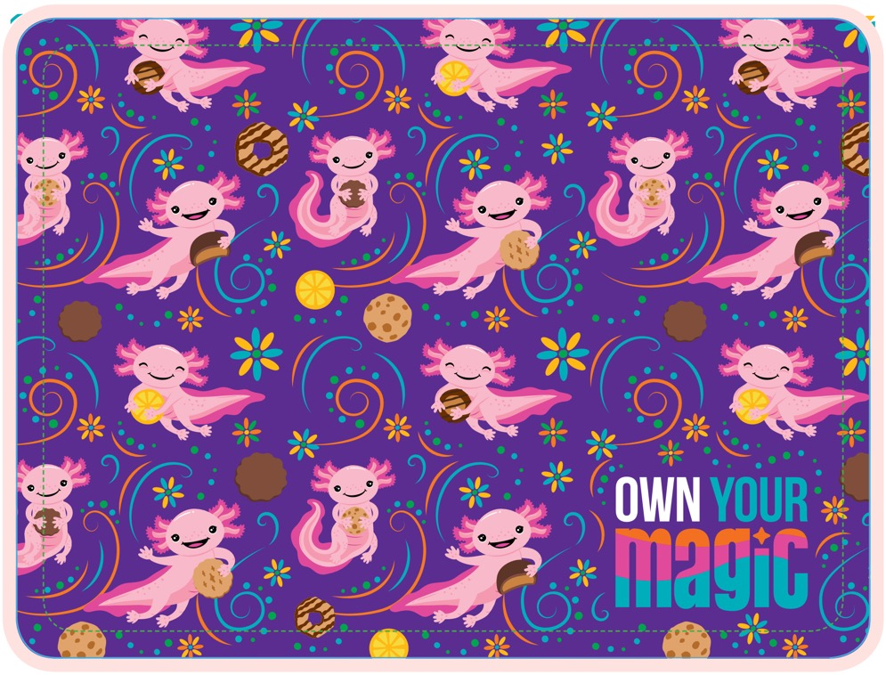
Thank you for Service Unit cookie volunteers
2024 Volunteer gift includes:
Tie Envelope Holder
Sticky notepad - 4x6” size
Pen with stylus
6x8 Sized fabric mousepad - can fit in a laptop when closed!

Slide 19
GSCM Council Goals
Council Package Goal:
1,074,971 packages sold
Council PGA Goal: 153

Slide 20
Initial Orders

Slide 21
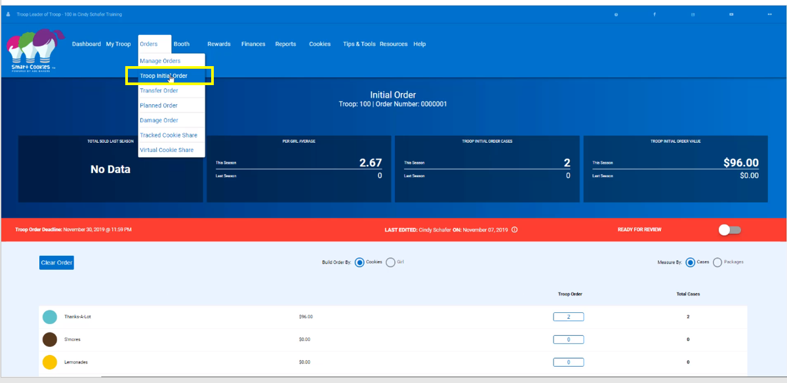
Initial Order Entry: by Girl, by Variety

Slide 22
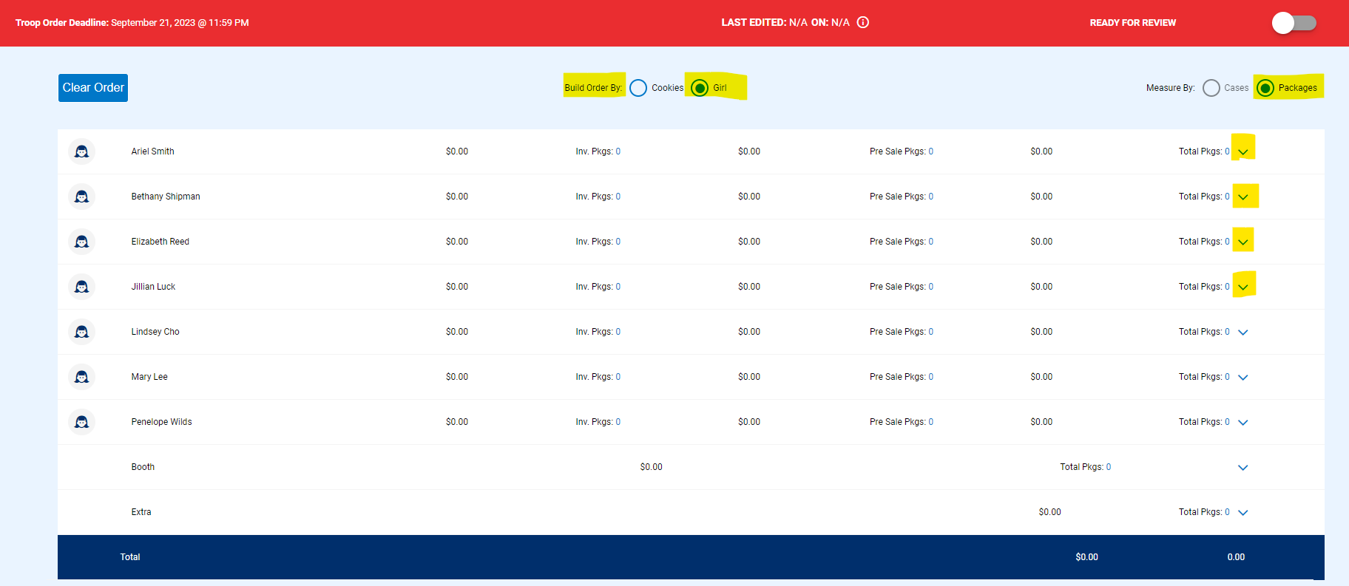
Initial Order guidelines
Service Units have until October 31st at 9:00am to review and submit the Troop initial order
Troop initial orders are due in Smart Cookies October 29th by 11:30pm
Troops create Initial Orders by GIRL, by variety and in packages. Select the downward arrow to the far right of each girl name to enter packages by variety

Slide 23
Depot Days

Slide 24
Depot Day Reminders
Each TCM will sign up for the time they will pick up their troop’s initial order when they submit the initial order in Smart Cookies.
Safety First – No tagalongs! Please be patient and flexible.
Sort and count your cookies before loading car or signing documents.
Your SUCM will have each TCM sign dot sheets or M-9 form.
Dot sheets or M-9 form must be sent into Terry Mercer as soon as possible after depot.

Slide 25
Depot Day 2024 Product Details
Item | The Pattern | # Layers | # Cases / Full Pallet | Pallet HT | Pallet WT (LBS)
Toast-Yay! | 18 | 10 | 180 | 94” | 1467.5
Lemonades | 18 | 10 | 180 | 94” | 1467.5
Trefoils | 17 | 11 | 187 | 93” | 1592.7
Thin Mints | 19 | 10 | 190 | 96” | 1617.5
PB Patties | 18 | 10 | 180 | 87.25” | 1163
Caramel Delites | 18 | 10 | 180 | 87.25” | 1163
PB Sandwich | 17 | 11 | 187 | 93” | 1452.5
Gluten Free Caramel Chocolate Chip | 12 | 12 | 144 | 52” | 751.2

Slide 26
Cookie Cupboards

Slide 27
Cookie Cupboards
Cookie Cupboards: A storage location, managed by a GS volunteer, where Troops pickup weekly Planned Orders after the Initial Order period
New Troops who miss Initial Order deadline will pickup their first order and Planned Orders from a Cupboard
Planned order entry in Smart Cookies is 11:30pm Sundays for following week pickup
Cupboard locations and availability are available in smart cookies
Cupboards will open the week of November 20th. Multiple locations are available throughout GSCM
Verify your cupboard location and arrive on time. No Walk ins!
No returns! Damages can be EXCHANGED at cupboards, package for package and variety for variety
Cupboard managers will approve Troop Planned Orders in Smart Cookies. A reminder that once your planned order is approved, it becomes a transfer in the system

Slide 28
Transfers in Smart Cookies
ALL cookie transfers should be complete in Smart Cookies
Troop is financially responsible until entered into Smart Cookies
Single package transfers are allowed
Troop to Troop Transfers:
  Troops can transfer packages or cases of cookies out of inventory to another troop. (Check Smart Cookies before giving any cookies to another troop.)
  *T4 form is filled out
  * Entered into Smart Cookies in a timely manner by the giving troop
Troop to Girl Transfers:
  Cookies sold by Girls should be transferred frequently throughout the sale. Girls do not earn incentives until packages are transferred in Smart Cookies
  Troops create Troop to Girl transfer
  Cookie booth sales should be transferred to girls via Smart Cookies Booth Divider

Slide 29
Booth Sales

Slide 30
Service Unit Booth Coordinator (Booth Sale Coordinator) Job Description
Establish booth locations for use during the cookie program within SU boundaries
Booths outside of SU must be negotiated with the other SU before securing the site.
GS of Central Maryland region includes Baltimore City and the 5 surrounding counties: Carroll, Anne Arundel, Baltimore, Hartford and Howard
Facilitate a Lottery for TCMs in your Service Unit before Initial Orders are due (10/29 for Troops, 10/31 for SU).
  Distribute booth sale slots equitably to each Troop within your Service Unit
  If slots remain, upload to Smart Cookies for Troops to select during FCFS
Approve ALL Troop Secured booth requests. REMEMBER: out of SU physical booths must be approved by the SU in which the booth location resides before a Troop can secure
Maintain good working relationships with your booth businesses by enforcing Girl etiquette and removing Troops and Girls who exhibit inappropriate behavior at booth sale locations
SU Booth Coordinators needing assistance with any booth matters or booth uploads should contact the “Council’s Volunteer Booth Advisor” Christina Christiansen at 301-418-5442 or email mygirls2528@gmail.com.

Slide 31
2023-2024 Booth Sale Options
Type | Definition | What to Know:
Physical Booth Sale | Traditional, in person booth sales are back for the 2023-2024 cookie program! Please adhere to most recent Covid guidelines | Refer to Cookie Booth Etiquette agreement Troops transfer packages to Girls using Smart Booth Divider
Virtual Booth | Contactless ordering via link or QR code through DC24. Virtual Booths are no longer available through Smart Cookies, as all online sales functions have transitioned to DC24. Please refer to your DC24 Training on Central Maryland’s website for detailed information | More training will be coming for DC24 process. The ability to create a virtual booth in Smart Cookies is moving to DC24.
Troop Secured Booths | Troops request their own booth locations/dates/times and submit in Smart Cookies for approval | Council will approve the booth request within 48 hours

Slide 32
How to Secure Booth Sale Locations
Consider Troop and Girl availability on weekdays, weekends and evenings. Minimum 2 hour time slot; typical maximum is 4 to 5 hours
Contact the merchant in person or by phone. Speak with manager or person with authority to make booth sale decisions. Introduce yourself as representing the Girl Scouts of Central Maryland in your local area and would like to discuss table setup to sell cookies. Then:
- Put together a request letter for site including dates and times. (See samples on the www.gscm.org)
- Visit locations/send email with letter for manager/contact signature. Retain one for your records, leave copy with contact/manager.
Be sure to request blocks of time for the ENTIRE cookie season!
If requested, a Certificate of Insurance requires three weeks notice. DO NOT WAIT. Download the request form from GSCM and submit through GSCM member care

Slide 33
How to Add Booth Locations in Smart Cookies
You can enter your locations and timeslots via a spreadsheet upload or manually
Spreadsheet Booth Upload Process Video – YouTube Video
Securing a booth First Come First Serve – YouTube Video
Smart Booth Divider – YouTube Video
Troop Secured Booths – YouTube Video

Slide 34
Managing Booth Locations in Smart Cookies
Once all locations and timeslots and Troop assignments are loaded, the Booth Sale Coordinator must review and verify all assignments before the locations open to all Troops
If there is a location that is selected or shared by two Service Units, only 1 SU should own the location but share available timeslots with the other Service Units
Include detailed information in the booth location note section; remind Troops to follow all special instructions
Booth Sale Coordinator’s role includes loading Troop booth locations. If a TCM has a booth location suggestion, please help them load it into Smart Cookies

Slide 35
Reminders for Booths
Businesses can refuse booth sales. If a Troop is scheduled at a business and the manager says no, the Troop should be polite, leave the site, and contact their Booth Sale Coordinator
No Booths on military bases, Ft. Meade & Aberdeen. These bases are located within a SU and they have very specific contracts and rules to follow.
Marc Train stations are contracted, and specific regulations apply. Sign up through Smart Cookies for any available slots at Marc and follow all guidelines.
All booths should be listed and approved in Smart Cookies so they appear in the GSUSA National Cookie Finder

Slide 36
DC24

Slide 37
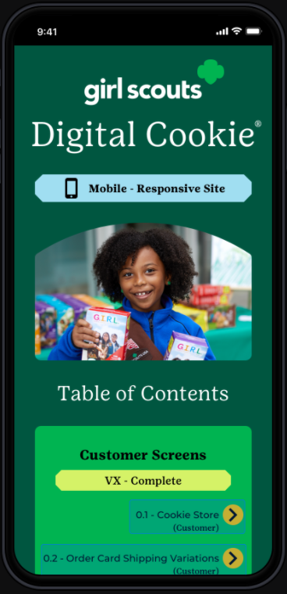
All online selling moves to DC24
All online sales are moving to DC24:
November 3rd: Volunteer access
November 6th: Caregiver access
November 13th: Open for Girl sales
Girl online sales features, plus all credit card payments
Girl online sales reporting features, by sales channel
Virtual booth process
Girl/Troop credit card transactions, sales and refund ability
Girl delivery credit card financial settlement
Girl, Troop and Direct Ship support
Direct ship financial settlement

Slide 38
DC24 Training Tools and Key Dates
Parent/caregivers will receive registration emails from DC24 when they are given access on November 6th.
Sales open for girls on November 13th
There will be a mobile app for sales, compatible with both Android and Apple devices
Please continue checking back at www.gscm.org, under the Cookies section, for a full listing of DC24 tip sheets. Council will continue to add tip sheets and videos as GSUSA releases them

Slide 39
DC24 migration benefits:
Customizable girl and troop sites that let customers see photos, videos, and her story/sales pitch directly on the girl or troop’s order page
  Cookie Business badges and Family Entrepreneur Pin requirements that are integrated into the system, reinforcing the importance of badge work and the girl experience within our cookie program
  The ability for caregivers to turn delivery on/off and cookie varieties on/off to match their family participation goals and available inventory
  Customizable shipping promotions
  A streamlined Mobile App for ease in collecting sales

Slide 40

Thank you!

