Slide 1
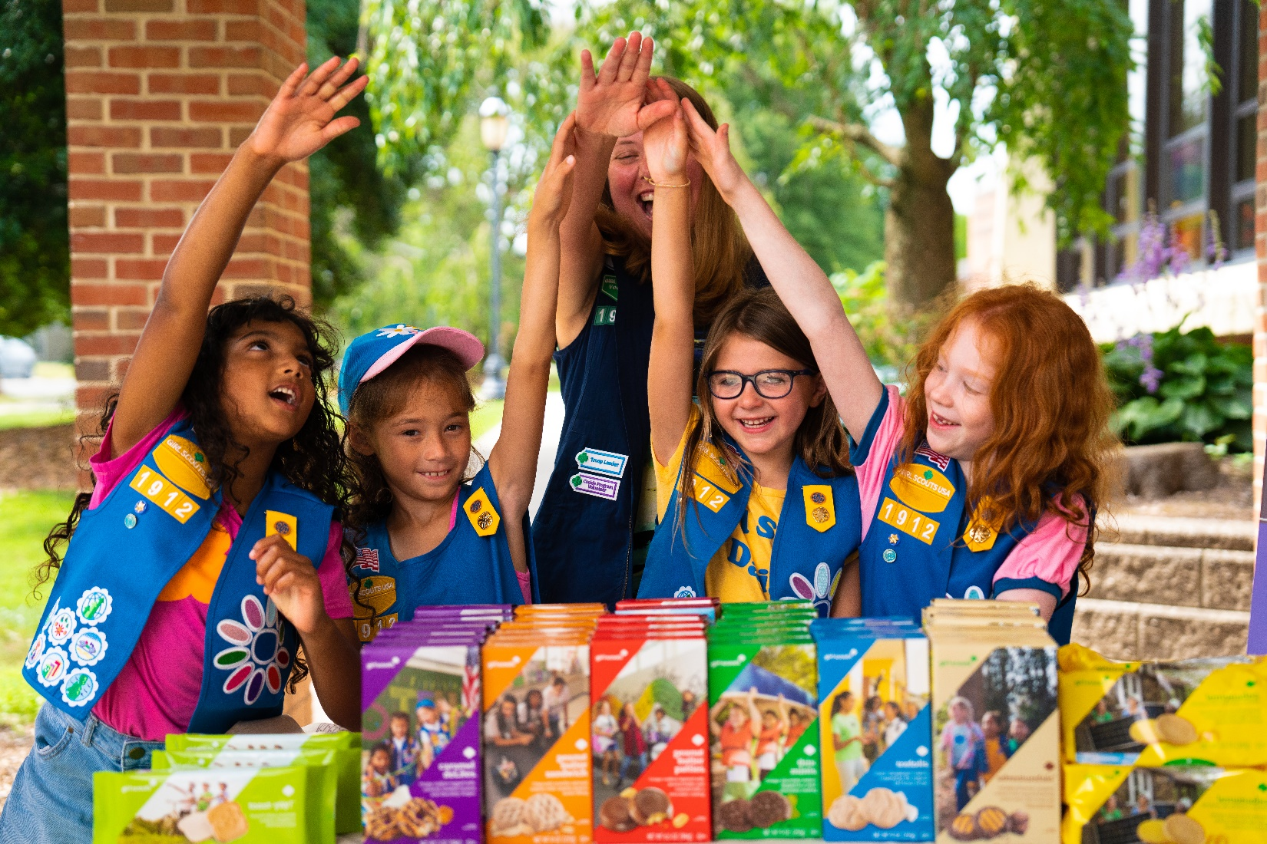
2024 Cookie
Guide
Notes:
Welcome to the 2024 Cookie Season at Girl Scouts of Central Maryland.

Slide 2
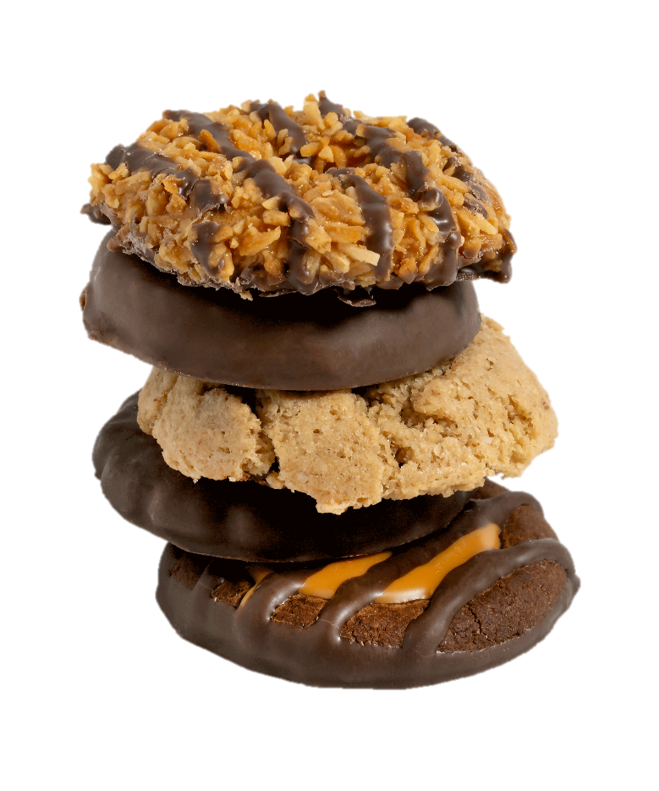
Table of Contents
Topic | Page
Skills | 3
Badges | 4
Calendar | 6
Cookie Share | 7
Safety | 8
Favorites | 10
Ways to Participate | 12
TCM Checklist | 13
Rewards & Proceeds | 16
Smartcookies | 20
Digital Cookie (DC24 Cloud) | 21
Promising Practices | 22
Terms & Definitions | 23-26
This Girl Scout Cookie™ season, we are inspiring Girl Scouts® to own the magic that makes them unique and unstoppable!
Notes:
Here is your table of contents. Our theme this season is “Own Your Magic”. We are inspiring girls to be unique and unstoppable.

Slide 3
Include the 5 Skills
Through the Girl Scout Cookie Program®, Girl Scouts gain these 5 skills and learn to think like entrepreneurs!
 | Goal Setting | Girl Scouts learn how to set goals and create a plan to reach them.
 | Decision Making | Girl Scouts learn to make decisions on their own and as a team.
 | Money Management | Girl Scouts learn to create a budget and handle money.
 | People Skills | Girl Scouts find their voice and build confidence through customer interactions.
 | Business Ethics | Girl Scouts learn to act ethically—both in business and life.
Notes:
Be sure to include the 5 skills girls learn when discussing the benefits of participation.

Slide 4
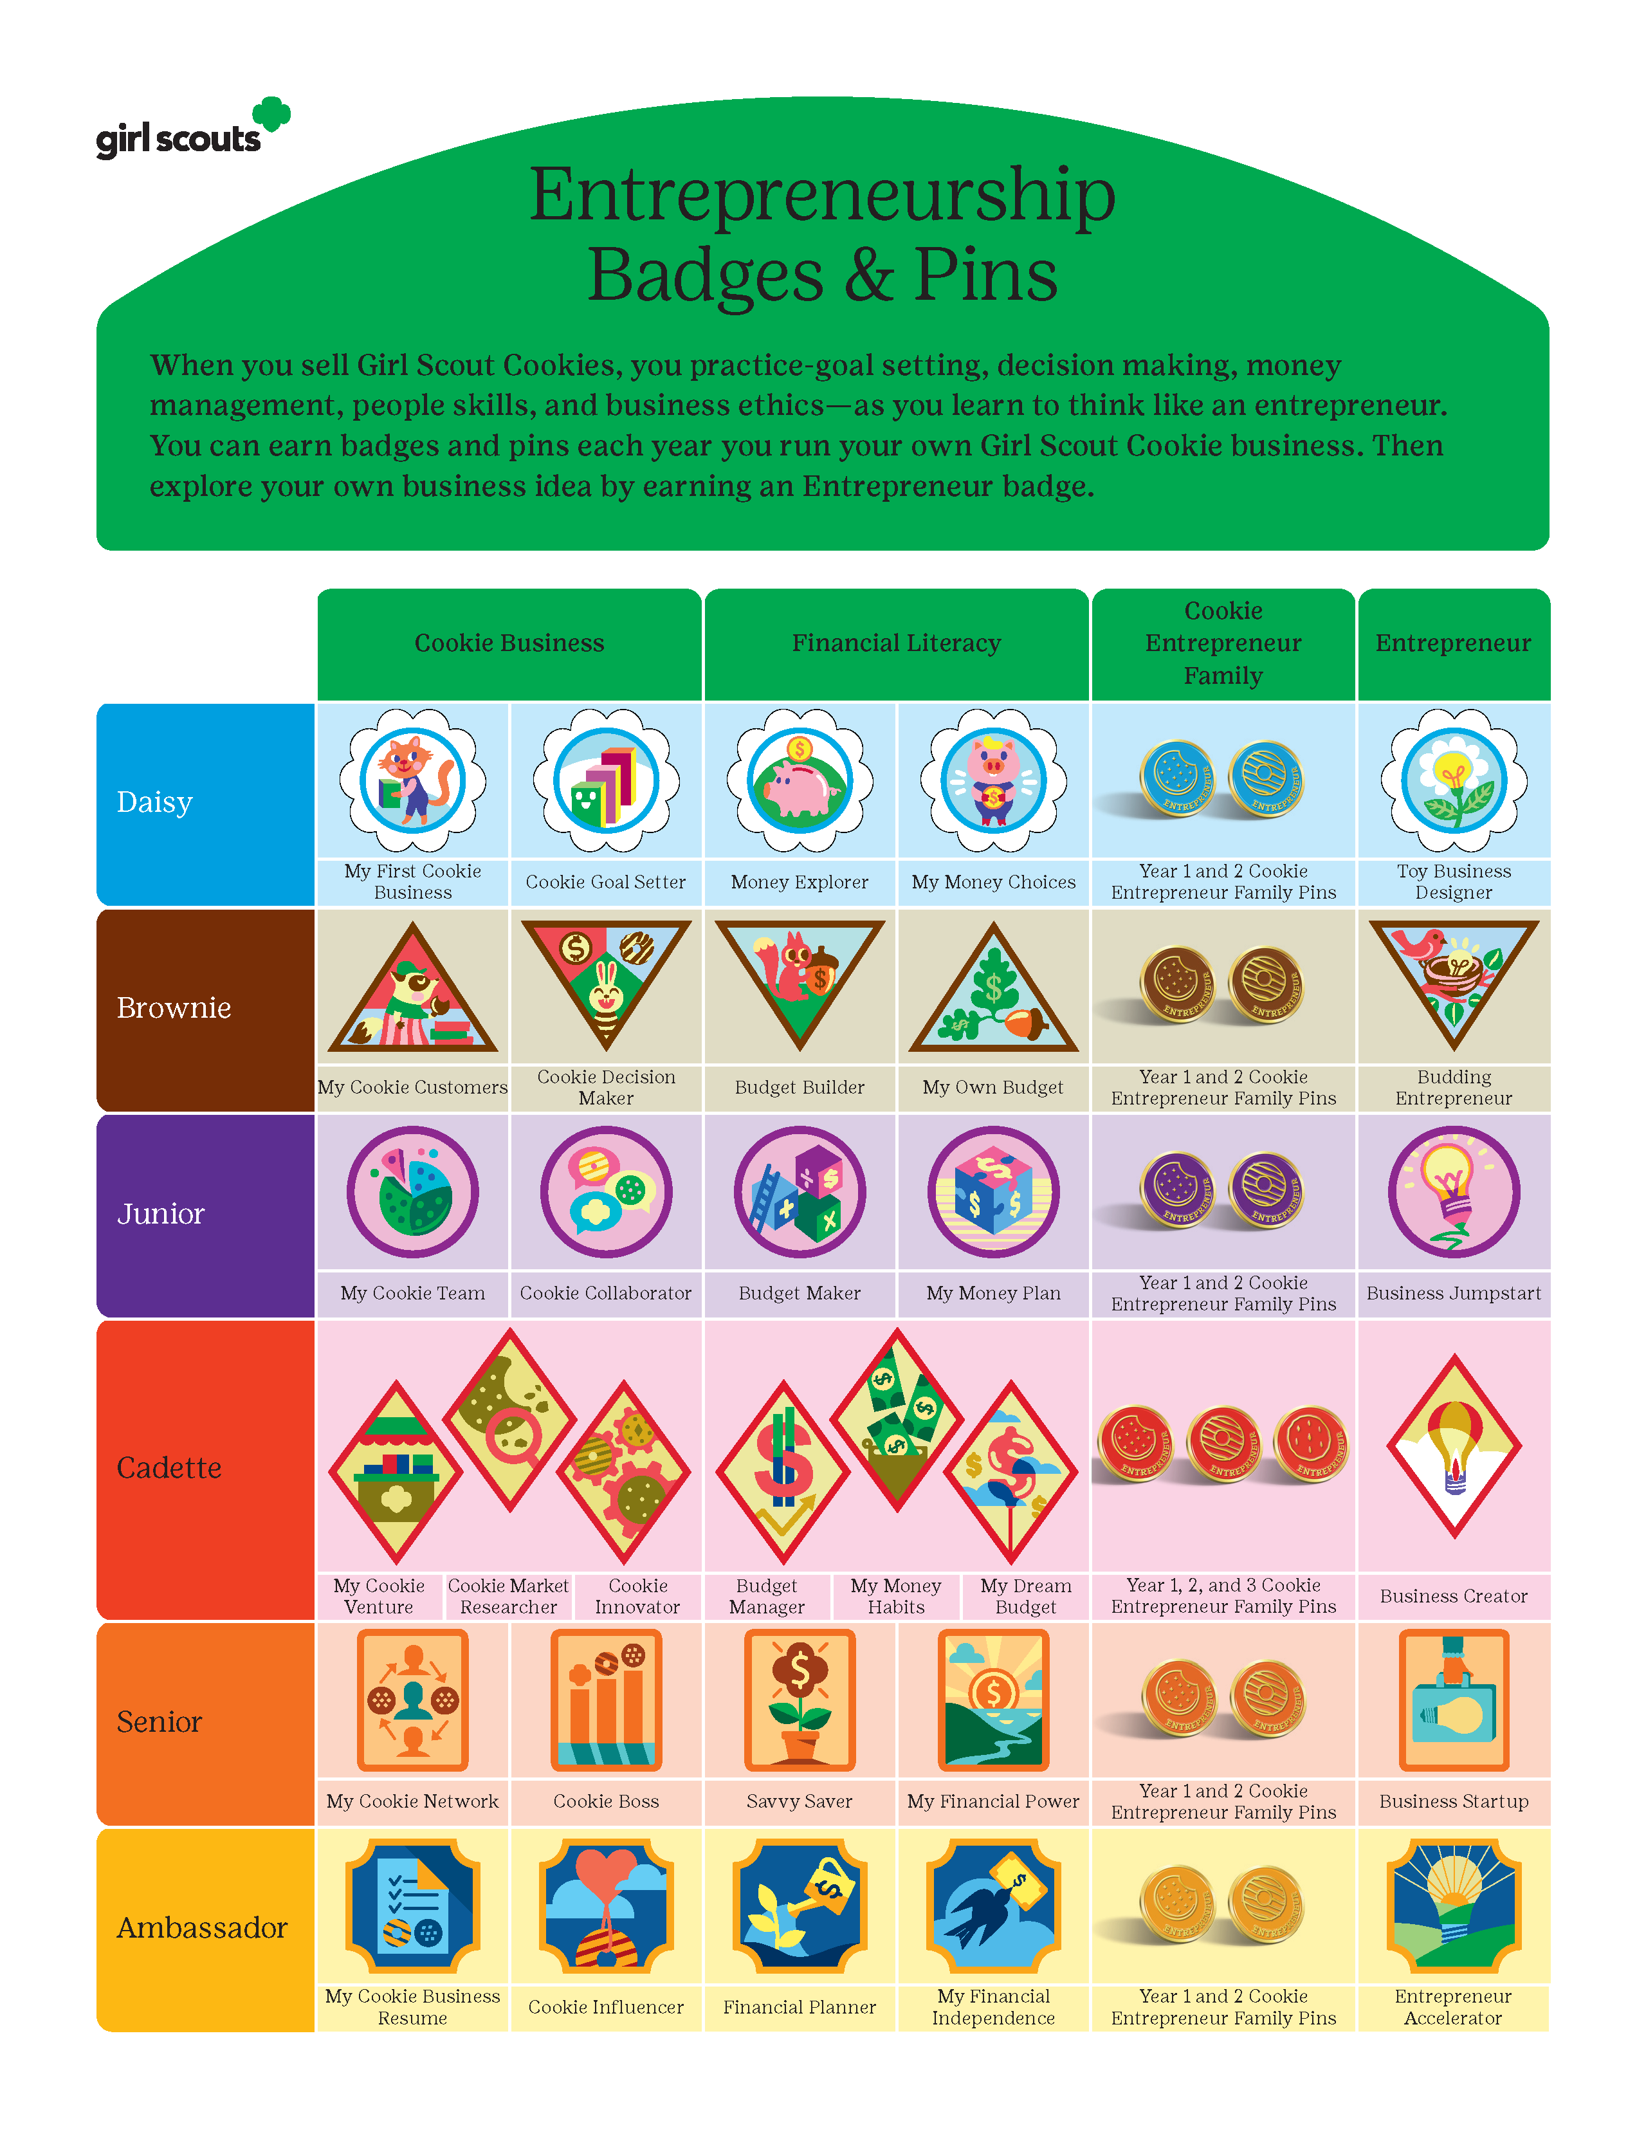
Notes:
UPDATED FOR 2023 Badges and Pins. How many can you and your troop earn?

Slide 5
Resources
ABC Bakers Facebook | Excite and energize volunteers and troops about cookie sales with sales strategies, success stories, technology tips and more | www.facebook.com/abcbakers
Lemonades Facebook | Product sales and marketing tool | www.facebook.com/LemonadesCookie
Lemonades Instagram | Product sales and marketing tool | @Lemonadescookie
Cookie Calculator | Calculate package sales goals based on number of packages sold last year and the desired percentage increase this year | www.abcsmartcookies.com/resources
Cookie theme information | Gallery of images, clip art, certificates | www.flickr.com/photos/abcbakersvolunteergallery/albums
Cookie varieties | Product descriptions and recipes | www.abcbakers.com www.abcsmartcookies.com
Rally Guide | Fun ideas for troop rallies | www.abcsmartcookies.com/resources
Standard forms | Parent permission slip, count it up activity | www.abcsmartcookies.com/resources
Troop goal poster | Poster | www.flickr.com/photos/abcbakersvolunteergallery/albums www.abcsmartcookies.com/resources
Volunteer and girl videos | How-to videos on a variety of topics | www.youtube.com/user /ABCCouncils
Notes:
ABC Baker has provided numerous resources for the volunteers and girls. Many times, volunteers and caregivers feel overwhelmed and should look to the resources to help narrow down the information to just what you want and need.

Slide 6
Cookie Calendar Highlights
Activity | Date
Cookie Sale BEGINS | 10/01/2023
Troop Initial Orders are due in Smartcookies/opt out | 10/29/2023
DC24 Cloud Launch for parents/caregivers | 11/06/2023
DC24 Cloud OPENS for Digital Sales | 11/13/2023
Service Unit DEPOT DAYS | 11/15-20/2023
Booth Sales Begin | 11/17/2023
1st ACH for 50% of troops initial order | 12/01/2023
2nd ACH for 50% of balance owed as of 12/18/2023 | 12/21/2023
Cookie sale ENDS / Troops enter girl rewards order | 01/14/2024
3rd ACH for remaining balances due to GSCM | 01/22/2023
Troop Virtual Cookie Share pick-ups | Jan. 23. 10am - 3pm Jan 24. 10am -3pm Jan 27. 9am – 1pm
See full Calendar on GSCM’s website. https://www.gscm.org/en/cookies/forms-and-documents.html

Slide 7
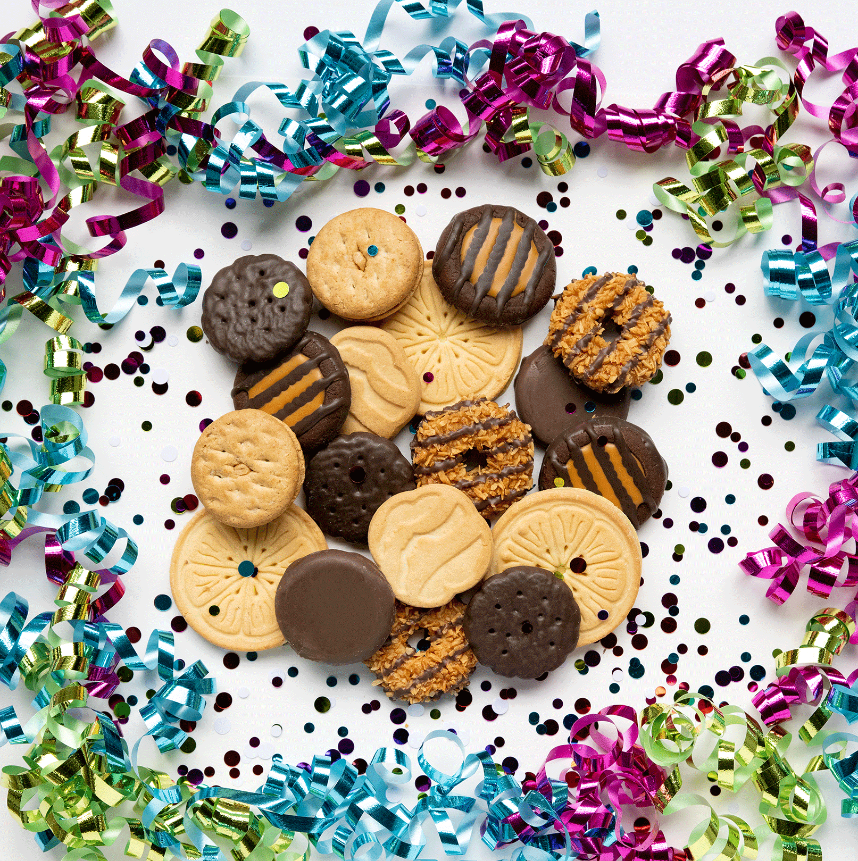
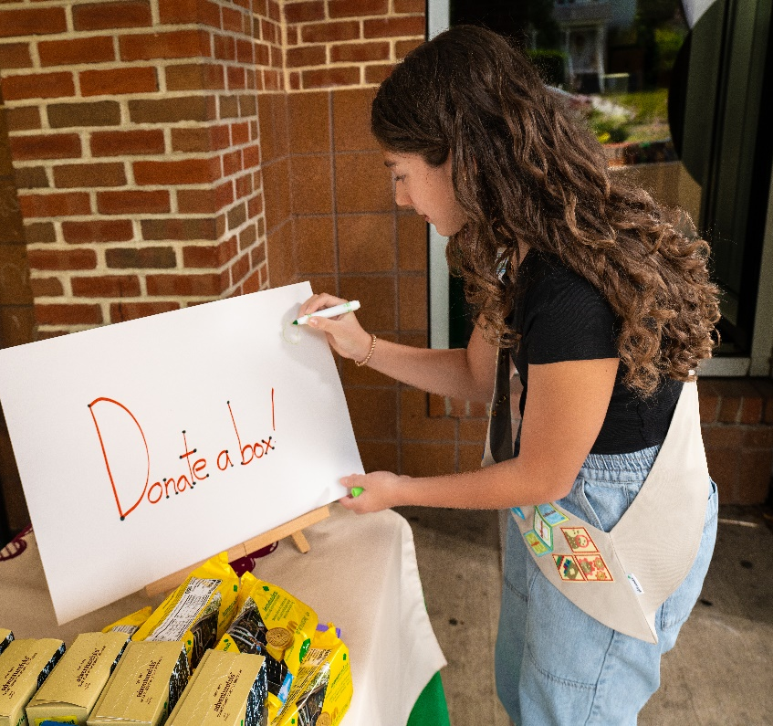
Promotions
Cookie Share
Girl Scout Cookies purchased through “Cookie Share” are donated to a charitable organization chosen by the Girl Scouts’ troop or council. The Girl Scout will receive credit for your cookie donation purchase, as will the troop.
Cookies from the Heart
All virtual cookie share donations are collected at Council and then distributed to LOCAL hometown heroes. From firefighters and police to active and retired military. Church pantries, nurses, shelters, food banks, teachers and more!
See dates on the calendar when troops can help distribute Council donations.

Slide 8
Safety
Girl Scout Safety Practices
Show you’re a Girl Scout. Wear the Girl Scout membership pin, vest, sash or other Girl Scout clothing to identify yourself as a Girl Scout.
Buddy up. Always use the buddy system. It’s not just safe, its more fun.
Plan ahead. Be prepared for emergencies, and always have a plan for safeguarding money.
Protect Privacy. Girl Scouts’ last names, home addresses, and email addresses should never be given to customers. Protect customers’ privacy by not sharing their information, except when necessary.
In Person Sales
Digital Sales
Partner with adults. Adults must accompany Girl Scout Daisies, Brownies and Juniors. Girl Scouts in grades 6-12 must be supervised by an adult and must never sell or deliver cookies alone.
Sell in the daytime. Sell during daylight hours, unless accompanied by an adult.
Do not enter any homes or vehicles. Never enter someone’s home or vehicle. Only approach vehicles at designated drive-thru cookie booths.
Be streetwise. Become familiar with the areas and neighborhoods where you’ll be selling and delivering cookies. Avoid alleys.
Be safe on the road. Always follow safe pedestrian practices when crossing at intersections or walking along roadways. Be aware of traffic when unloading products and passengers from vehicles.
Be safe online. Girl Scouts must have their caregiver’s permission to participate in all online activities.
Participate in Digital Cookie. Read and abide by the Girl Scout Digital Cookie Pledge.
Read and agree. Read and agree to the GSUSA Internet Safety Pledge.
Caregivers’ agreement. Read and abide by the Digital Cookie Terms and Conditions for Parents/Guardians.

Slide 9
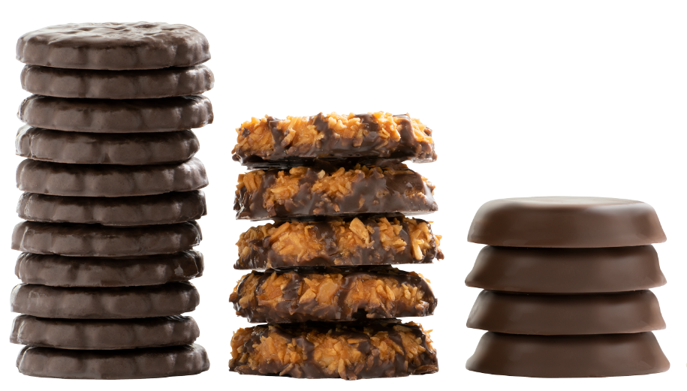
Facts to know!
ALL proceeds stay local!
12 cookie packages per case
$5.00 per package.
$6.00 for Gluten Free
How much should I order?
Based on average sales per cookie variety in the past, we recommend you order based on the below mixture:
How much can I pickup?
Compact car | 23 cases
Hatchback car | 30 cases
Standard car | 35 cases
SUV | 60 cases
Station Wagon | 75 cases
Minivan | 75 cases
Pickup truck | 100 cases
Cargo van | 200 cases
Thin Mints® | 28% | Trefoils® | 9%
Caramel deLites® | 18% | Peanut Butter Sandwich | 6.5%
Peanut Butter Patties® | 15% | Toast-Yay!® | 4.5%
Adventurefuls® | 7% | Caramel Chocolate Chip | 2%
Lemonades® | 10%
The oven that bakes Trefoils® is as long as an American Football field.
A cookie season of Caramel deLites® needs as much coconut as 6 blue whales' weigh.
Fun Facts!
ABC uses enough peanut butter in Peanut Butter Patties® to fill 6 swimming pools.
Girl Scouts have been selling Lemonades® since 2006.

Slide 10
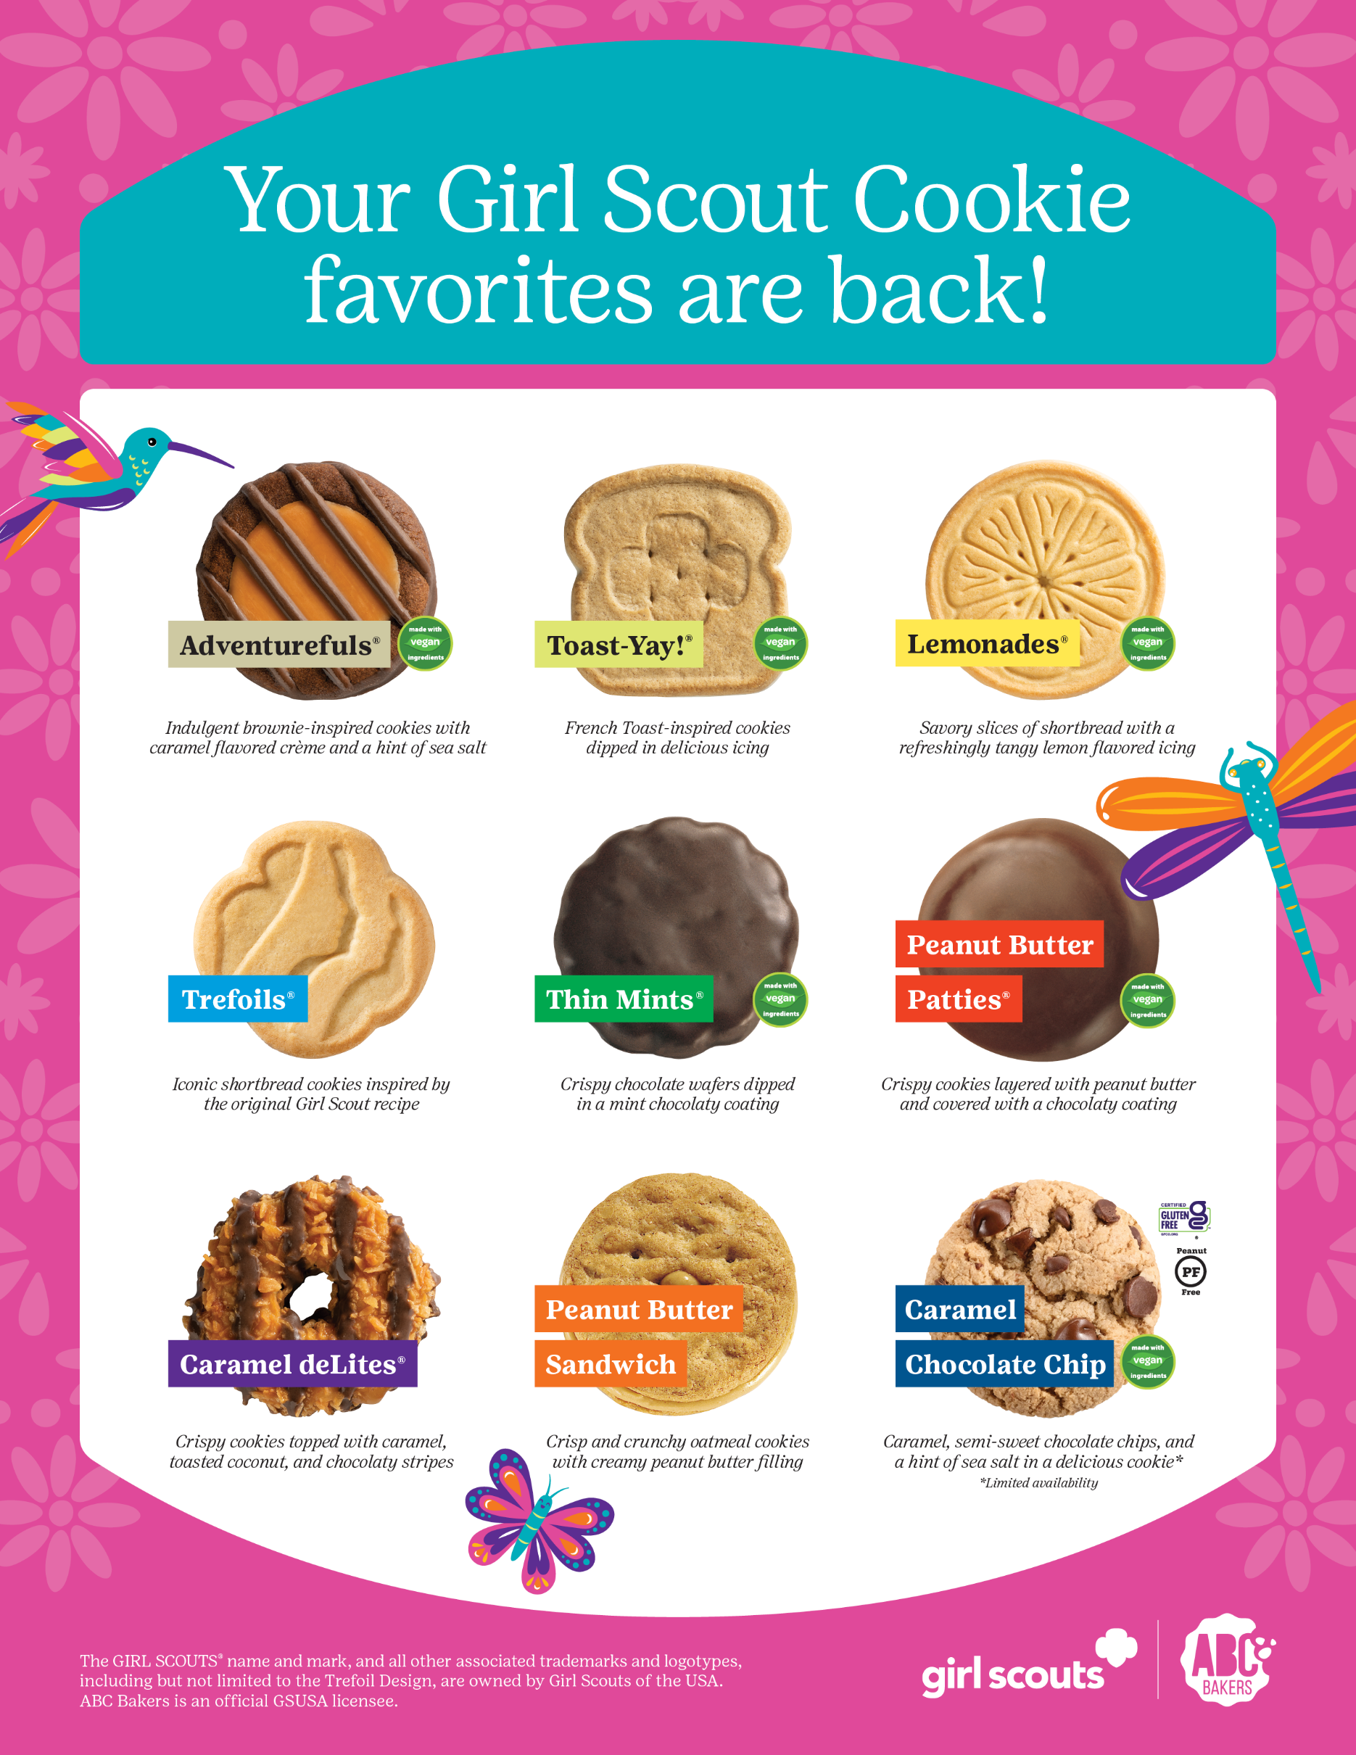

Slide 11
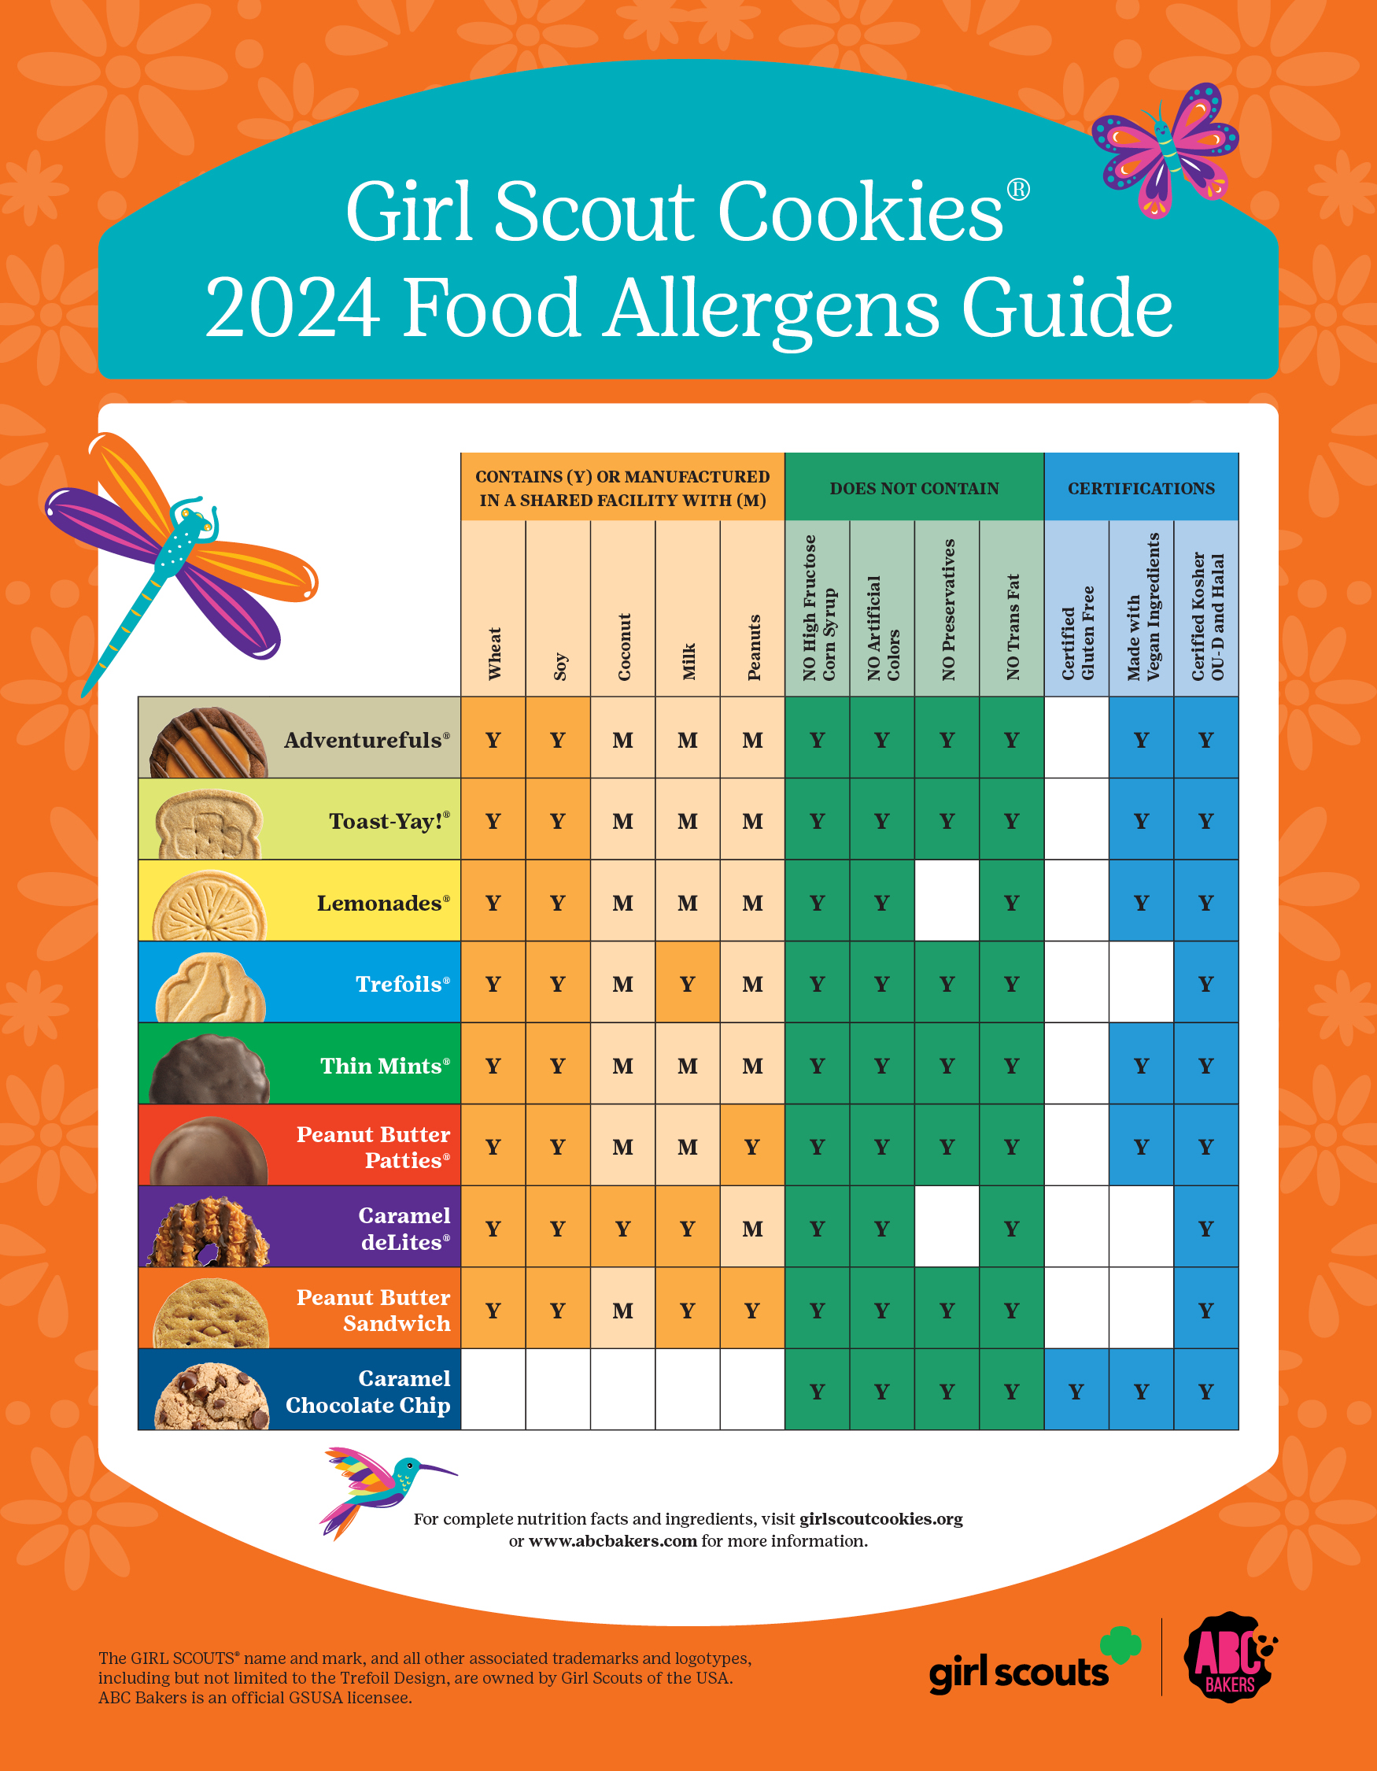

Slide 12
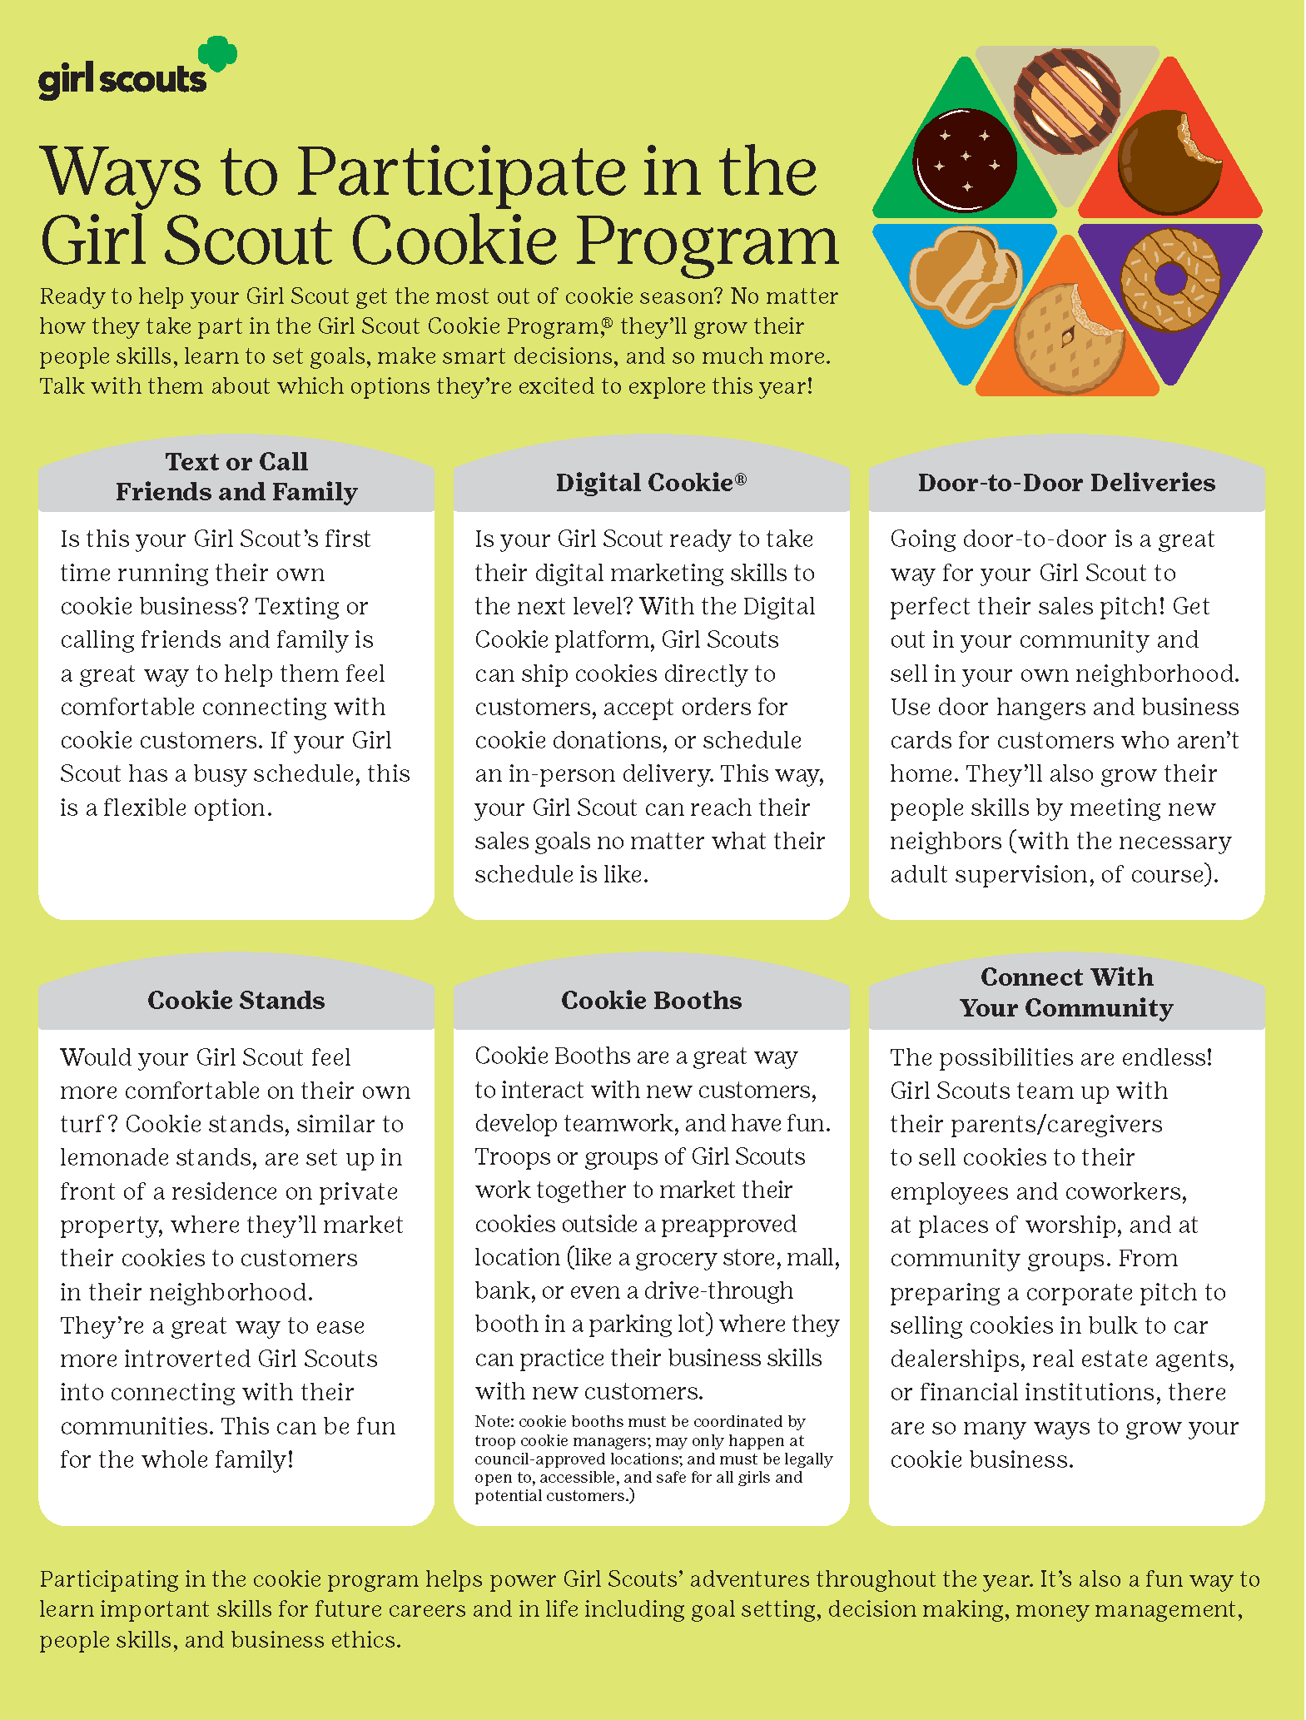
Notes:
Liz asked us to add this for 2023

Slide 13
Troop Cookie Manager Checklist
_____ Register as a member of Girl Scouts of the U.S.A. for FY’24, October 1, 2023, through September 30, 2024.
_____ Submit a completed T-1 and T-3 ACH form. Assume financial responsibility for all cookies received by the troop.
_____ Take Cookie training as instructed by Council.
_____ Provide adequate information sharing and support for all girls and parents in the troop during the cookie sale.
_____ Submit the troop initial cookie order with booth cookies included via Smartcookies by October 29, 2023, no later than by 11:30 pm.
_____ Participate in your Service Unit Booth Sale Lottery.
_____ Sign up for additional FCFS Booth Sale opportunities through Smartcookies.
_____ Arrange with the Service Unit Cookie Manager for pickup of the Troop initial order.
_____ Distribute cookies to parent/guardian and obtain signature on the T2 Troop Worksheet form. Continue to collect re-orders and obtain additional cookies from cupboards as needed.
_____ Place planned orders in Smartcookies weekly as needed.
_____ Handle money properly and provide parent receipts. Provide troop leader with validated troop deposit slips or obtain a receipt if cash is given directly to the leader.
_____ Update Smartcookies with girl’s final sale totals and order main recognition no later than January 14, 2024, by 11:30 pm. If the troop chooses to opt out, patches must still be ordered by the deadline.
_____ Report parent/guardian or other outstanding debts to Service Unit Cookie Manager and GSCM immediately by using a T-6 delinquent account form.
_____ Turn a copy of the Troops final cookie sale report to the Troop Leader.
_____ Arrange for pickup of girl regards from your Service Unit Cookie Manager. Distribute girl awards and report any discrepancies to your Service Unit Cookie Manager prior to March 31, 2024.
Notes:
Liz asked us to add this for 2023

Slide 14
A-lot-l things to know
Ordering
Distribute order cards, rewards inserts, and money envelopes to girls.
Set a date to collect all girl paper order cards for initial order.
Enter the girl’s initial orders into Smartcookies by 10/29/2023.
Submit the order and select your delivery location.
Girls continue to take orders between initial order and delivery day.
Continue to collect reorders and place planned orders into Smartcookies to re-stock troop’s supply.
Delivery
Booths
Delivery information will be printed on your order.
Schedule a time for your troop to pickup cookies from the Service Unit.
Sort cookies out to girls per their initial order cards.
Have parent/caregiver sign for all cookies they receive.
Attend the Service Units Booth Lottery to get first choice of secured booths.
Select any additional booths from Smartcookies FCFS available slots.
Follow all safety guidelines while at the booth.
Track cookies sold and use Smartcookie Booth Divider to assign boxes to girls.
Remember: You are representing all Girl Scouts and be on your best behavior.

Slide 15
Money
Troops should set their own policy for accepting checks. With the digital system, credit cards can be used for payment.
Council pays all credit card fees.
ACH’s can either be withdrawals or deposits into the troops bank account.
Safely secure cash money at booths and learn how to identify counterfeit bills.
Deposit all cash and checks into the troops bank account.
Donations
Returns, Damages + Leftovers
All virtual cookie share donations are collected at Council.
Troop shave the opportunity to help distribute them at the end of the sale.
All donations go to local hometown heroes.
GSCM does not allow for any returns.
Troops can transfer any remaining stock to other troops.
Damaged boxes can be replaced box for box, variety for variety, at any Cupboard.
Troops can continue to sell any remaining stock after the sale has ended but payment for them must be made by the final ACH deadline.

Slide 16
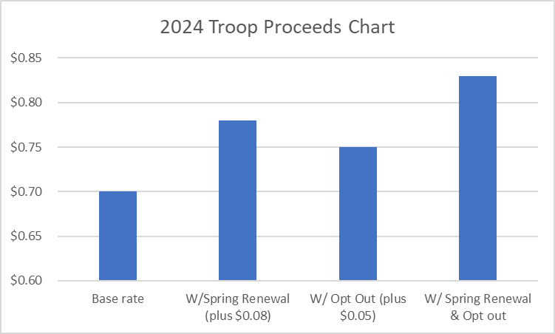
Rewards
Troop Initial Order Reward Plan
(non-cumulative)
New Troops - Order 50 cases or more and receive a “My First Cookie Sale” Patch for each girl in the troop as of 10/29/2023.
Troop increases initial order year over year by 50% - Receives $50.00 off a GSCM campsite rental.
Troop increases initial order year over year by 100% - Receives $100.00 applied to their Smartcookies account.
Lucy + Lottie the axolotls are wishing you a successful Girl Scout Cookie® season!

Slide 17
Rewards
Girl MAIN Rewards Plan (cumulative)
See rewards insert
36 pkgs – Theme Patch
60 pkgs – Lanyard
100 pkgs – Axolotl Water Game
150 pkgs – Goal getter patch and Mood mixer camp light
200 pkgs – Large plush
250 pkgs – 2025 membership renewal
295 pkgs – Belt Bag
355 pkgs – T-shirt
415 pkgs – Tumbler
500 pkgs – 500+ Club patch and Orioles event
625 pkgs – Hoodie
750 pkgs - $75.00 Program/Camp credit
1,000 pkgs – CEO Club Event
1,500 pkgs – Dry Bag Backpack
2,000 pkgs – Great Wolf Lodge Event
6 Regional highest sellers - Plaque, sash, Axolotl Pillow.
Entrepreneur of the year – Plaque, Tiara & sash

Slide 18
Rewards
Patches
Booth Sale – Participate in 2 booth sales documented in Smartcookies Booth Divider.
Cookie Share – Collect 20+ Pkgs in virtual cookie share.
Cookie Techie – Use DC24 and sell 60+ Pkgs via direct ship.
Level Bar – Attained at highest level sold. Increments of 100.

Slide 19
Axolotl Fun Facts
In the wild, they are found in only one lake in the whole world!
Lake Xochimilco, Mexico.
Axolotls are critically endangered amphibians.
Axolotls are 1,000 times more resistant to cancer than mammals.
Axolotls are neotenic, which means they never outgrow the larval stage.
Wide range of color + camouflage abilities!
Axolotls can completely regenerate lost limbs + organs. Wow!
Life span: 10 years+
“Axolotl” means “water dog” in native Aztec language.

Slide 20
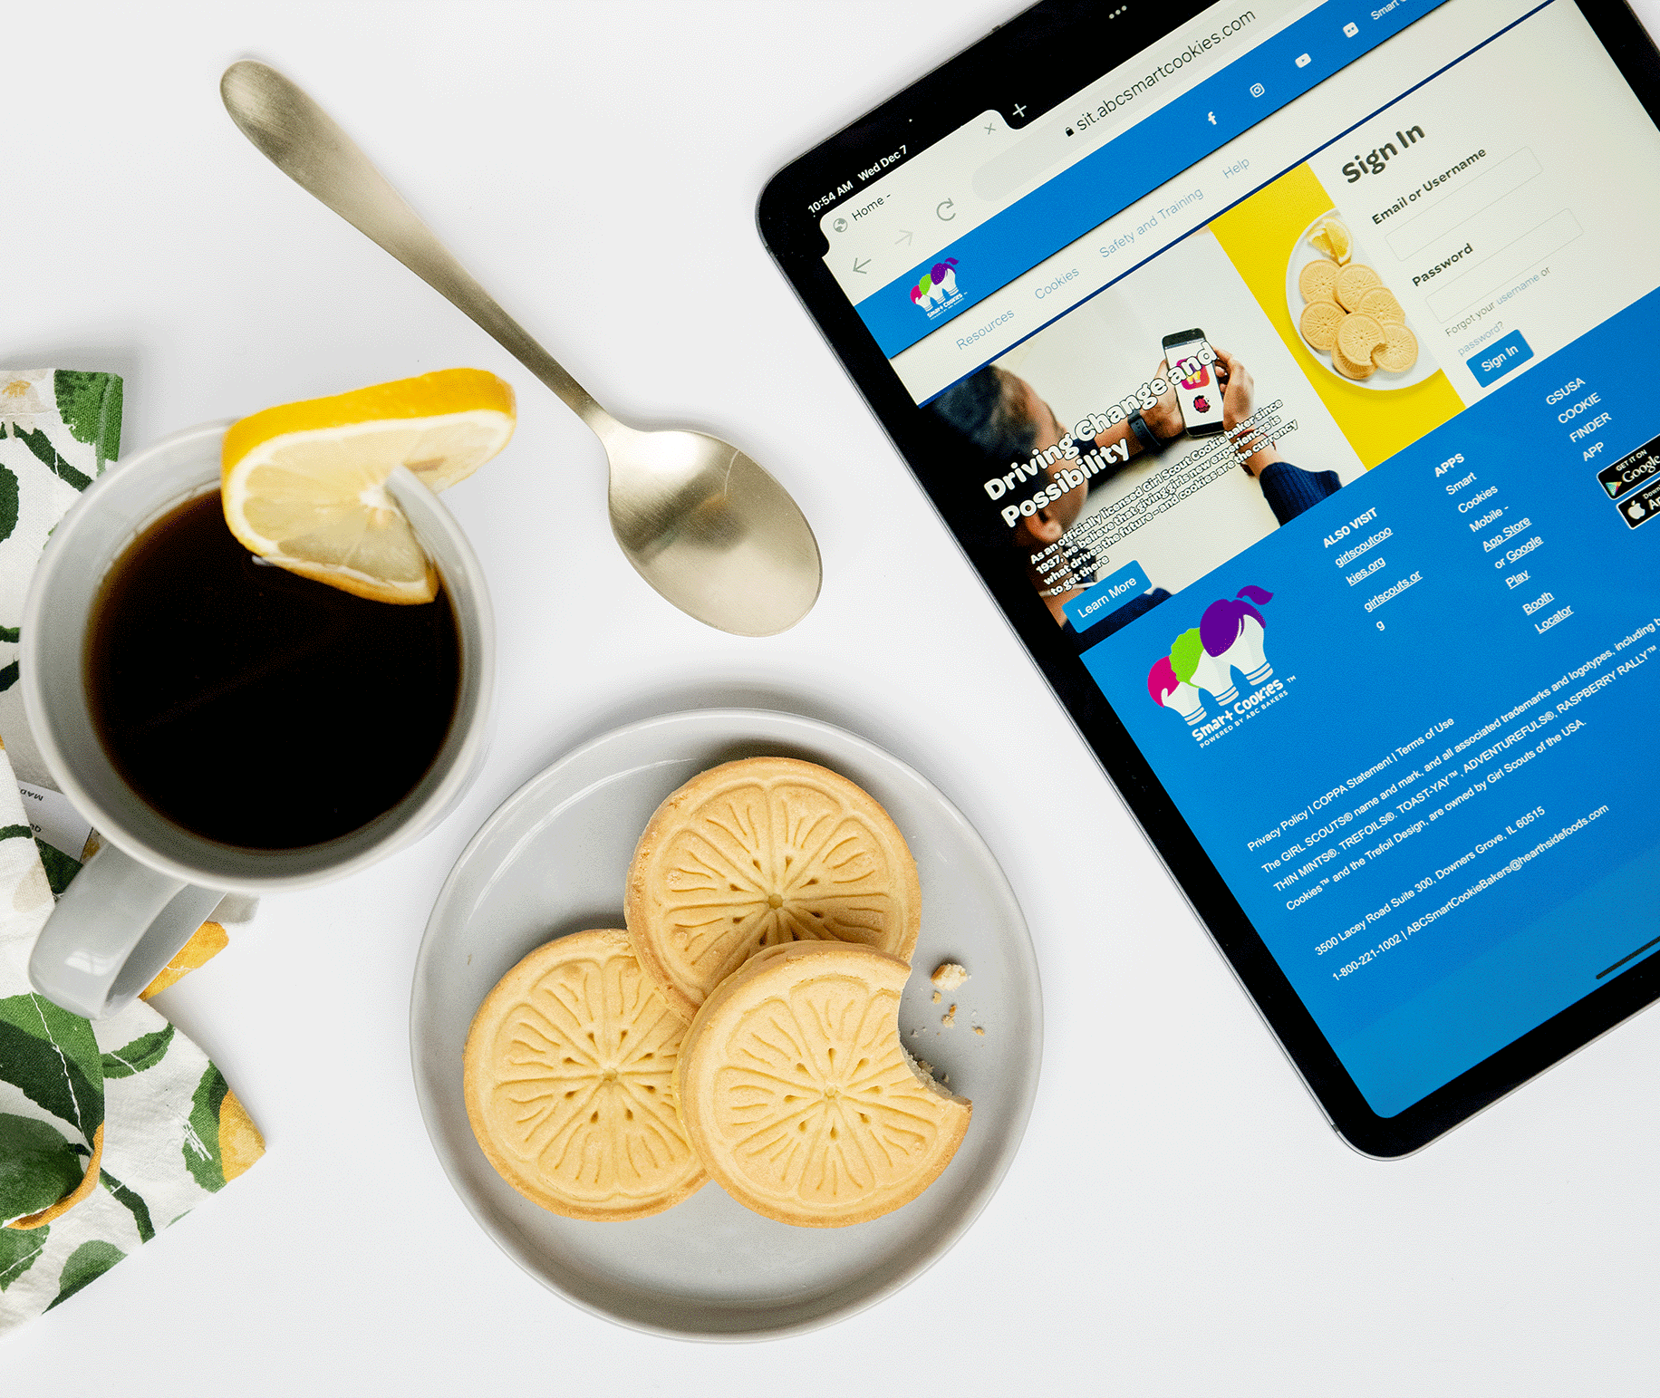
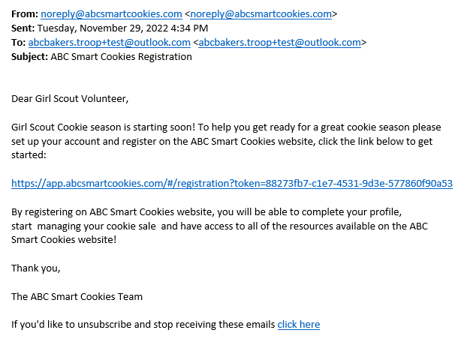
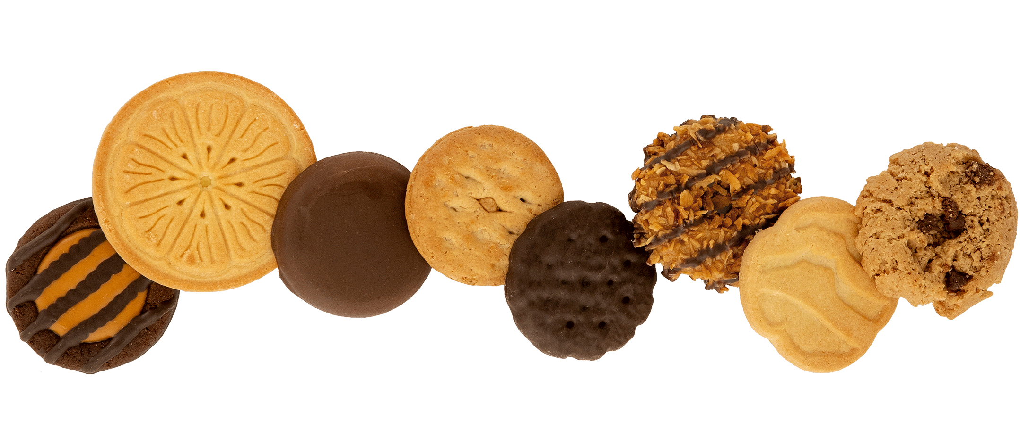
ABC Bakers provides YouTube training videos to guide you every step of the way!
Training can be accessed directly from
www.abcsmartcookies.com/safety-and-training
Be on the lookout for this important email!
Add noreply@abcsmartcookies.com
to your safe sender list!

Slide 21
Digital Cookie®
Exciting news, your online Girl Scout Cookie® sales platform is getting a revamp! We’re moving your online cookie sales to a platform called Digital Cookie®. Going forward, you will be using the new Digital Cookie application to sell cookies to customers online, track progress towards a goal, and manage sales. Selling Girl Scout Cookies® online and reaching your goals just got easier!
Please note: Troop leaders and volunteers will still utilize Smart Cookies™ for cookie business management tasks like sourcing additional cookies for the troop and allocating cookie sales.
Digital Cookie® features make selling cookies a fun, universal experience for all entrepreneurs.
For Girl Scouts/Troops:
Customizable Girl Scout pages allow customers to read your story and sales pitch and view your profile image or video.
Troops can customize their site with the same marketing tools available on a Girl Scout's site with stories, sales pitches, a photo or a video.
Cookie Business Badges and Family Entrepreneur Pin requirements are integrated into the system to reinforce the importance of badge work and the Girl Scout experience within the cookie program.
Girl Scouts can send "cheers" to one another by choosing from an assortment of encouraging and congratulatory images.
Girl Scouts can make sales on the go at cookie booths
For Parents:
The option to turn girl delivery off for customers based on family preferences and cookie availability.
The ability to turn cookie varieties on or off to match available inventory.
For Consumers:
Customers can order and pay for cookies online and pick them up at a booth.
All consumers will have the same checkout process when using an individual Girl Scout or troop link, ensuring a unified experience across the Girl Scout brand.

Slide 22
DC24 Cloud / Digital Cookie
DC24 Cloud will open on a varied schedule based on the volunteer or parent/caregiver role. You will receive an email from (email@email.girlscouts.org) when you are in the system. You must read and accept the Terms and Conditions.
Access dates are listed on the cookie calendar.
Rather than bring you back for another training, we have posted all the DC24 Cloud resources on our website. We will continue to add more resources and training videos as they are released by GSUSA.
Continue to check the website to get your questions answered regarding DC24 Cloud as you use and go through the system.
Go to GSCM.ORG/Cookies
Forms & Documents
FAQ’s
Tip Sheets (based on user role)
Training videos

Slide 23
Promising Practices
Set a goal, both a troop goal and a personal goal.
Hold a cookie kickoff meeting to build excitement and use the Cookie Rally guide for fun ideas.
Hold a parent/caregiver meeting to discuss cookie sale goals and how the troop plans to reach them. Ask for parent involvement to help reach those goals.
Go over the safety guidelines (page 8).
Discuss ways to participate (page 12).
Discuss deadlines and the importance in meeting them (page 6).
Set up troop booths so girls can enjoy the activity together.
Make posters showing your troop goals and service projects. Customers love to support what you are doing!
Try upselling – when a customer buys a box or two, ask them to buy another box to donate to Cookies From The Heart, which provides cookies to military personnel and hometown heroes.
Participate for the entire sale period.
Use resources on the websites at GSCM and ABC Baker.
When in doubt, ask your Service Unit Cookie Manager. They are there to support you throughout the sale.
Notes:
Liz asked us to add this for 2023

Slide 24
ABC BAKERS
The current contracted baker who provides Girl Scout Cookies to the Girl Scouts of Central Maryland Girl Scout Council.
ABCSMARTCOOKIES.COM
Is the bakery website with cookie selling resources for girls, parents, and adult cookie volunteers. Tips, ideas, and cookie recipes can all be found here.
ACH FORM (T-3)
An “Automatic Clearing House” form filled out by troops to authorize Council to withdraw funds for product payment from the troop’s bank account. This form is filled out at the beginning of the cookie sale and annually thereafter. This form outlines the dates and amounts to be withdrawn in a calendar sale. Troops understand that they may not order or receive Girl Scout Cookies until the ACH Debit Authorization form, T-3, is received by the Council.
ACH SWEEP The term used for the automatic deduction of product sales payments from the troop bank account to Council for product sold. See the ACH FORM for date and amount details.
BOOTH LOTTERY A lottery process used to sign up for cookie booths within your Service Unit geographic area. This can be done in person at meetings held at the Service Unit. It can also be done via an on-line process. Whether in-person or on-line, troops choose available cookie booth times and locations.
BOOTH SALE COORDINATOR
The appointed Service Unit Booth Sale Manager responsible for the soliciting, coordinating, distribution, monitoring and evaluating the Troop Booth Sales in the assigned geographic area.

Slide 25
COOKIE BOOTH A cookie booth is a group of girls and adults that set up a stationary table, usually in front of a business, to sell product. We recommend a minimum of two adults and two girls. All Troop Cookie Booths should be coordinated with the Service Unit Booth Sale Coordinator or Service Unit Manager. Permission to set-up a Troop Cookie Booth in another Service Unit should be coordinated with that other Service Unit prior to conducting the Cookie Booth.
COOKIE CUPBOARDS Cookie Cupboards are set up throughout Council as cookie storage locations where you can pick up additional cookies after sales have begun. See also Planned Order.
COUNCIL
The regional Girl Scout Charter for a geographic region responsible for the operations of the business and the management of volunteers.
DEPOT and DEPOT DAY
Depot is the place where your Service Unit has established the initial order cookie delivery will take place. All arrangements are made by the Service Unit Cookie Managers. Depot Day is the day troops come to the centralized location to pick-up their initial orders.
DIRECT SALE
When cookie product is delivered to Troops and Booth Sales are conducted.
FORM #s
All forms have form numbers in the upper right-hand corner. The letter included in the form number indicates which group uses the form. A form beginning with (T) is a Troop form, a form beginning with (G) is a girl form, a form beginning with (SU or N/S) is a Service Unit level form and forms beginning with (BS) are Booth Sale Forms.

Slide 26
INITIAL ORDER The first order for product placed by a troop. Cookie Initial orders are based on expected sales and placed prior to the beginning of the sale.
JULIETTE
Juliette’s is a program designated for individually registered girls above the Daisy Girl Scout age level without a troop designation.
OPT OUT
Is when a troop decides to forfeit girl recognition items for additional troop proceeds per box sold by the troop. Girls in opt out troops still receive appropriate patches and the celebration events at individual sales levels.
PLANNED ORDERS A planned order is an order placed with a specific Cookie Cupboard for pick-up of more cases of cookies after initial order. Refer to the full calendar on the GSCM website for dates.
RECOGNITIONS /REWARDS Recognition items are earned by girls for achieving sale volume levels. Levels and items are outlined on the girl cookie order card. Troops decide if the girls want incentive items or additional proceeds per box. All incentives are cumulative.
SERVICE UNIT (SU)
The geographic service area assigned by the Membership Department based on school districting. Service Units are comprised of several Troops.
SERVICE UNIT MANAGER (SUM) A volunteer who manages the SU and the troop volunteers therein.

Slide 27
SERVICE UNIT COOKIE MANAGER (SU COOKIE MANAGER)
A volunteer who manages the Cookie Sale coordination for all troops in the SU.
SERVICE UNIT BOOTH SALE COORDINATOR (SU BSC)
A volunteer who secures, coordinates, and disseminates the booth locations to troops in the SU.
T-1 TROOP COOKIE MANAGER Position Description
Completed by the adult troop member responsible for coordinating the Cookie Sale on behalf of the troop.
T-6 DOCUMENTATION OF UNPAID MONIES A form used by a troop to document when parents have not completed the financial responsibilities, they agreed to for the product checked out to them.
TROOP COOKIE MANAGER (TCM) The adult troop member responsible for coordinating the Cookie Sale on behalf of the troop.
TROOP TRANSFERS
Troops may transfer cookies between themselves by using the (T-4 / CC-2) cookie transfer form and entering the transaction in Smartcookies.

Slide 28
Have a magical sale!
Notes:
Liz asked us to add this for 2023

