Slide 1

Digital Cookie
Troop Volunteer Training
::GSCM 2024:
©2021 Girl Scouts of the USA. All Rights Reserved. CONFIDENTIAL-Not for public distribution.

Slide 2
Dashboard
Troop Virtual Booth Link
Orders Tab
My Troop Tab
My Troop Orders Tab
Cheers Tab
Virtual Booth Tab
Agenda
Notes:
GSCM.org for Tip Sheets which are topic specific help resources.

Slide 3
Dashboard

Slide 4
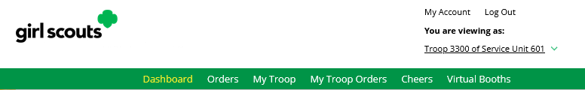
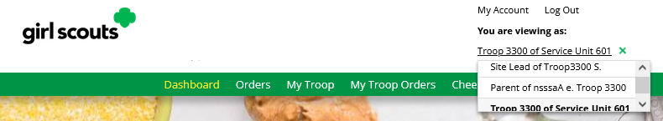
Dashboard
Notes:
Troop Volunteers can easily toggle between their roles, directly from the dashboard using the drop-down arrow under the role they are currently logged in as.

Slide 5
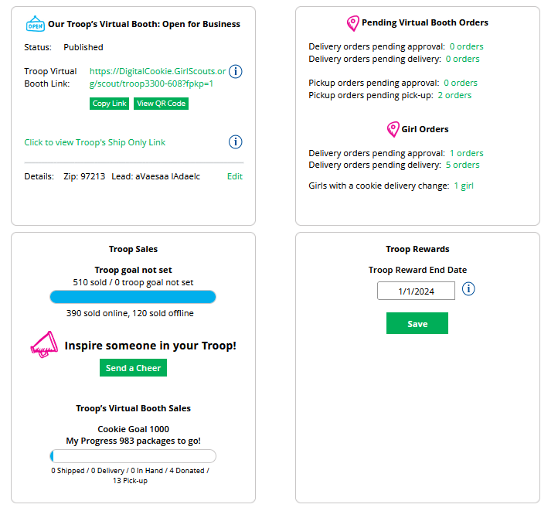
Dashboard
Troop links setup and troop links.
See if your troop link or any Girl Scouts in your troop have an order to approve.
Troop sales data and send a Cheer to a Girl Scout in your troop.
Need to request girl reward selections earlier than the council date? Change it here.
Notes:
Your Digital Cookie Dashboard has information that helps you support your Girl Scouts and their parents in their Digital Cookie sales.
All appointed Troop Leaders and Cookie Volunteers for the troop should have access to this Dashboard when they login to Digital Cookie.
The dashboard has five sections. The top half has:
Troop Virtual Booth Info (more information on a later slide)
Pending Virtual Booth Orders
Troop Rewards Deadline
Troop Online Sales and Marketing + Troop Goal Progress

Slide 6
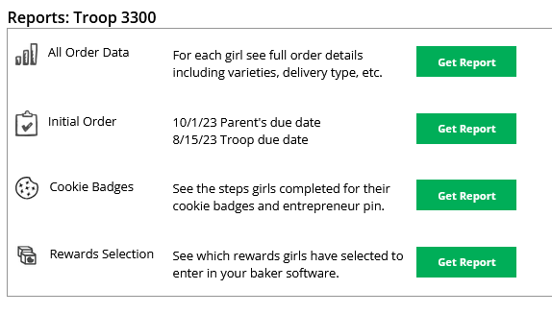
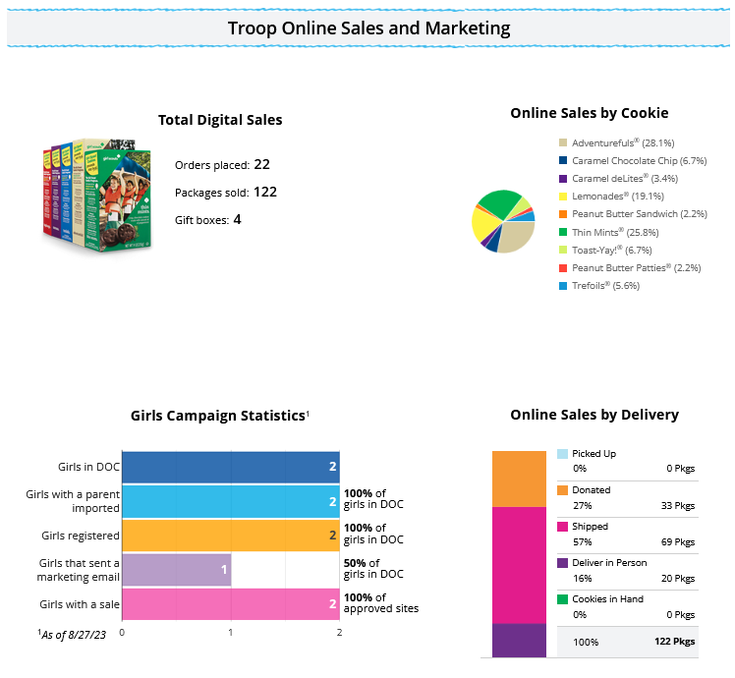
Dashboard
Monitor Girl Scout sales in your troop
You can pull reports for your troop from your dashboard
Notes:
View the sales for the girls in your troop from your dashboard, it’s a great way to make sure they are actively participating in reaching their customers.
You have four reports to view that can help you manage your girl’s Digital Cookie activity.
All Order Data will show you details on every order for every girl.
Initial Order (If applicable) will show you the initial paper order card entry by the parents to allow you to compare what is in the baker software if desired.
Cookie Badges will let you know if girls are completing any of the Cookie Business badges and/or the Family Entrepreneur Pins. Encourage them to complete these with their families to increase their cookie program learnings!
Rewards Selection will be helpful if your council enabled girls to select their rewards in Digital Cookie. You simply pull this report and enter their choices in to the baker software without needing to track down each choice for each girl in the troop.

Slide 7
Troop Virtual Booth Link

Slide 8
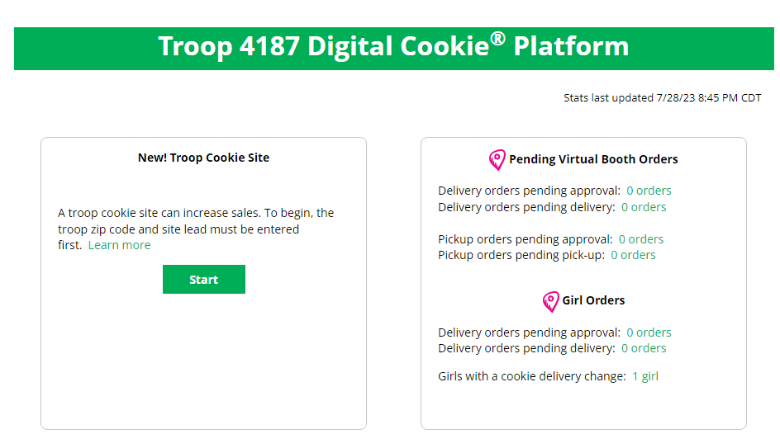
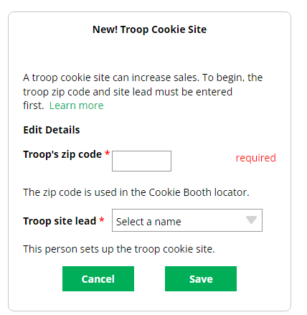
Troop Virtual Booth Links
Setting up your Troop Virtual Booth Site
Step 1: Click Start
Step 2: Enter troop Zip Code and select a Troop site lead.
Notes:
Your Troop Virtual Booth links will help your troop make sales online instead of, or in addition to, your regular in person cookie booths. When you set up your Troop Virtual Booth site, there may be two links you can use, depending on your council’s settings. These links will let your troop reach new customers in your local community and beyond.
Setting up your Troop Virtual Booth Site
Step 1: The first time a leader or cookie volunteer for the troop logs in to their volunteer role in Digital Cookie, they will see a place to begin the process to have a troop virtual booth link. To begin, click the “Start” button.
Step 2: You will be asked to enter a zip code for your troop. Enter one that is representative of the majority of the girls in your troop
You will also select a name from the drop down of one of the volunteers from the troop to serve in the role of “Troop site lead”. The Troop site lead will be responsible for working with the girls in the troop to set up their site and approving orders.

Slide 9
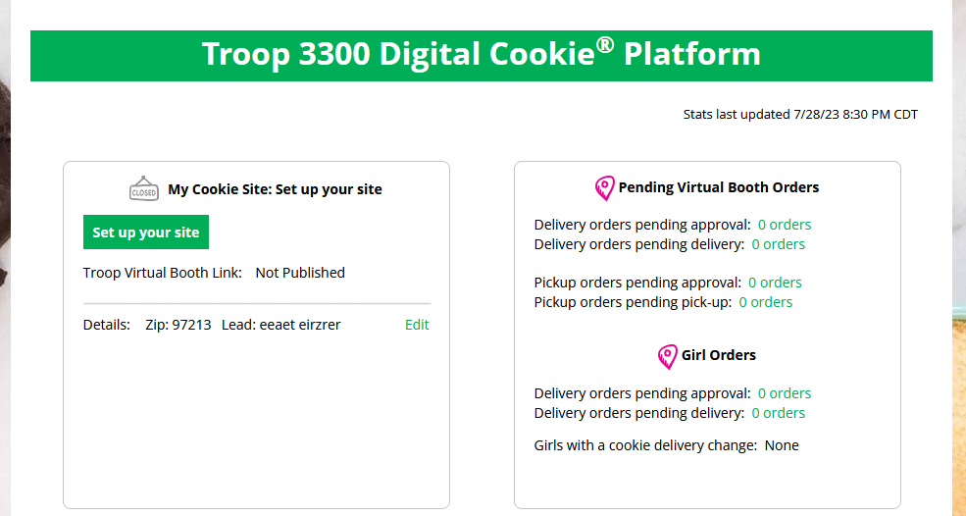
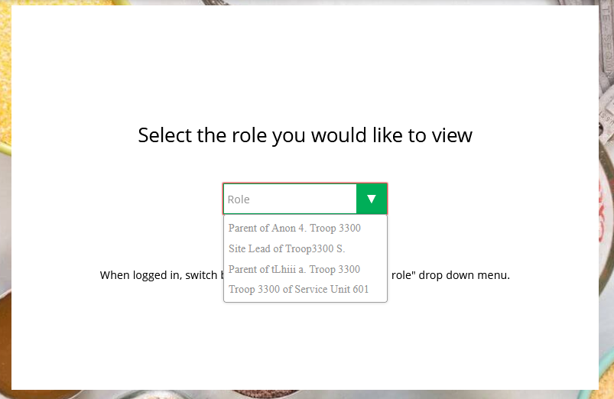
Troop Virtual Booth Link
Setting up your Troop Virtual Booth Site cont.
Step 3: Set up your site
Find Site Lead in role drop down
Notes:
If you assigned yourself to be the troop site lead, your dashboard will be updated with a Set up your site button. If you have assigned another troop cookie volunteer to be the troop site lead, the next time they log into Digital Cookie they will see the new role in their role selector drop down.
To begin setting up the troop site, click set up your site.

Slide 10
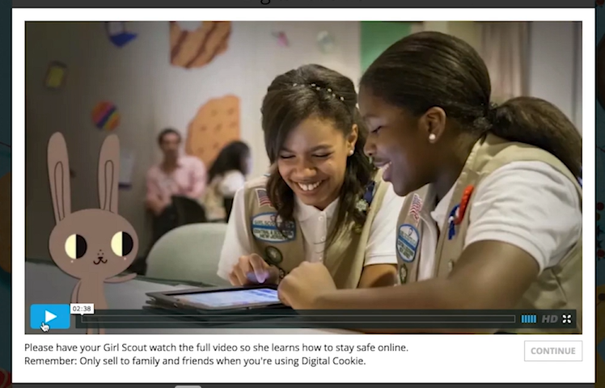
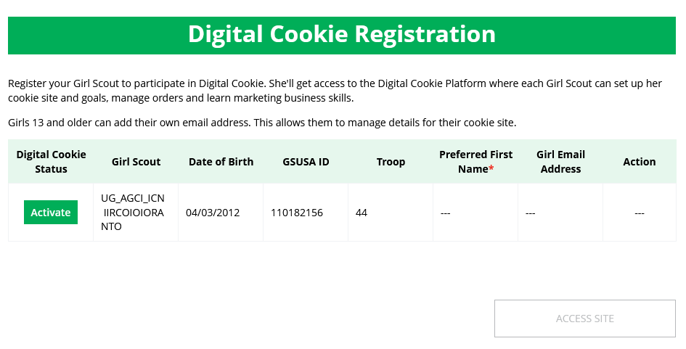
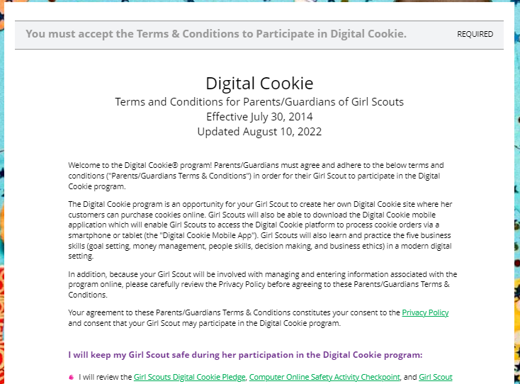
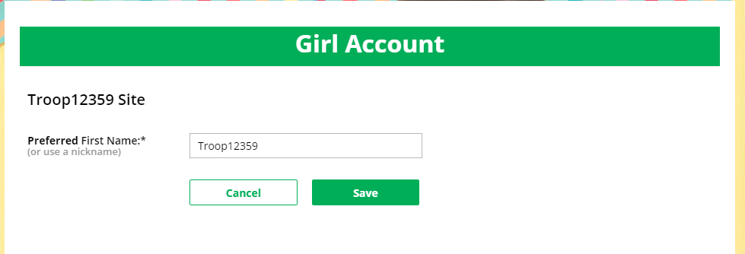
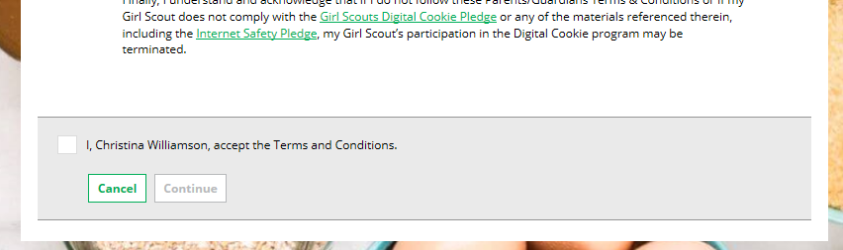
Troop Virtual Booth Link
View Safety Video/Approve Terms and Conditions/Safety Pledge
Select View/Activate Girls
Click to activate Girl Scouts
Continue button will turn green after video
Do not change Preferred First Name for troop to avoid confusion
Check box to accept
Continue
Notes:
The site lead will then need to complete the registration process as if the troop were a new Girl Scout by possibly watching the safety video (depending on role and prior logins) and accepting the terms & conditions and Girl Scout pledge, plus activating the account.
It is important to leave the Preferred First Name as it appears so that your Troop URL is correct. If there is an issue with the troop number, please contact your Council Customer Care to resolve before proceeding.
After that, the Troop Site Lead will use the “Site Setup” to work with the Girl Scouts in the troop to create their message and photo/video. It functions the same way as the Girl Scouts’ Site Setup.
Once the site is published and the council’s sale is live, the troop will have two links to use if they wish for the cookie season.
Note to council: You can add the site set up slides from the parent training, if you need to walk the volunteer through setting up the site.

Slide 11
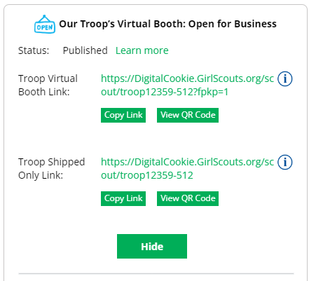
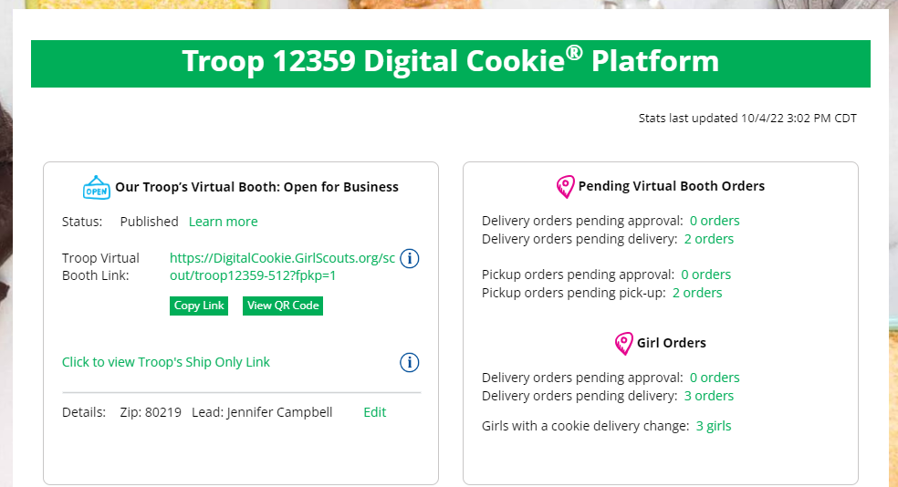
Troop Virtual Booth Link
Troop Virtual Booth Link
Troop Shipped Only Link
Notes:
Troop Virtual Booth Link
From your Troop Dashboard, you may see two links available for your troop.
The top link is your Troop Virtual Booth Link.
This link will function the same as any Girl Scout’s link with Shipping, Donation, Delivery and In Hand (on the app) as options that customers can use when enabled by your Girl Scout Council. You can turn delivery off for the troop link the same way a caregiver can turn delivery off for their Girl Scout.
If pickup is an option in your council, this link will enable customers to select pickup orders as a delivery type.
Troop Ship Only Link
The Troop Virtual Booth link is available if you need a shipped/donated only link.
This link will only allow customers to purchase Shipped and Donated orders. This link will be sent to the National Girl Scout Cookie Finder beginning National Girl Scout Cookie Weekend. (CONFIRM THIS FOR YOUR TROOPS to be sure it hasn't changed)
Once your site is set up and published, there is nothing additional you will need to do in order to have your Troop Ship Only link appear to customers coming to the cookie finder to find a troop near them to purchase cookies from.
All purchases on either Troop Virtual Booth Link will appear in your troop records in your baker software.

Slide 12
Orders Tab

Slide 13
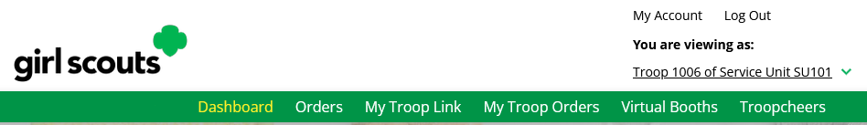
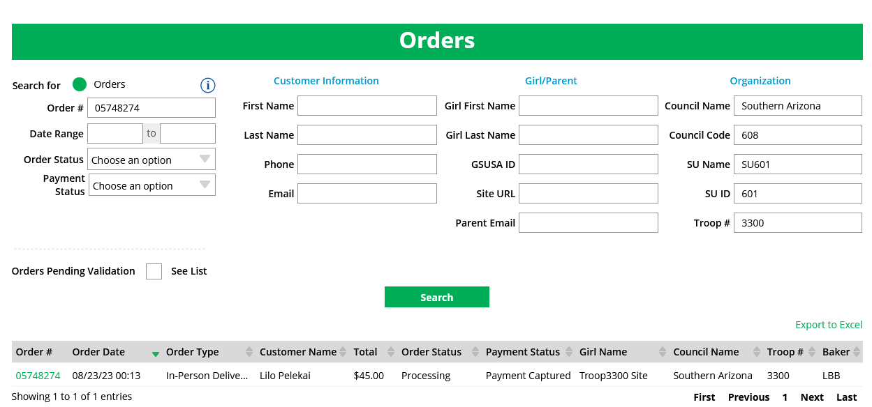
Orders Tab
Searching for orders
ABC/LBB
Notes:
Note to council: Remove slide if you are not offering this feature.
The “Orders” tab allows you to lookup individual orders and refund delivery/donation/cookies in hand orders.
Start by navigating to the “Orders” tab on your troop dashboard. If it is a lighter color or you can’t click on it, your council has not enabled it and you will need to consult your council to make any customer refunds.
Once you are in, you can look up the order a few different ways. Select one of the lookup options, selecting more than one can cause the results to not appear properly. The recommended lookup options are: Customer Order #, Customer Email address, Parent Email Address, Girl Name (first and last), or Customer Name (first and last, min 2 letters)

Slide 14
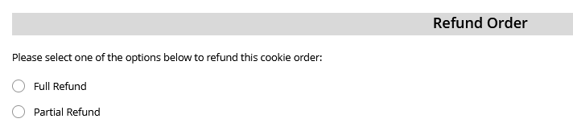
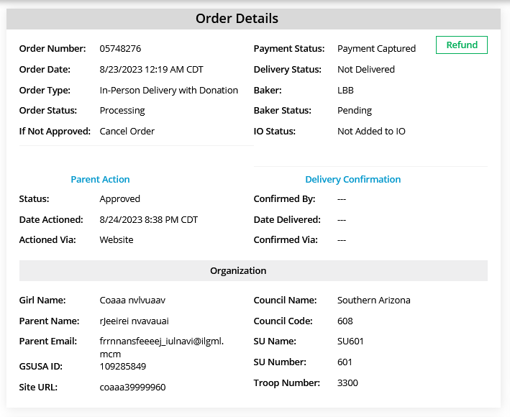
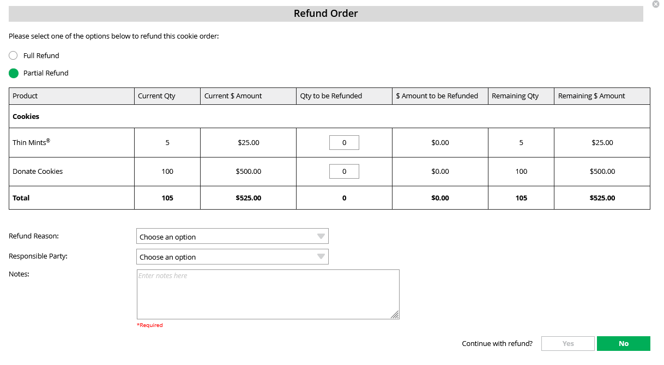
Orders Tab
Refunding an Order
Select refund type
Notes:
Clicking the refund tab will bring up another screen.
You will first need to decide if you are refunding the entire order, OR, in the event the customer got some of their order, but not all of it, select “partial refund”. (Note: Partial refunds will not be an option for ABC councils)
Select one of the options.
If selecting partial, you will need to indicate what packages in the order you are refunding.
You will select an option for refund reason. In general, you will choose “In person delivery issues” unless otherwise instructed by your council.
Then add information to the notes section so that if anyone looked at this order in the future they would know why the refund was made. This might be a national customer service person, so please give a thorough explanation.
Then, continue with refund.
If you select Full Refund, you will still need to select a refund reason of “In Person Delivery Issues” and add the notes before processing the refund.

Slide 15
My Troop Tab

Slide 16
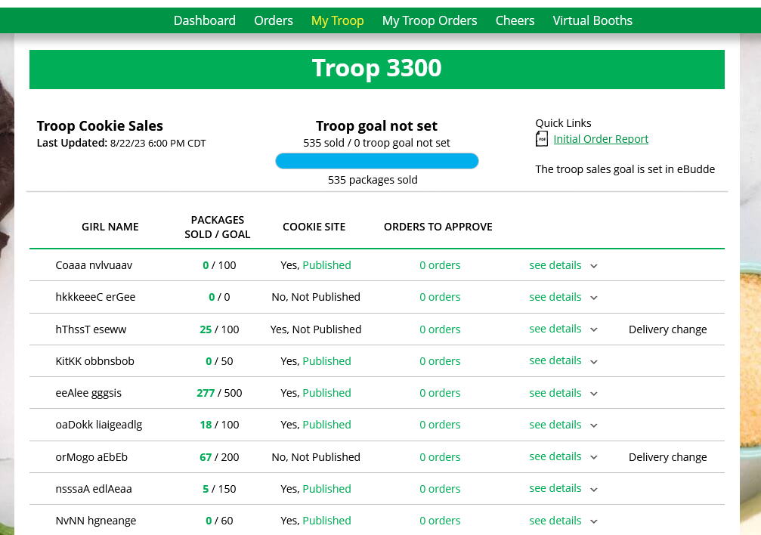
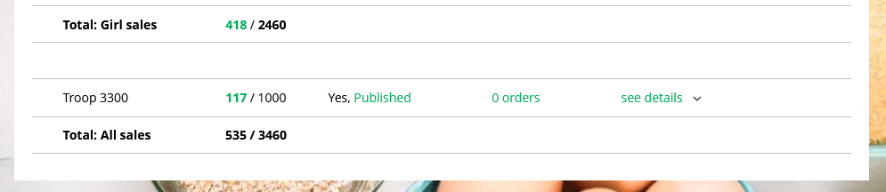
My Troop Tab
Use this tab to see many sale details for each girl in the troop
1
3
2
4
5
Notes:
“My Troop” tab allows you to see how each girl in the troop is doing in her Digital Cookie Sales and if she has turned off delivery or any varieties.
1.Troop Goal: This pulls the troop goal set in the baker software and measures the troop’s progress towards that goal. If the goal has not been set yet, it shows total troop’s sales to date.
2.Cookie Site: If the Girl Scout’s site is published, click on the link to be taken to their customer facing site. If it shows as Not Published, offer to help the family to get started and see sales roll in.
3.Orders to Approve: If your council has In-Person Delivery available, this will indicate if the family has any orders that need approving.
4.See Details: Clicking “See Details” will bring up details on the girl, her orders, her email marketing to customers, and if her parent has turned off delivery or any varieties (if available in your council). You may also see "delivery change" to note if any family has turned off delivery or cookies.
5.If your troop link has been published you will see what the goal is for the Troop ##### “girl”, you can click the link to go to the troop site and you can see any sales that have come in for the troop link.

Slide 17
My Troop Orders Tab

Slide 18
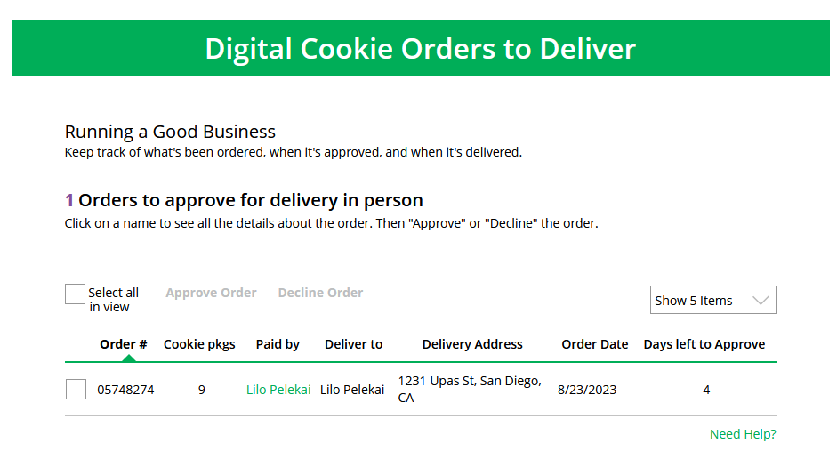
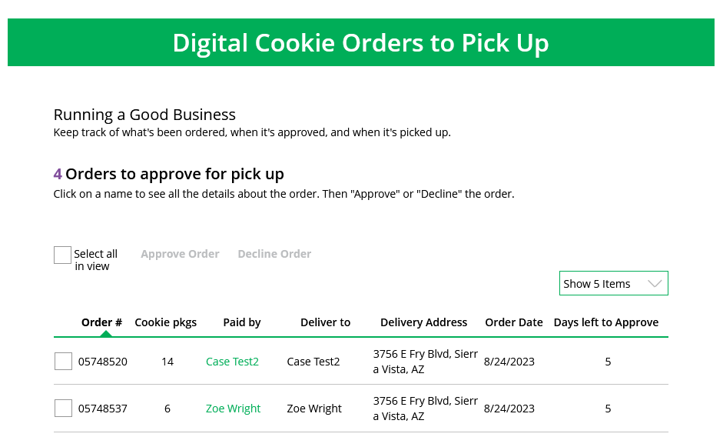
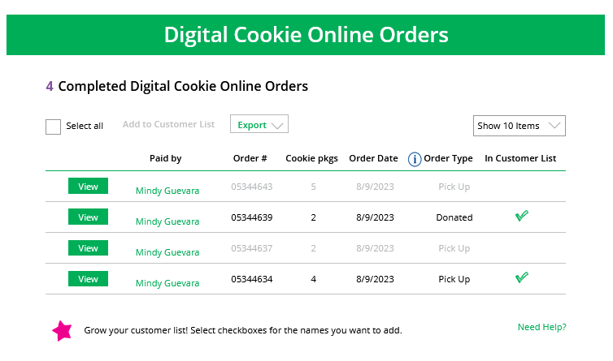
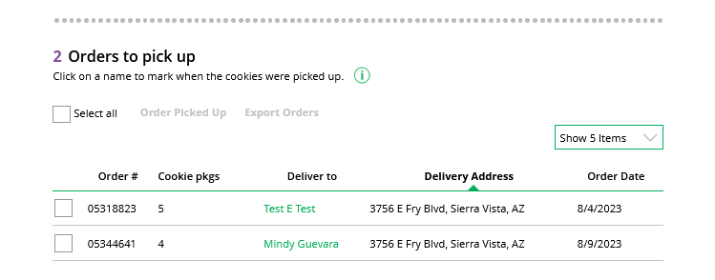
My Troop Orders Tab
Use this tab to see order details for the troop link
Notes:
This tab works the same as the Girl Scout orders tab.
You can approve/decline orders Girl Scout delivery orders as well as pick up orders.
When you approve a pick up order it moves down to the Orders to pick up section.
Here you can pull a list or find additional details on each order to prepare them for pick up.
Once they are picked up, you can mark them as such in this section as well.
Once the order is complete it moves down to the bottom “completed” section, where you will find shipped and donation only orders placed for your troop.
The greyed-out orders are canceled/declined orders.
Note to council: You can bring over slides for approving orders, if necessary, found in the caregiver training.

Slide 19
Cheers Tab

Slide 20
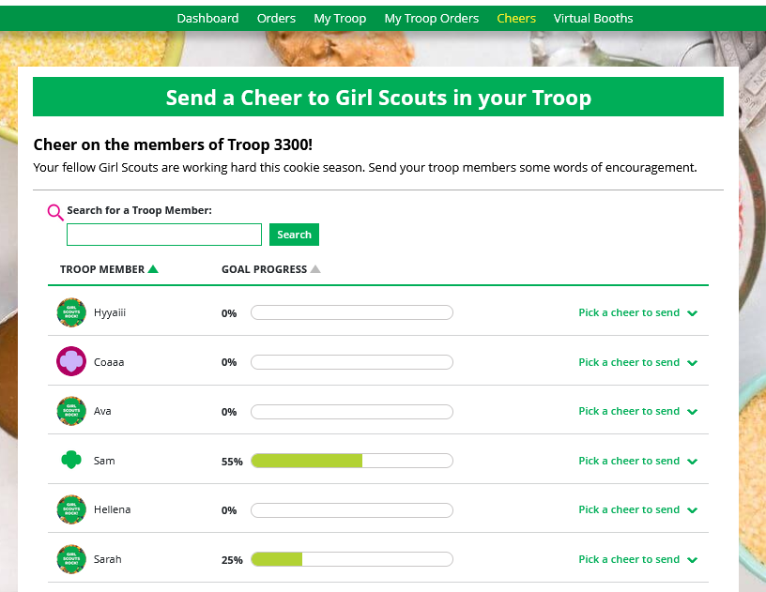
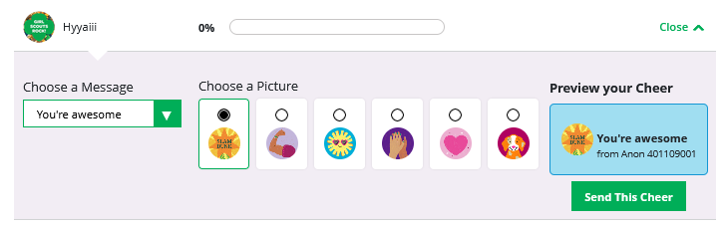
Cheers Tab
You can send Cheers to Girl Scouts in your troop!
Click the drop down next to the Girl Scout to view the message and picture options, then preview and send your Cheer to that Girl Scout.
Notes:
Troop Volunteers can send the Girl Scouts in their troop cheers the same way the troop members can send them to each other. The difference is that girls can’t cheer back to volunteers.
Step 1: You can “Send a Cheer” from the button on the dashboard or the “Troop Cheers” tab.
Step 2: In the Cheers module, volunteers can see the Girl Scouts in their troop and the percentage of sales towards them reaching their goal.
They can select the “Pick a cheer to send” drop down next to the name of the Girl Scout they wish to cheer.
Step 3: Volunteers will see a choice of .gif images and short messages they can send. As they select the message and image they will see a preview of the cheer and then can click “Send this Cheer.” The Girl Scout will then be able to see the Cheer on her dashboard. Girl Scouts are unable to send a Cheer back to volunteers or customers.

Slide 21
Virtual Booths Tab

Slide 22
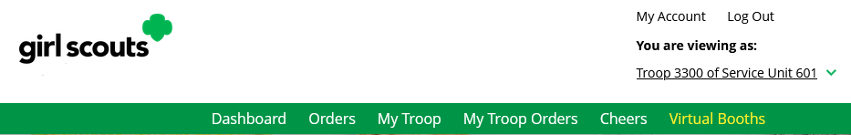
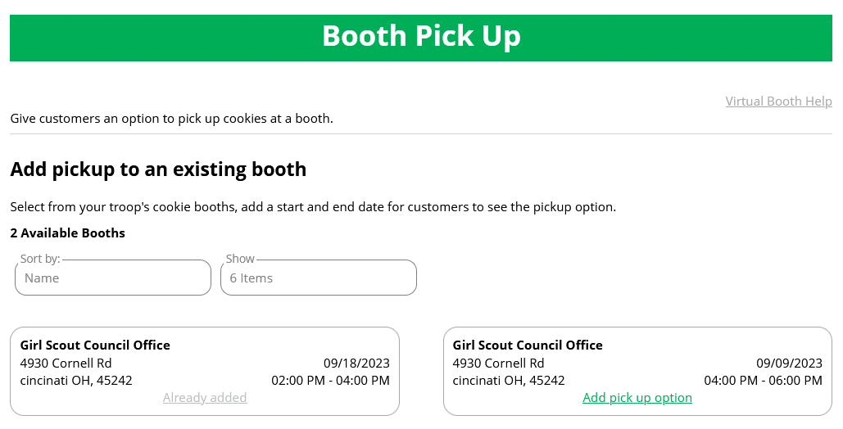
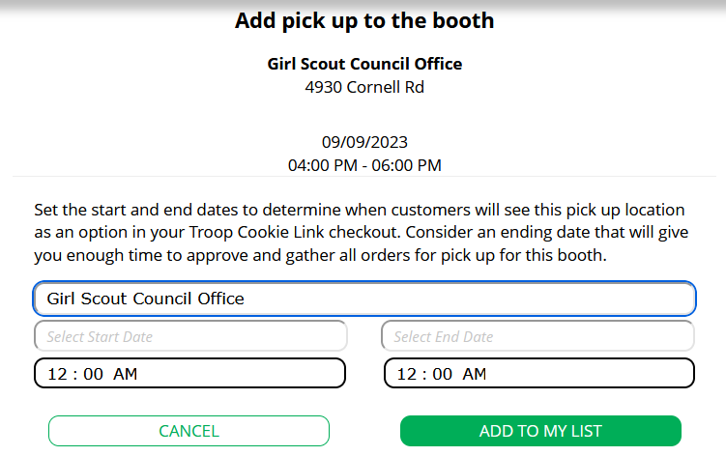
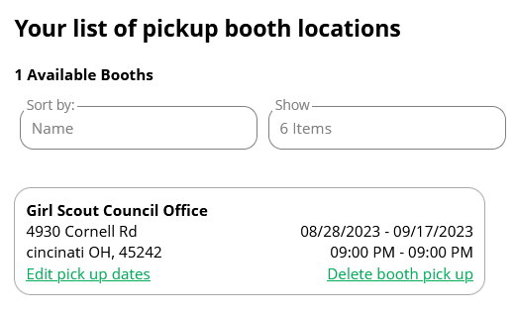
Virtual Booths Tab
Click “Add pick up option”
Set date and times
Cookie Booths the troop has signed up for in your baker system
Edit or delete if necessary
Notes:
Your Virtual Booths tab is a place where you can add the option for customers to place an order online and pick it up at your troop’s upcoming cookie booth.
To activate that option for your troop customers, there are just a few steps to set up that option using the cookie booths you have signed up for.
Start by selecting an existing cookie booth from your list by clicking on “Add pick up option”
Once you have selected a booth to add a pickup option for customers to, you will need to enter a few details about when the customer will see that pickup location as an option.
NOTE! Consider ending that option 12-24 hours before the booth sale will begin so you have time to review and approve all orders. If you have concerns about inventory for pickup orders, consider ending the option even earlier so you can secure the necessary product for the orders.
If you need to edit or delete your pickup locations, you can view your list of pickup locations and edit or delete them.
Important! If you cancel a booth in the bakers system, you must delete the booth from here so customers can no longer select it as a pick-up option.
Check your orders tab for any orders that were scheduled to be picked up and make alternate arrangements or cancel and refund them

Slide 23
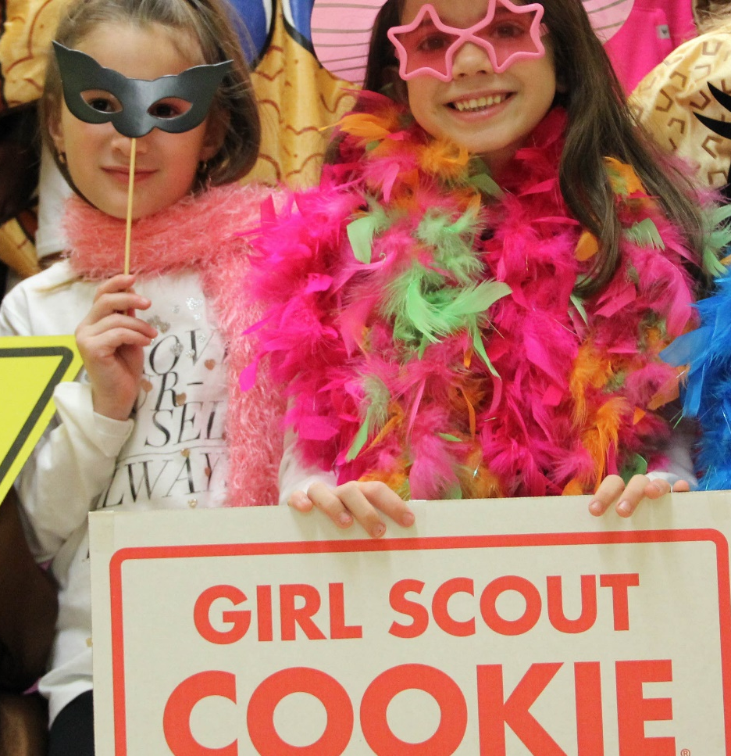
Questions?

Slide 24
Appendix

Slide 25
Registration Issues-Self Help
Type here to enter the presentation section name.
Notes:
Note to council: If you want to show the Digital Cookie Help Center slides, bring them over from the parent training.

Slide 26
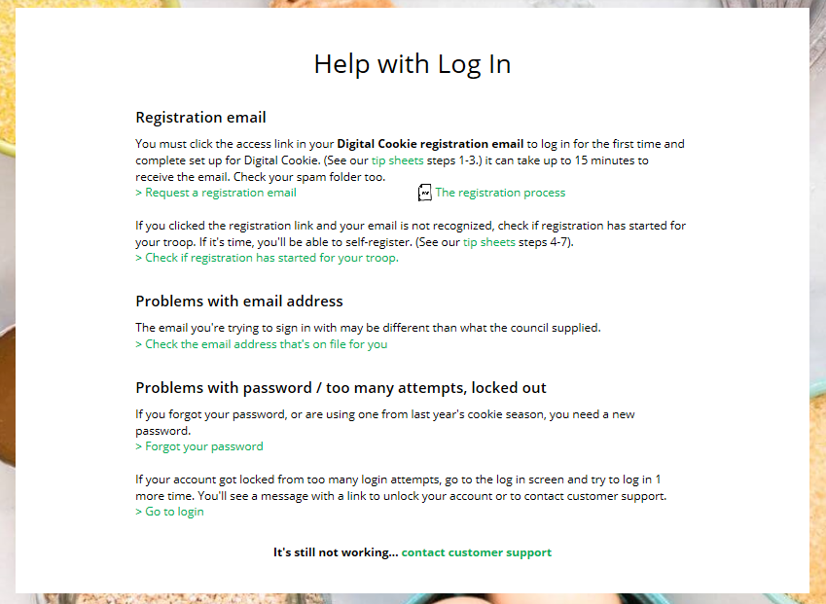
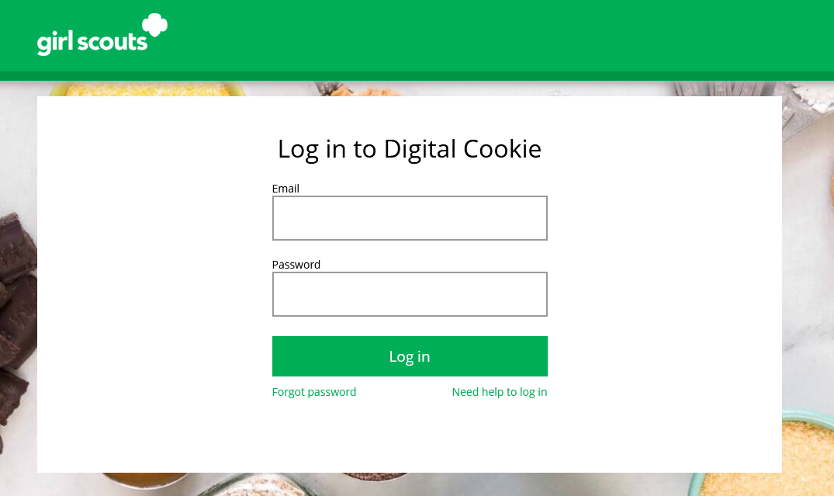
Registration Issues-Self Help
Getting to Registration Success
Check spam/junk/promotions inbox for an email from “Girl Scout Cookies”(email@email.girlscouts.org)
Click “Need help to log in” link
Request a registration email
Notes:
In order to receive a Digital Cookie registration, a Girl Scout must be registered for the current membership year and the Girl Scout council will need to have the correct email address on file for her primary caregiver. If you have opted out of receiving emails from the council, skip to Step 4.
Step 1: Check your junk/spam/promotions inbox one more time for an email from “Girl Scout Cookies” (email@email.girlscouts.org) with the subject “It’s time to register your Girl Scout for Digital Cookie!”. If you do not see the email, follow these steps to get registered for Digital Cookie.
Step 2: Go to digitalcookie.girlscouts.org and click the “Need help to log in” link.
(For best results, use the most up to date web browsers)
Start by clicking on the “Request a Registration Email”

Slide 27
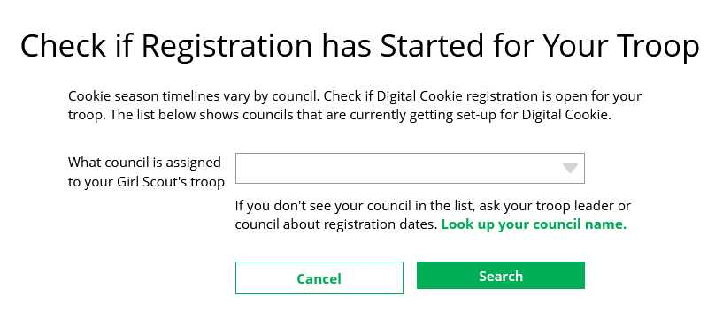
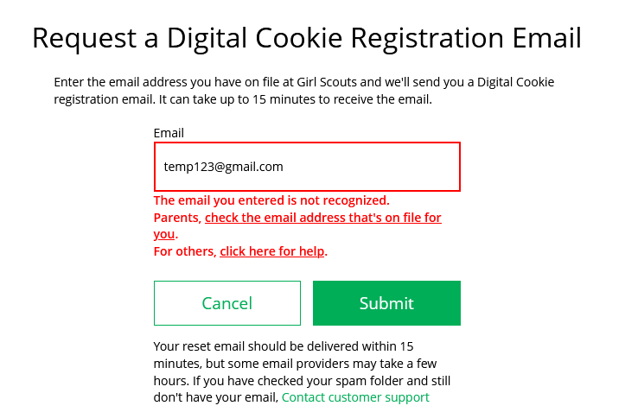
Getting to Registration Success
If not on file, user gets error message. Can check what’s in the system for them.
Select your council from the drop down.
Notes:
Enter the email address that you used to register your Girl Scout. If your email is in the system, you will get a message letting you know that you have been sent a registration email and you will receive it within 15 minutes.
If you get a red message: “The email you entered is not recognized” and you think your Girl Scout is a registered Girl Scout member with your local council, you can choose “check the email address that’s on file for you”
You will be taken to a new screen where you will select your Girl Scout Council from the drop down.

Slide 28
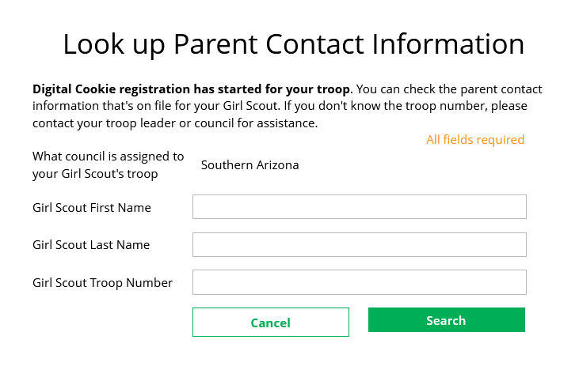
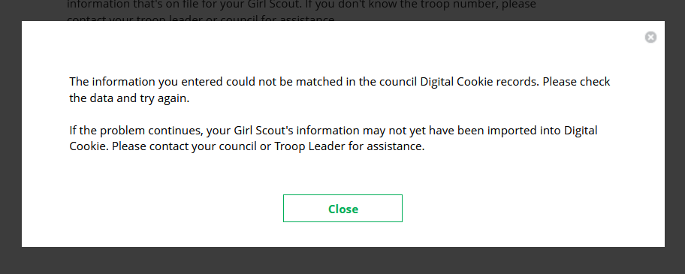
Getting to Registration Success
Enter Girl Scout name and troop number
Council Name
If information provided doesn’t match anything on file, a message pops up.
Notes:
Then enter your Girl Scout’s first name, last name, and troop number.
If your Girl Scout’s information is not in the system or not in the system the way you entered it, you will get a message letting you know you will need to contact your council, Troop Leader, or Customer Support for assistance.

Slide 29
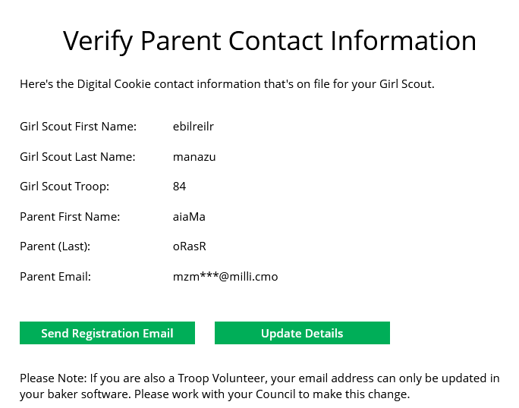
Getting to Registration Success
If the girl and parent info is in DOC, the information appears and can be updated if necessary.
Note! If user is also a volunteer, they can not update their details here. A message will pop up to let them know they need to update their information in their baker’s system.
Notes:
If the Girl Scout and her primary caregiver information is loaded into the Digital Cookie system, you will see the information in order to verify that it’s correct.
If the information is correct, you can send a registration email knowing what email address you should use to look for the email.
If the primary caregiver information is incorrect, click on the “Update Details” button.
NOTE: if you are also a cookie volunteer you will need to update your email address in the baker software.

Slide 30
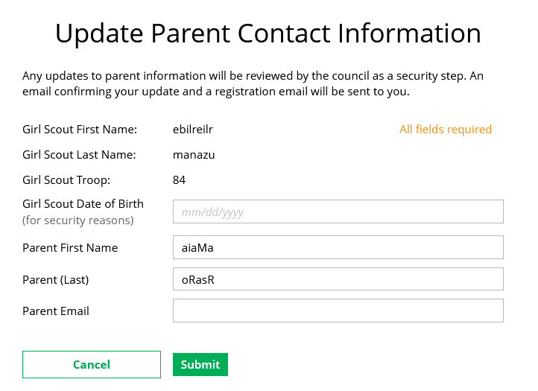
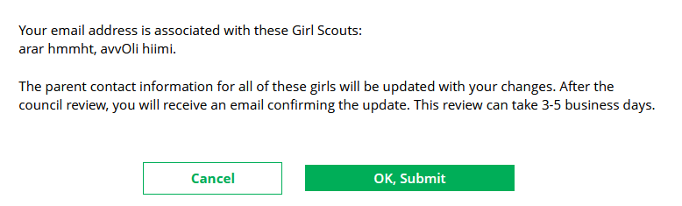
Getting to Registration Success
Update details and submit the changes. Council needs to approve the updates.
Warning if more than one girl will be updated
Notes:
To update your information, you will need to enter your Girl Scout’s Date of Birth as a security measure, then you can update your name and/or email address.
If the Girl Scout is imported but her caregiver information is not on file, you can add the caregiver information.
You will get a success message once you submit your changes; if more than one girl is associated with the email, you will receive the message that all accounts will be updated.
Your council will then review the updates and approve or reject the updates. You will receive an email notification when they have completed that step.

