Slide 1
Digital Cookie Parent Training ::GSCM 2024::
©2021 Girl Scouts of the USA. All Rights Reserved. CONFIDENTIAL-Not for public distribution.

Slide 2
Four Steps to Getting Started
Digital Cookie Tabs
Customer View
Mobile App
Digital Cookie Help Center

Slide 3
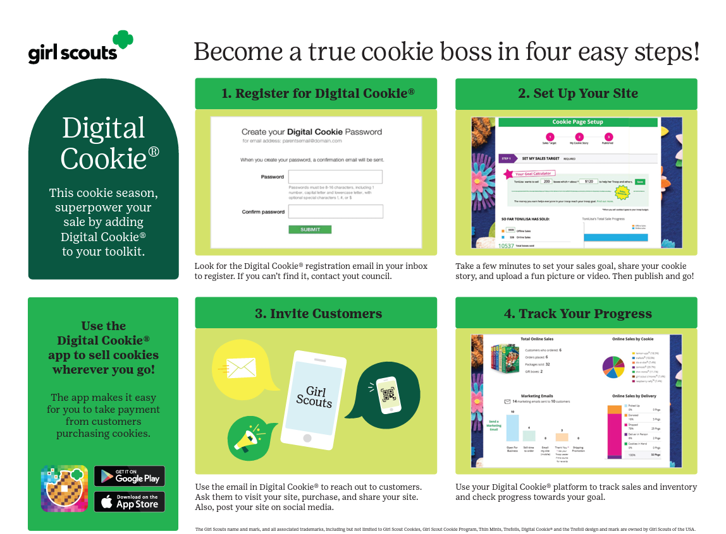
Four Steps to Getting Started
Notes:
Copy can be downloaded from GSCM.org/cookies.

Slide 4
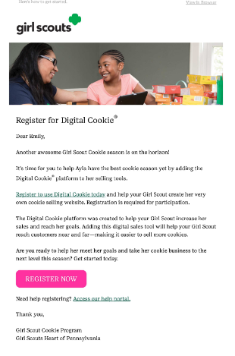
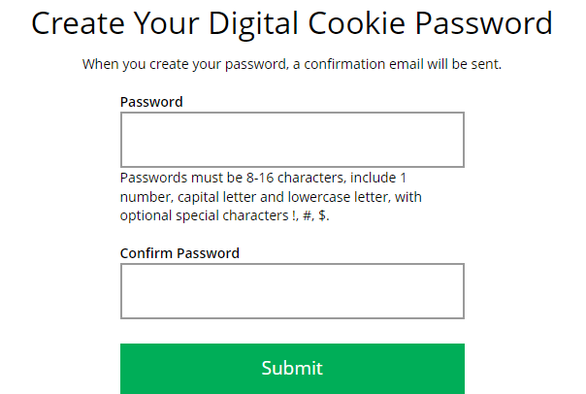
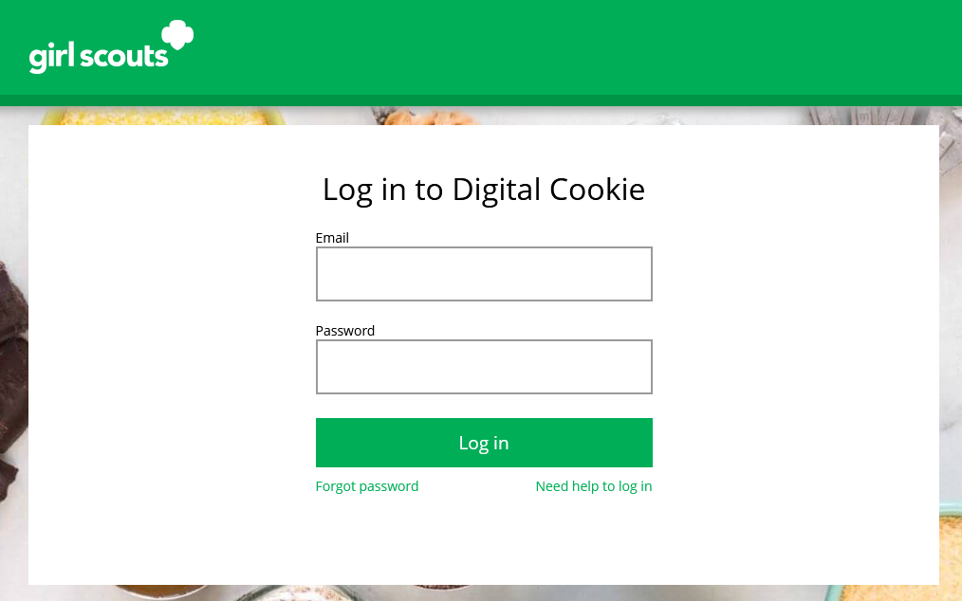
Step 1-Register
DATE-Volunteer Registration email
DATE-Parent Registration email
Sender: “Girl Scout Cookies” email@email.girlscouts.org
Subject: It’s time to register your Girl Scout for Digital Cookie!
Create Password/Login with password
Click: “Register Now”
Notes:
Note to councils: Customize the dates for when registration emails will be sent.
Watch for your registration email* from “Girl Scout Cookies” (email@email.girlscouts.org) with the subject “It’s time to register your Girl Scout for Digital Cookie!” on ::ENTER COUNCIL DATE:: Search your “Promotions/Clutter/Spam” folder too.
Click on the link in the email to be taken to the Digital Cookie site to create a password and login with that password.

Slide 5
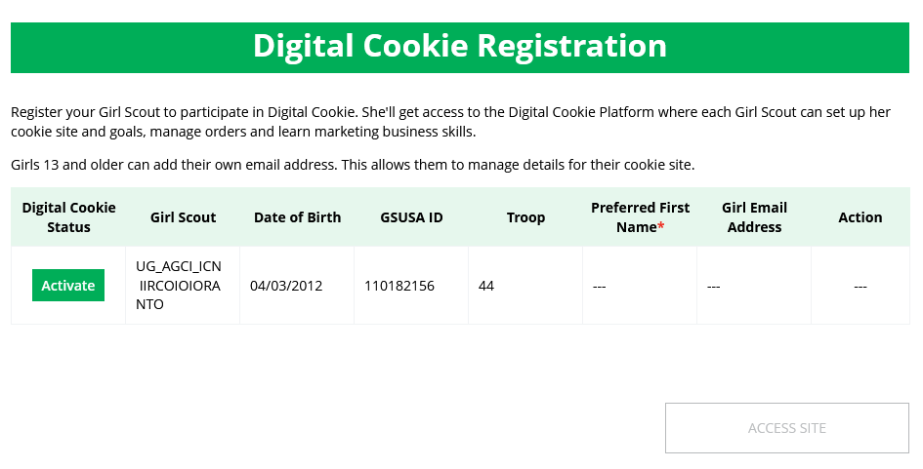
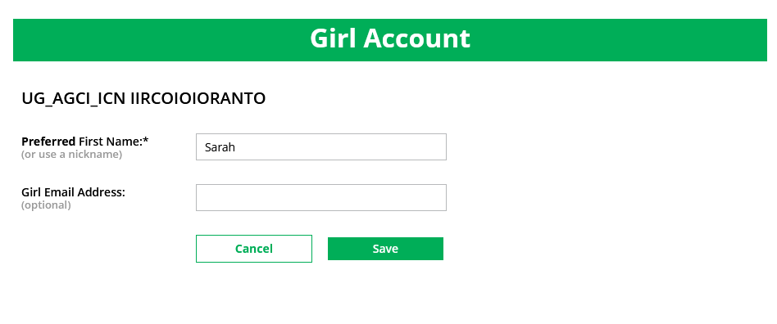
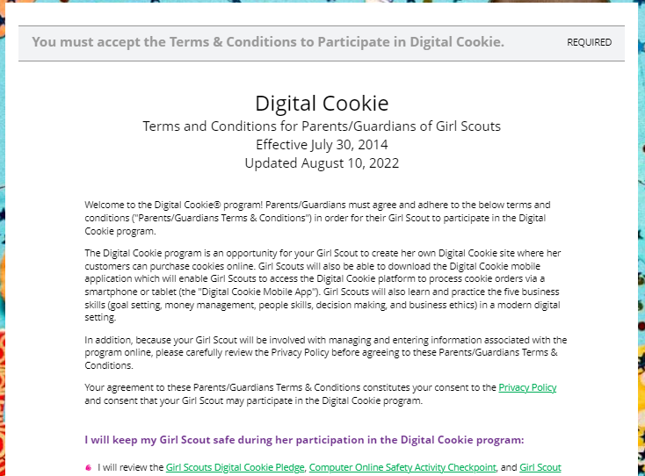
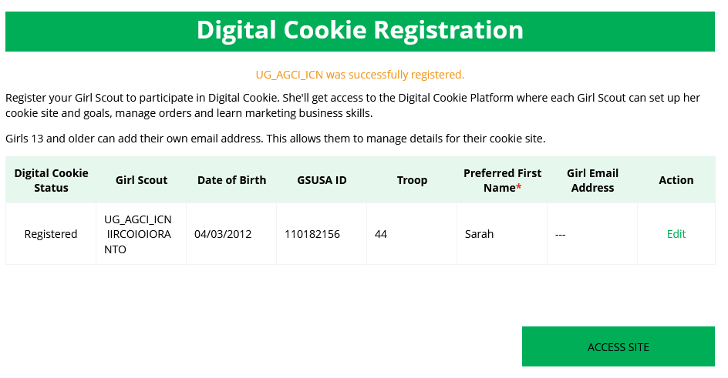
Step 1-Register
View Safety Video/Approve Terms and Conditions/Safety Pledge
Select View/Activate Girls
Click to activate Girl Scouts
Continue button will turn green after video
Check box to accept
Continue
Notes:
When you first log in, you will have the “Safe Selling for Smart Cookies” safety video pop-up to watch and review with your Girl Scout(s). Continue button will turn green after video. You can’t proceed any further until the full video has been viewed
Read and accept the Terms and Conditions agreement. Note, if you are a volunteer, you will first see an additional Terms and Conditions for Volunteers.
Next, the “Girl Scout Safety Pledge” will appear. Be sure to read it to/with your Girl Scout(s). Then check the box for “accept” and click “continue.”
You will then be taken to a screen to activate your Girl Scout(s) for the Digital Cookie program and update their preferred name if desired.
If the Girl Scout you are activating is 13 or older, you have the option to enter her email address and she will complete her own registration process. (Note, the email address for a girl 13+ must be unique and not in use in Digital Cookie)
Girl Scouts under 13 will login in partnership with their caregiver and do not need a separate email address.
After activating all of your Girl Scouts (if you have multiple), you will click the “Access Site” button to be taken to the first Girl Scout’s home page. Once you have registered, watch your inbox for a registration confirmation email and save this email where you can find it during cookie season!
Note to councils: If caregivers are both volunteer AND parent, they will only walk through this process once. If parent access is after volunteer access, they will not see the parent Terms and Conditions the parent role until parent access date starts.

Slide 6
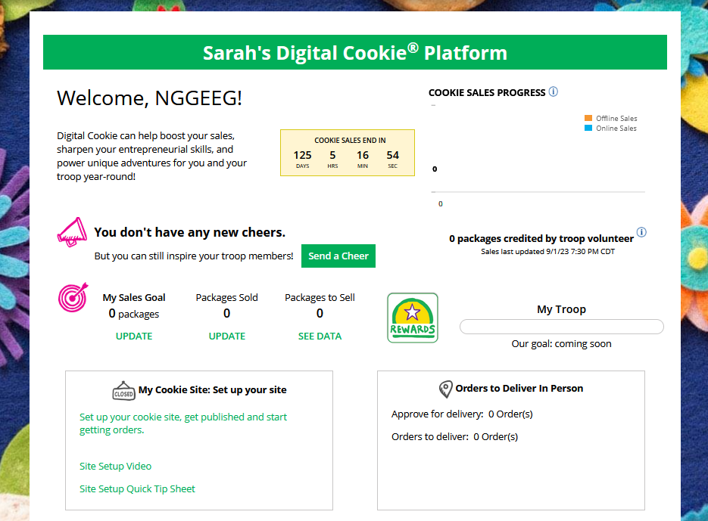
Step 2-Setup Your Site
Have multiple Girl Scouts? Easily switch between each site here.
To setup the Girl Scout’s cookie site, click on the “Set up your Digital Cookie site…” link in the My Cookie Site section, or the “Site Setup” link at the top.
Notes:
To setup the Girl Scout’s cookie site, click on the “Set up your Digital Cookie site…” link in the “My Cookie Site” section, or the “Site Setup” at the top

Slide 7
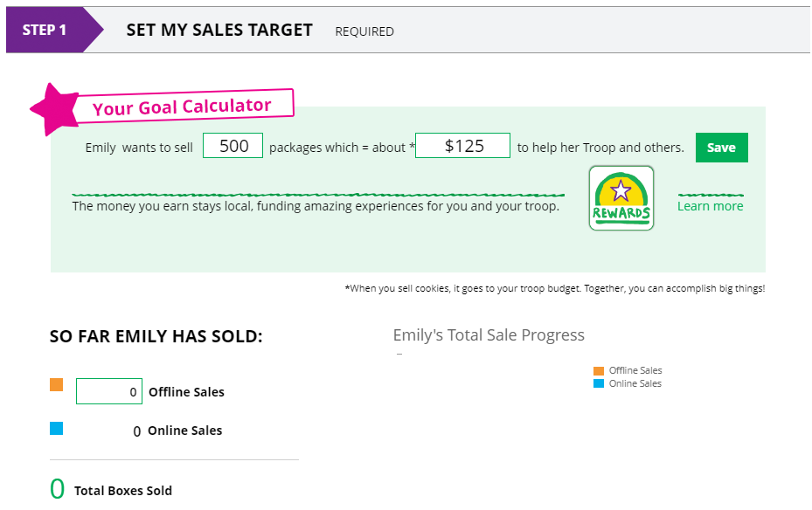
Goal Setting: Set My Sales Target
Step 2-Setup Your Site
2
1
3
4
Notes:
Goal Setting: Set My Sales Target
Girl Scouts enter how many packages of cookies they are working to sell this year through online and offline sales.
When the information is entered, the calculator will show how much money the troop will get from her hard work.
Clicking on “Rewards” will take you to your council’s rewards tab (if available) to see what rewards the Girl Scout might want to work towards.
Girl Scouts can enter any offline packages they have sold so their customers will see their total sales, not just their digital sales.

Slide 8
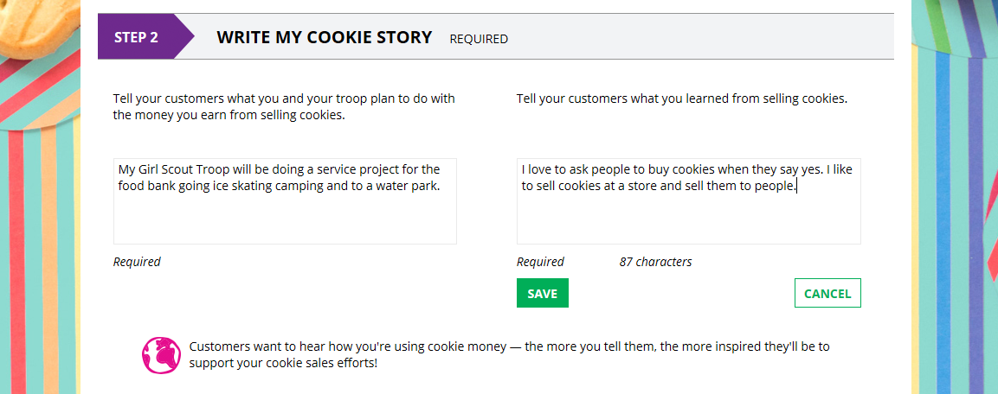
My Cookie Story
Step 2-Setup Your Site
1
2
3
Notes:
My Cookie Story
Girl Scouts tell their customers about a troop goal and why it’s important.
Girl Scouts share what they’ve learned from the cookie program.
Save their story. They can make edits to it at any time.

Slide 9
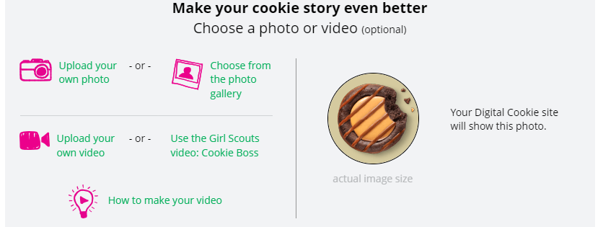
Photo/Video Upload
Step 2-Setup Your Site
Girl Scouts who uploaded a photo or video of themselves sold more than double the boxes on average than those who did not.
1
2
3
Notes:
Photo/Video Upload
1. Girl Scouts can choose to upload a photo or use a picture from the gallery.
2. Or, Girl Scouts can upload a video or use the “Cookie Boss” video.
3. Bonus! Girl Scouts can get tips on how to make a great video.

Slide 10
Approve and Publish
Step 2-Setup Your Site
If your button only says “see your site” you may be missing some required fields or didn’t make any changes. Go back and check that everything has been completed.
Click to edit
Click to review and publish
Notes:
You will see what the customer will see. Some things to check:
Is the spelling and grammar correct and does it tell a story?
Make sure the photo or video are displaying correctly.
Are the goals accurate?
If you need to change anything, click Edit and make changes, then go back to Step 2a.
If it looks good, approve and publish it.
Your Girl Scout’s cookie store now has its own website! If your council’s digital cookie sale hasn’t started, the link will not be active yet.
Council Note: Girls 13+ green button says, “see your site and submit for approval”. They see preview and can edit. Parent is sent an email to approve the girl’s site. Parent logs into Digital Cookie, goes to the girl’s preview and approves it.

Slide 11
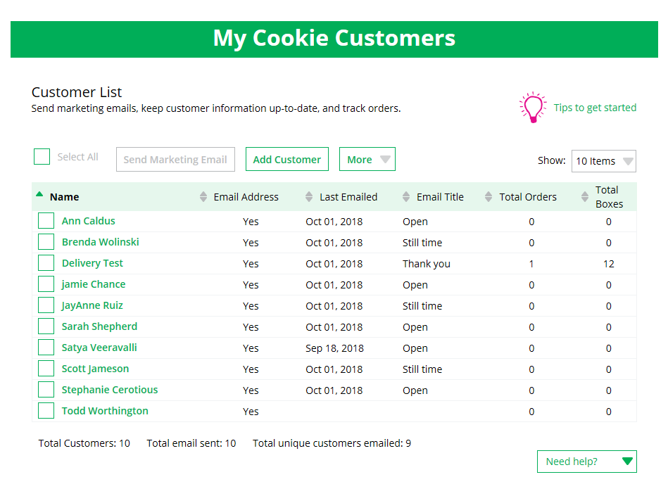
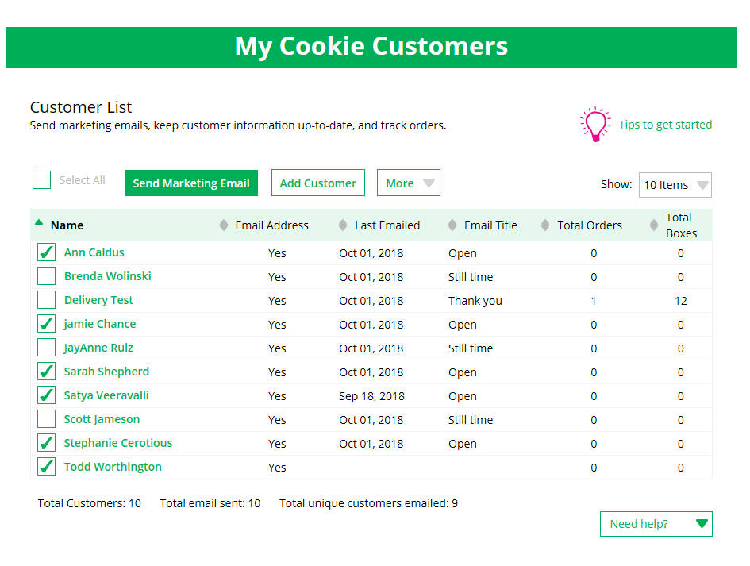
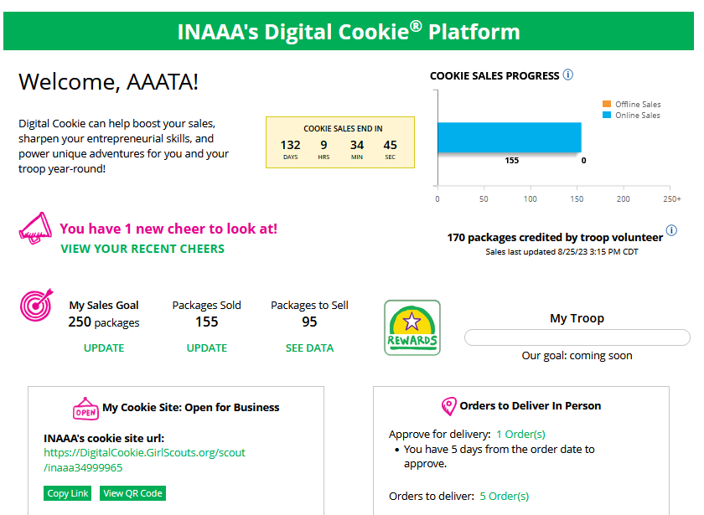
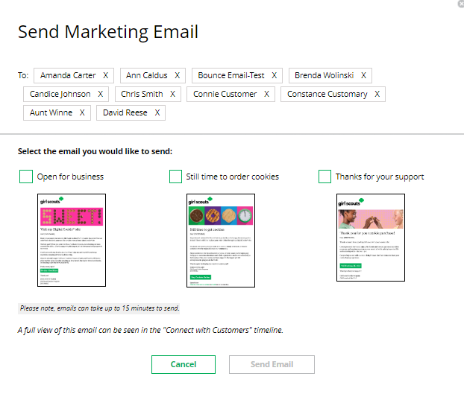
Step 3-Invite Customers (when cookie sales start)
Copy URL
Email link or share QR code
Add or import customers
Send one of three marketing emails
1
2
OR
4
3
Notes:
Girls can add customers individually or import. Great opportunity to import from fall sale customer list. Work is already done!
To send emails, click on box in front of customer name and click “send marketing email”
Select which email to send “Open for business” “there’s still time” “thank you”
Customer page updates with which email was sent and when
Girl Scouts can also send customers a link to their Digital Cookie website OR generate a QR code for them to use directly from their home page.
Customers who purchase directly from a link won’t be reflected as an email sent in the totals. But their orders are treated the same no matter how they reached their website.
Additional notes:
Clicking on a customer’s name brings up more information about the customer, including details about any orders.
At the end of the sale girls can export their customer list to use in the fall sale

Slide 12
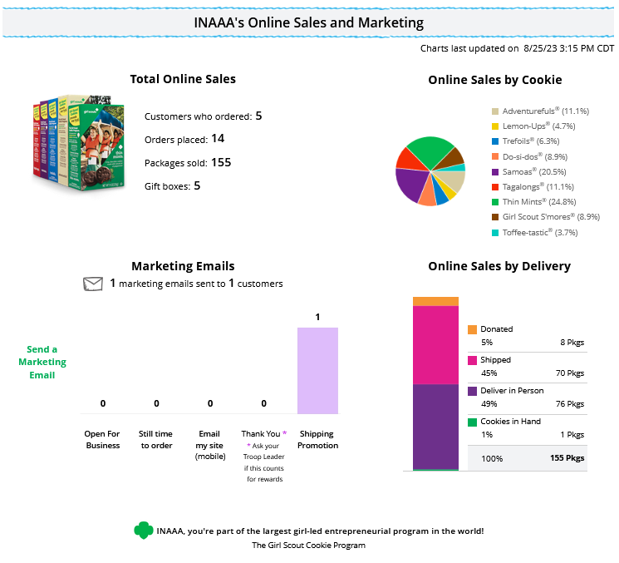
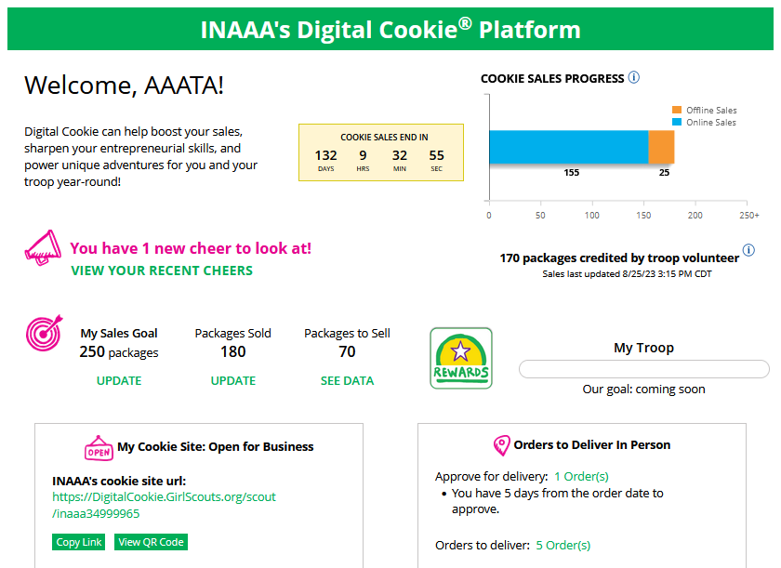
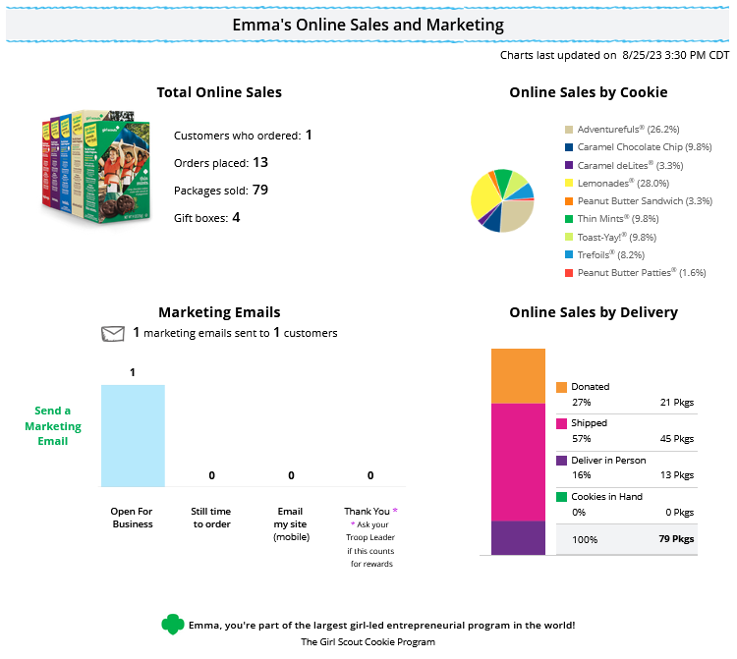
Step 4-Track Your Goal
Notes:
Note to council: delete graphic with other baker’s cookies on it.
Girl Scouts LOVE to see their progress update with sales
Donated and In hand orders appear right away
Shipped orders appear in the graph when the order ships. This can take a few days, orders don’t ship on weekends and holidays
In-person delivery orders appear when the order is approved
Girl Scouts can go to click the update under “Packages Sold” to enter additional “offline” sales, so customers see a true representation of her sales. The closer they get to their goal; the more customers really want to make a difference to help them reach that goal
Right side is the bottom of the home page.
Girl Scouts have other sales and marketing tools to help them keep track of their sale.

Slide 13
Digital Cookie Tabs
Badges
Learning
Orders
My Rewards
My Cookies
Cheers

Slide 14
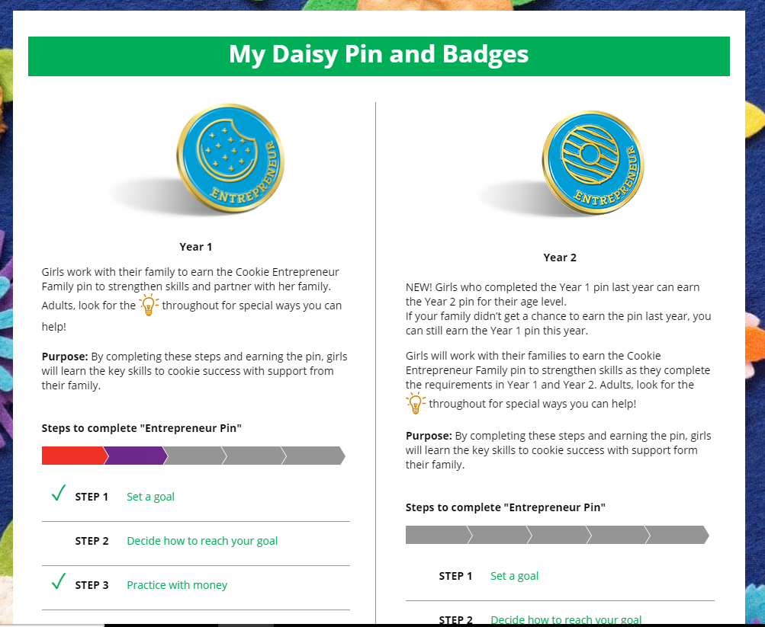
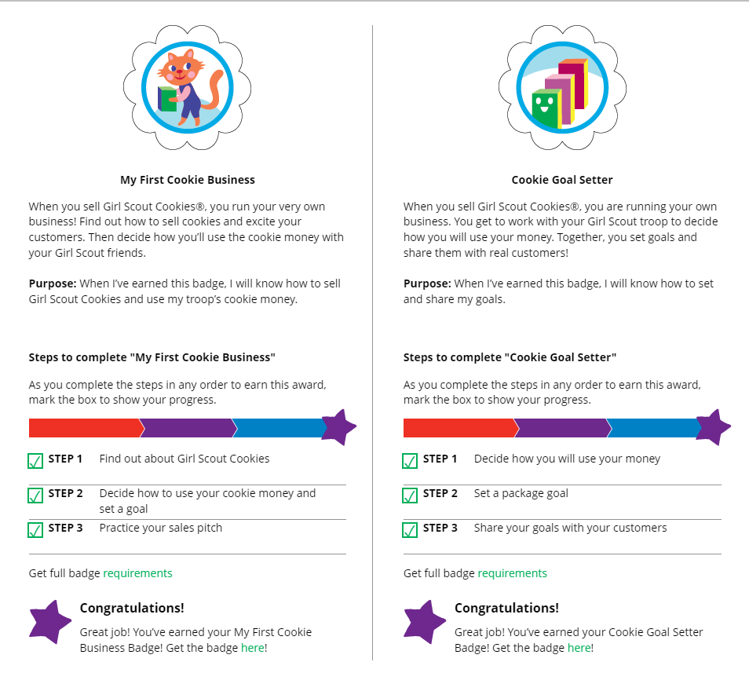
Badges Tab
Notes:
You’ll be taken to a page that displays the Cookie Entrepreneur Family Pins and the Cookie Business badges appropriate to your Girl Scout’s level.
For the badges, Girl Scouts can read an overview of the steps. For full details, she can check with the troop volunteer or purchase the online requirements using the shop link or from your local council store.
For the Cookie Entrepreneur Family Pins, Girl Scouts can click on the instructions for each step
The instructions for that step of the pin will pop up. She can click on the link to complete any activities in Digital Cookie, and once completed the Girl Scout will click the box next to each step.
When the box for the last step in earning that pin is checked, a pop-up will appear asking to confirm the Girl Scout completed the last step. Once confirmed, she can’t go back.
Girl Scouts can mark the steps as completed even if they finished the badge earlier.
If she wants to do the steps again, she can—they are all great tools for her cookie sale. When she has completed all the steps, a star will appear at the end of her progress bar, and she will get a message of congratulations!
Once the Girl Scout has completed her badge or pin, it will display in color on her home page.

Slide 15
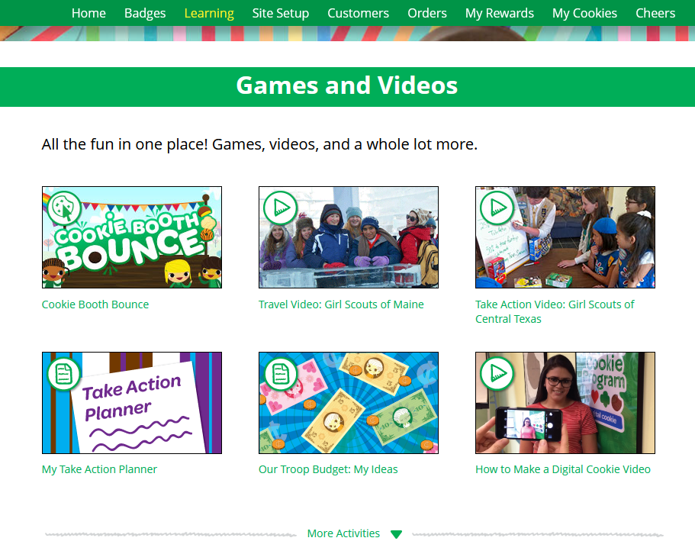
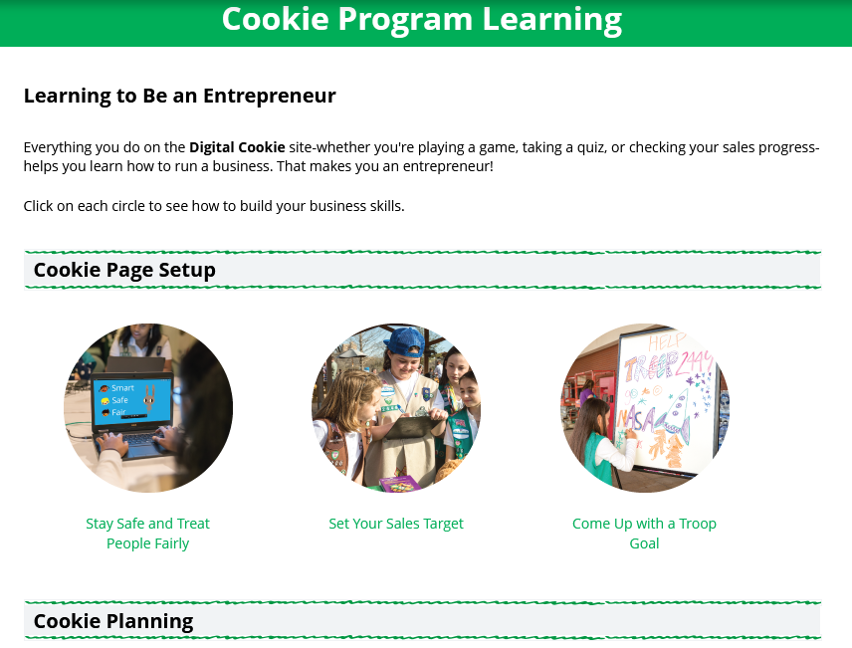
Learning Tab
Notes:
Offerings vary by age.
Click “more activities” to see them all.
Also has printables, videos, Daisy: Cookie Booth Theater, Daisy/brownie: cookie song, Juniors & up has more videos of girls using their cookie earnings for take action projects and travel.

Slide 16
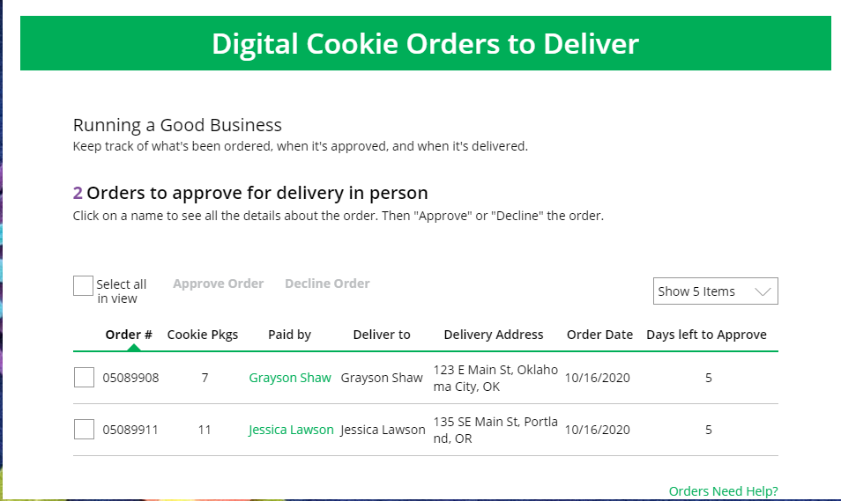
Orders Tab: In-person Delivery Orders
Click on the “Paid by” name to review customer and order details
When determining whether to approve or decline the order, consider:
Is the customer a known and trusted individual?
Are you willing and able to get the cookies to the customer’s location before the end of the sale.
AND
Do you have or will you have the inventory available?
If so, “Approve Order.”
Notes:
In-person delivery orders
If Girl Scouts receive an In-Person Delivery order that needs to be approve and you have not approved the order by midnight, you will receive an email from email@email.girlscouts.org with the subject “Action required: you have an in-person delivery request!” letting you know your Girl Scout has received an order for delivery.
On the orders tab, you will see a list of all orders needing approval, including the customer order number, number of packages in each order, the customer’s address, when the customer placed the order, and the number of days you have to approve it until it reverts to the customer’s second choice option.
Orders must be approved or declined with in 5 days or the order will be automatically declined.
::Read slide on determining whether to approve order::
If caregivers are unable or unwilling to fulfill the customer’s order, click “Decline Order” and the order will default to whatever second option the customer has selected: “Cancel” or “Donate”.

Slide 17
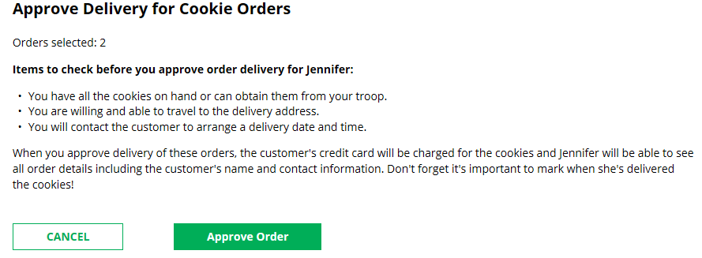
Orders Tab: In-person Delivery Orders
Approving/Declining Orders in Bulk
Check box
Once you approve or decline you can’t change the action and an email is deployed to the customer.
Notes:
There are multiple ways to approve and decline orders for delivery. You can approve orders in bulk here.
Check the boxes in front of the orders you want to approve or decline and then click “Approve Order” or “Decline Order”
You will get a pop-up message confirming you want to approve all of the orders you selected and can deliver them to the customer

Slide 18
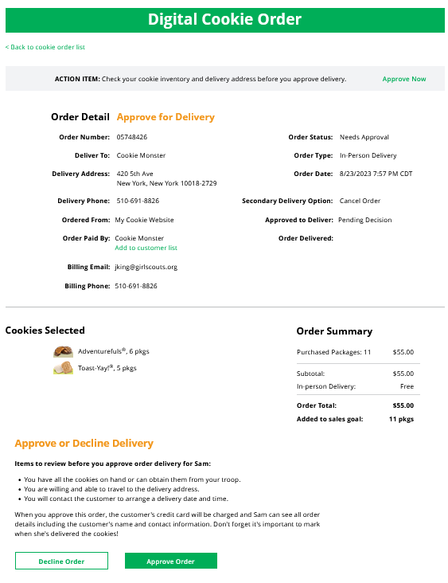
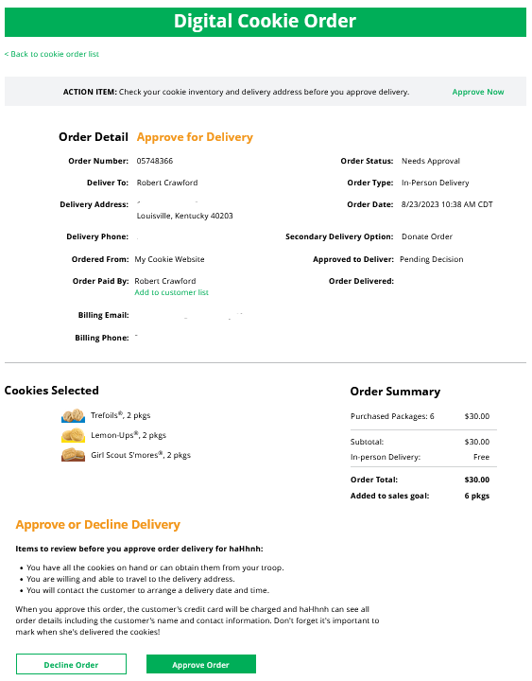
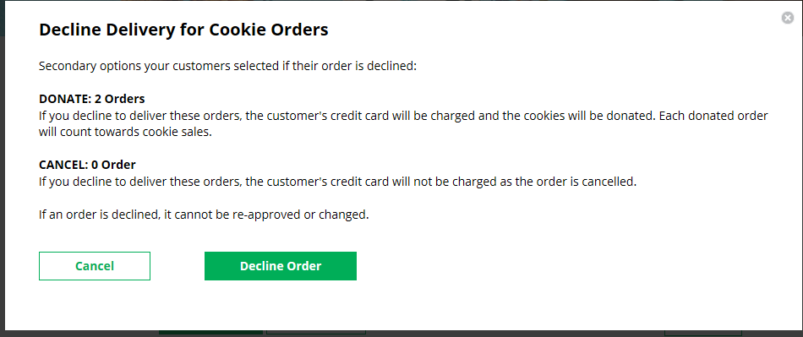
Orders Tab: In-person Delivery Orders
Once approved: customers receive an email to expect their cookies within two weeks of when you have them.
Approving/Declining Orders Individually
Notes:
Note to council: Delete graphic with other baker’s cookies on it.
The second way to approve orders individually:
Click on the individual customer to bring up that person’s order details and click “Decline Order” or “Approve Order” at the bottom.
If you decline the order, you will get a pop-up message confirming you want to decline the order and understand if the order is being cancelled or donated.

Slide 19
Orders Tab: In-person Delivery Orders
Orders to Deliver
Orders must be marked as delivered to update cookie inventory correctly.
Select all
OR
Select a customer
Notes:
Once you have delivered the cookies, log back into Digital Cookie and mark those orders delivered.
There are two ways to indicate you have delivered your order:
Check the “Select All” box to select all of the orders on the page; they will all be marked “Order Delivered”.
Check the box in front of any orders you have delivered, and then click “Order Delivered.”
When they are marked as delivered, they will move down into the third section on the page as a completed order.

Slide 20
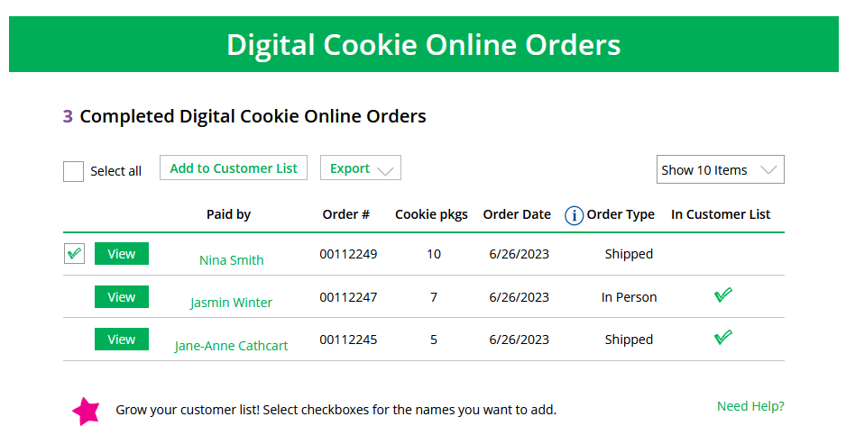
Completed Orders
Orders Tab
Customers not added to the customers list will not roll over to the following year.
.
Notes:
In the completed orders section, girls can see all orders including Shipped and donation orders.
If the customer is not in her Digital Cookie contact list, your Girl Scout can check the box in front of the customer’s name and click “Add to Customers tab.” Then, the customer will be in her records for sending thank-you emails this year and marketing emails next year for repeat business.

Slide 21
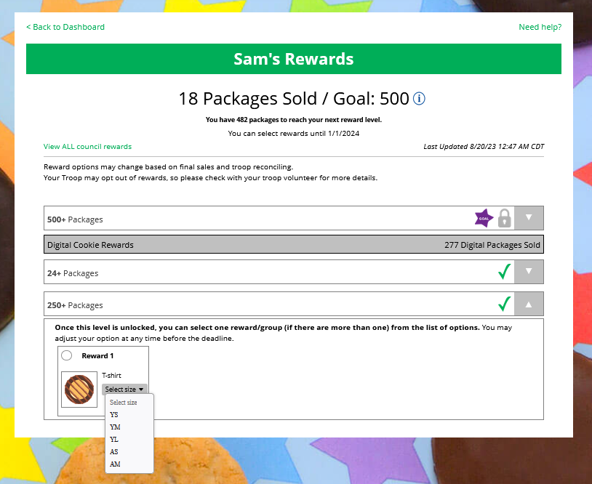
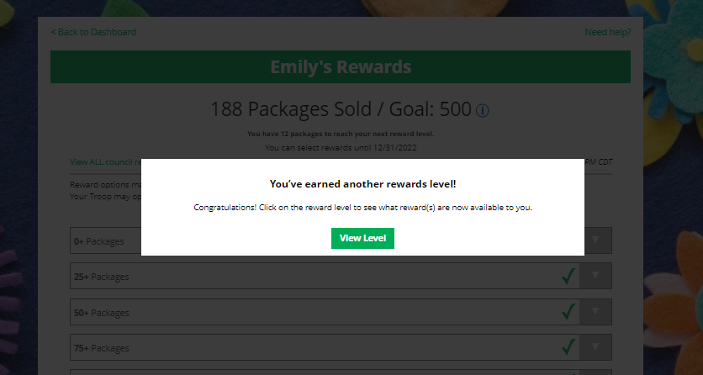
My Rewards Tab
Purple star =Goal
Earned Reward
As Girl Scouts earns a reward, they will see a message on their “My Rewards” tab letting them know they earned another reward.
Select Size
Notes:
Note to councils: Remove if you are not offering this feature.
Girl Scouts can see the rewards they can earn for selling cookie packages, get more details about each reward, and select which ones they want when they unlock a new reward level through sales.
Girl Scouts can also see where their cookie goal is in relation to the rewards!
Girl Scouts can see all the rewards they can earn by clicking on the down arrow on the right side. It may still be locked, which means the Girl Scout hasn’t yet sold enough packages to earn the reward, but they can still see the rewards and get more details by clicking on them.
The data for what rewards the Girl Scout has earned comes from the amount of cookies the troop volunteer has in their records for the Girl Scout. Check with the troop volunteer if you believe the information is incorrect.
Not all rewards are represented here. System can’t accommodate GOC rewards, PGA rewards, etc.
Girl selections do not feed directly baker system. Leader needs to pull the report and enter. But having Girl Scouts select choices and sizes here cuts down on the amount of work the leader has to do at the end of the sale.

Slide 22
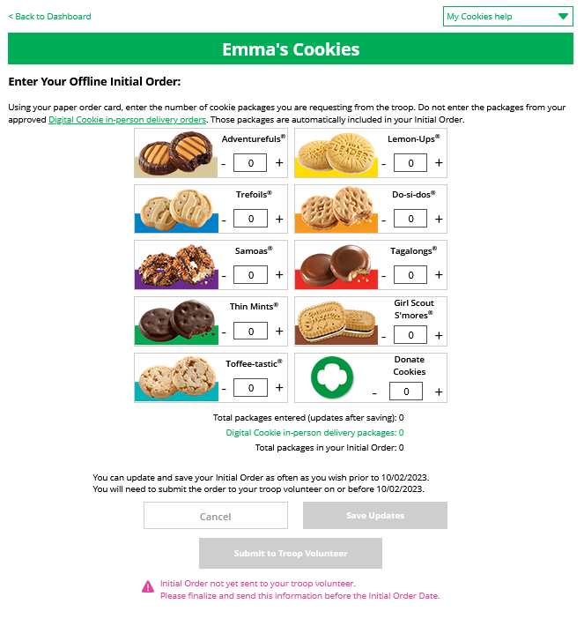
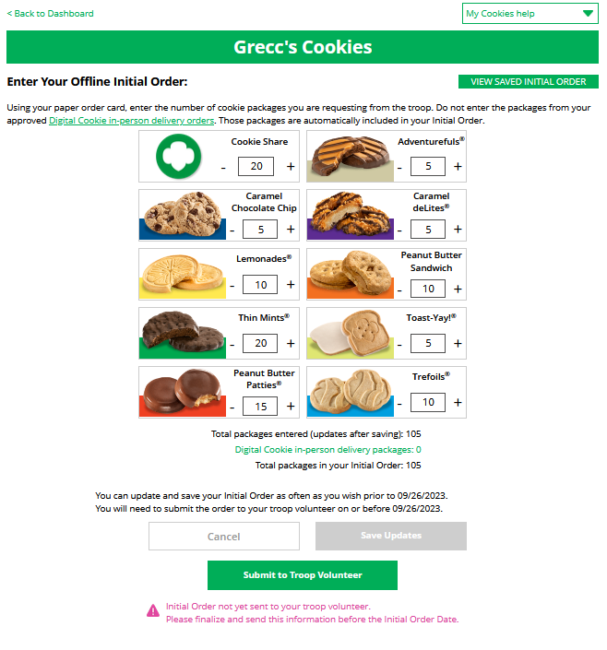
My Cookies-Initial Order Entry
Online girl delivery orders are already included. Do not add them again.
Once submitted, the order will flow to the baker’s ordering system.
Notes:
Note to councils: Remove if you are not offering this feature or you are a Direct Sale council, if you are using this feature remove the image with the other baker's cookies.
Enter the cookies your Girl Scout needs to fill the orders from her paper order card (and any extras you may want). Do NOT include any in-person delivery orders received online prior to the initial order, those are already ordered for you.
This will need to be completed prior to the due date noted above the “Save Updates” button. After the due date, you can’t make edits to the numbers on this section, and it will only appear at the top of your “My Cookies” dashboard to view.
Once the initial order has been submitted to the troop volunteer, the order will transmit to the baker’s ordering entry system.

Slide 23
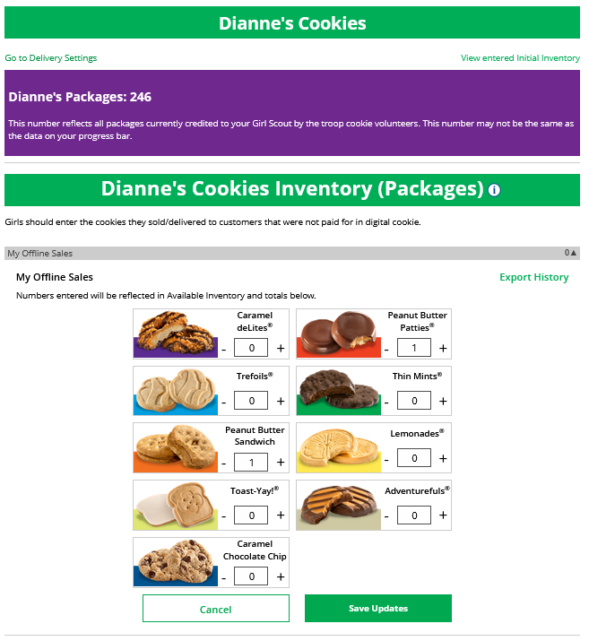
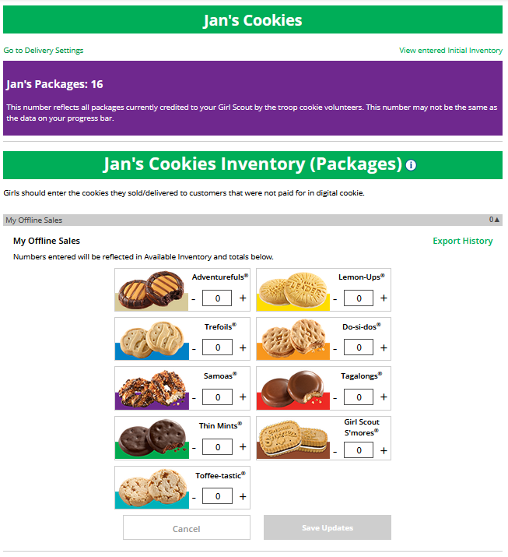
My Cookies Tab-Inventory: Offline Sales Entry
The total number of packages that have been allocated to your Girl Scout from the troop cookie volunteer.
Offline sales need to be updated by the Girl Scout/caregiver when the Girl Scout delivers cookies not ordered/paid for through Digital Cookie.
1
1
2
2
Notes:
Note to councils: Remove the image with the other baker's cookies.
Digital Cookie can help you make sure that you have enough cookies for your orders, track your progress on delivering/selling offline orders AND/OR make sure that your records of cookies received agrees with what your troop cookie volunteer has given your Girl Scout.
The top part of your dashboard shows the total number of packages that have been allocated to your Girl Scout from the troop cookie volunteer. It could include booth sales or troop sales. It is not the same as the number of cookies you are personally responsible for.
The inventory section gives you a quick view of how many cookies you should still have undelivered and how many you may need to fill your in-person orders.
“My Offline Sales” This is something that needs to be updated by the Girl Scout/her caregiver when she delivers cookies and receives a cash or check payment for them. If they are not entered in this section, they will not be removed from her inventory and this section will not be correct.
To enter offline sales, click the down arrow by the number of packages on the left side and open a screen to enter those sales. When those are entered, click “Save Updates”
Once you click Save Updates, you will be asked to confirm you want to update the inventory.

Slide 24
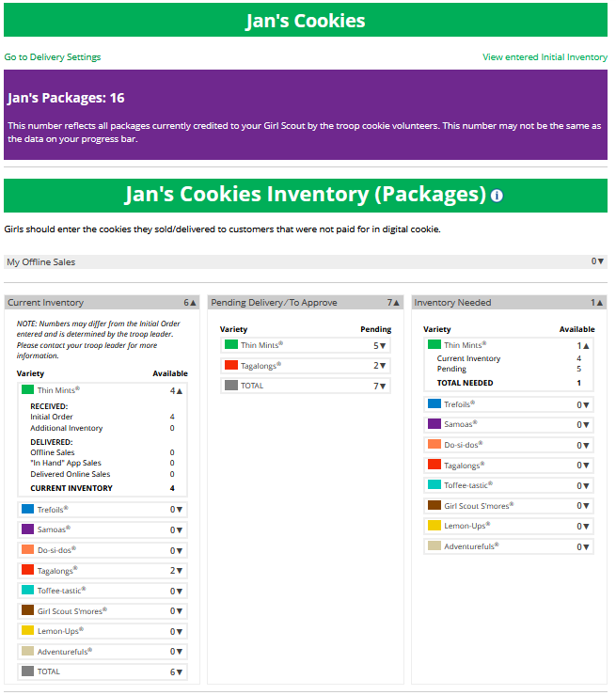
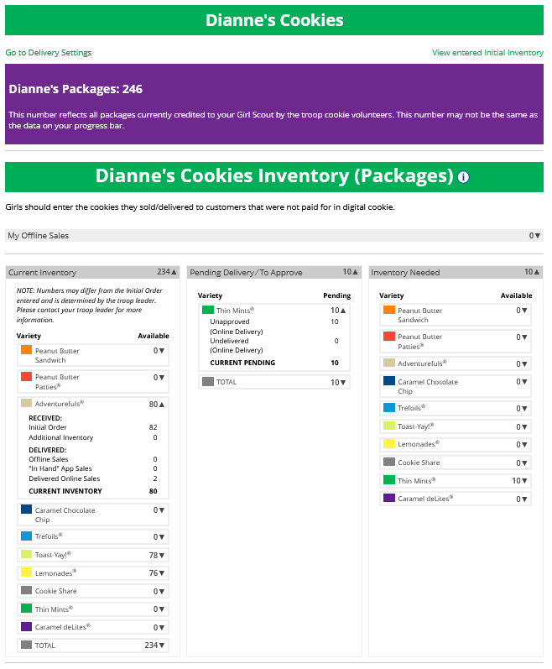
My Cookies Tab-Inventory by Variety cont.
Current Inventory
Pending Delivery/To Approve
Inventory Needed
1
2
3
1
2
3
Notes:
Note to councils: Remove if you are a category council, if you are using this slide remove the image with the other baker's cookies.
There are three other sections that calculate your inventory. The first is “Current Inventory”. Clicking the arrow next to the total number of packages will show you this information by variety.
If you click the arrow next to any of the varieties, you will see more detail on how that number was calculated.
The “Received” numbers come from the information the Troop Cookie Volunteer has of how many cookies you have received and signed for. If you believe there is an error in this, please contact your Troop Cookie Volunteer.
The “Delivered” section will reflect the Offline Sales the Girl Scout has entered above, any sales the Girl Scout made on her Mobile app using the “Give Cookies to Customer Now” feature and any girl delivery orders that have been delivered and marked delivered to her customer on the orders tab.
The next section will show how many cookies you need to fill girl delivery orders you have approved and girl delivery orders that you have yet to approve. Expanding each variety will show you how many orders are approved and how many are needing to be approved with how much inventory you need for each of those categories.
The final inventory section is Inventory Needed. This will show if you need any packages of cookies to fill your orders. Expanding any of the sections that show a number will show you how many you need and why. If you see a number for a variety in this column, be sure you can get the cookies you need before approving an order for a customer.
If you have questions about any of the numbers of received orders listed in your Current Inventory, ask your Troop Cookie Volunteer for more information.
Remember, it may take the volunteer a few days to enter transactions, so be patient if you have received cookies from the troop that need to be entered.

Slide 25
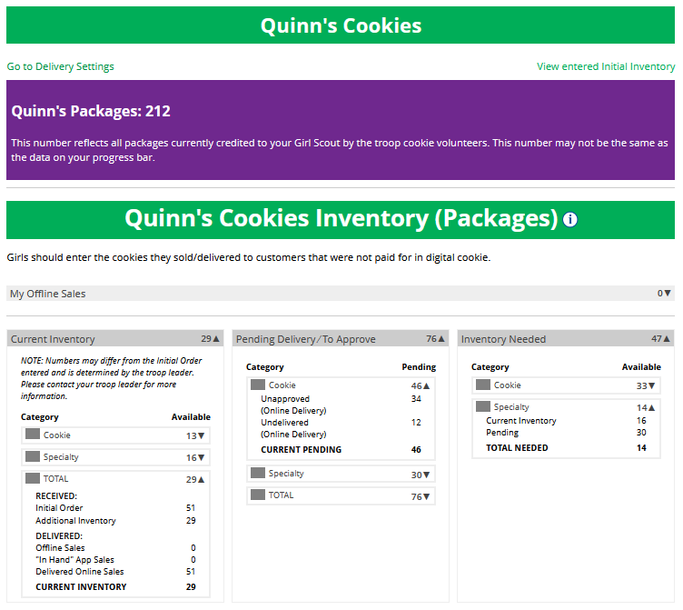
My Cookies Tab-Inventory by Category
Current Inventory
Pending Delivery/To Approve
Inventory Needed
1
2
3
Notes:
Note to councils: Remove if you are a variety council.
There are three other sections that calculate your inventory. The first is “Current Inventory”. Clicking the arrow next to the total number of packages will show you this information by type of cookie. In general, if you see “Specialty” and “Specialty 2”, those are cookies that are at a higher price than the rest of the cookies. Check with your Troop Cookie Volunteer for more information on what varieties are considered Specialty or Specialty 2.
If you click the arrow next to any of the varieties, you will see more detail on how that number was calculated.
The “Received” numbers come from the information the Troop Cookie Volunteer has of how many cookies you have received and signed for. If you believe there is an error in this, please contact your Troop Cookie Volunteer.
The “Delivered” section will reflect the Offline Sales the Girl Scout has entered above, any sales the Girl Scout made on her Mobile app using the “Give Cookies to Customer Now” feature and any girl delivery orders that have been delivered and marked delivered to her customer on the orders tab.
The next section will show how many cookies you need to fill girl delivery orders you have approved and girl delivery orders that you have yet to approve. Expanding each category will show you how many orders are approved and how many need to be approved with how much inventory you need for each of those categories.
The final inventory section is Inventory Needed. This will show if you need any packages of cookies to fill your orders. Expanding any of the sections that show a negative number will show you how many you need and why. To know what varieties are needed, you will have to review your orders tab and then work to secure more cookies to fill those orders.
If you have questions about any of the numbers of received orders in your Current Inventory section, ask your Troop Cookie Volunteer for more information.
Remember, it may take the volunteer a few days to enter transactions, so be patient if you have received cookies from the troop that need to be entered.

Slide 26
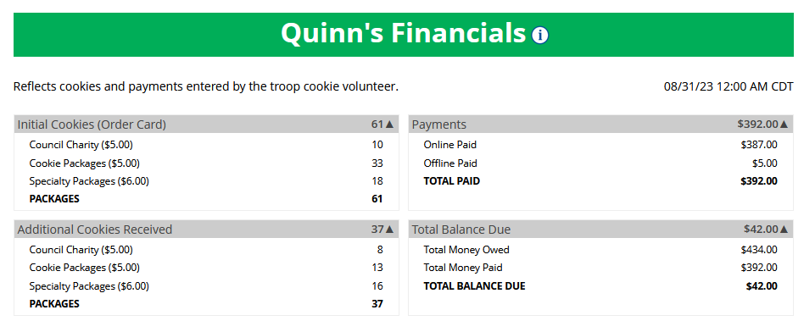
My Cookies Tab-Financials
See how much money is owed for cookies and how that has been calculated.
Notes:
The Financials section is a valuable tool to help you understand the amount due for the cookie sale and how the troop is calculating the amount.
Using the “at a glance” view is a great way to see the overall amounts paid and due. If you need more detail, you can expand any of the sections to find out more.
There are four sections to your financials that you can expand to get details.
Initial Cookies (Order Card)
This section may not apply if the council does not do initial order.
If you expand this section with the arrow, you will find information on the initial packages you received at pickup, minus any packages you received for in-person delivery orders because those were pre-paid and you do not owe for those.
You will also see any Council or Troop Charity (Cookie Share or Gift of Caring) packages that you had orders for.
NOTE: Cookie and Specialty packages may apply if your council sells cookies at two different pricing tiers. Contact your troop cookie volunteer for additional information.
Additional Cookies Received
The categories are the same as the Initial Cookies but reflect packages transferred to you from the troop. For any questions about this or if this figure does not reflect the packages you picked up, please contact your troop volunteer.
Payments
Online Paid: This reflects any online payments you received for In-Person Delivery or Cookies in Hand orders
Offline Paid: This amount is any payments for cookies received offline, generally cash or check, that you have given to your troop volunteer that they has entered.
If this does not match your records, contact the troop cookie volunteer to help understand the differences.
Total Balance Due
Total Money Owed: The amount you owed for the cookies received at initial pickup and additional cookies received. Note, if your council sells cookies at two different prices, that has been accounted for in your money owed.
Total Money Paid: The total from the “Payments” section.
Total Balance Due: The difference between the amount owed and the amount paid.
If you think any of the figures in this section are incorrect, contact your troop cookie volunteer to compare the information she has on file for you from what you think this should be.

Slide 27
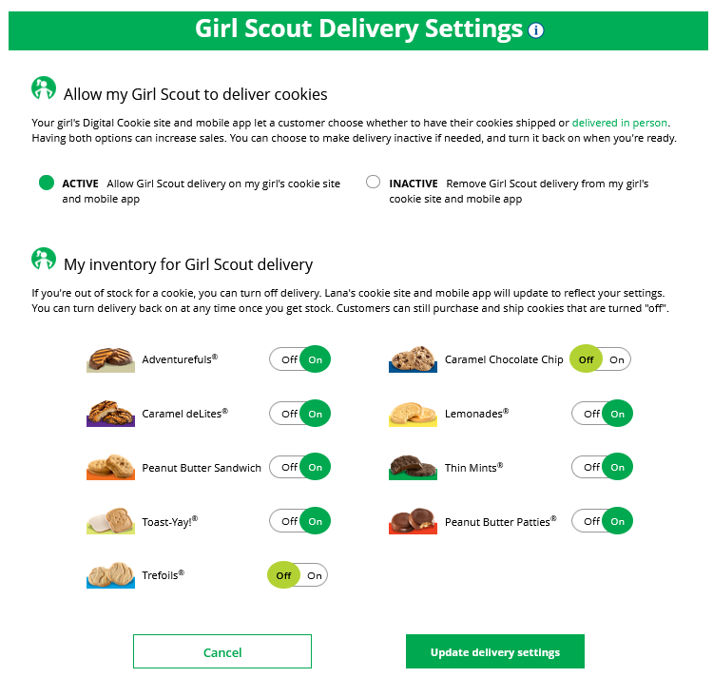
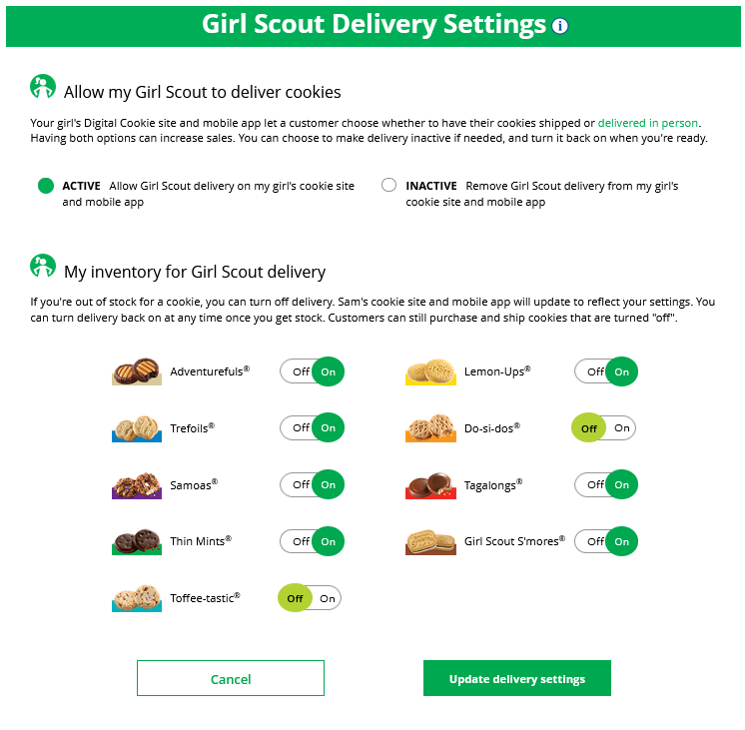
My Cookies Tab-Delivery Settings
Notes:
Note to council: Remove this slide if not using this functionality, if you are using I,t select which image has the correct cookies and delete the other.
The Delivery Settings function gives you the opportunity to turn off Girl Scout delivery and off varieties of cookies. This might be useful if you run out of a cookie variety and can’t get any more to fill customer orders or you are entirely out of cookies for delivering to customers or otherwise are unable to deliver cookies to customers.
If you are worried about your inventory, always check with your troop cookie volunteer first to see if you can get more cookies before turning off a variety. Turning it off means a customer doesn’t have the option to purchase it for delivery so you don’t have to decline their order and disappoint them if they can’t get the variety they ordered.
When you know you need to turn off delivery or a variety(ies), go to the bottom of your “My Cookies” tab and find the Girl Scout Delivery Settings section.
When you select “inactive” to turn off the Girl Scout delivery option for your customer, you will get a warning message. If you want to turn delivery off, click “Update delivery settings”. Once you have turned it to inactive, the varieties section will be removed and is superseded by a message. You can turn the site back on at anytime during your council sale dates.
If you wish to offer delivery but are out of a cookie variety and can’t get more inventory, you can turn off just that variety of cookie for delivery and customers can only purchase those for shipping and not delivery. To do that, simply click the “off” button then click the Update delivery settings button, and it will remove that variety from the Girl Scout delivery option. If you are able to offer that to customers again, return to this section and click the “on” slider to turn that variety back on.

Slide 28
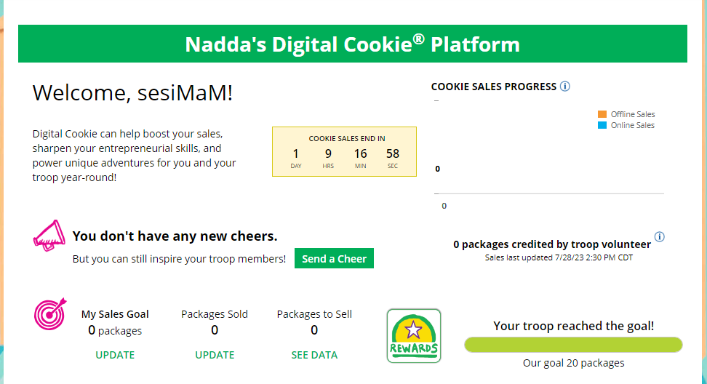
Cheers Tab
Girl Scouts can see and send cheers from their dashboard or Cheers tab.
Notes:
Girl Scouts can be even more excited about their Digital Cookie experience when they give a Cheer to another Girl Scout in their troop or receive one from a troop member, troop volunteer, or even a customer.
Girl Scouts can see if they have any cheers on their dashboard. If they don’t, encourage them to send some from the “Send a Cheer” button on their homepage or the “Cheers” tab.

Slide 29
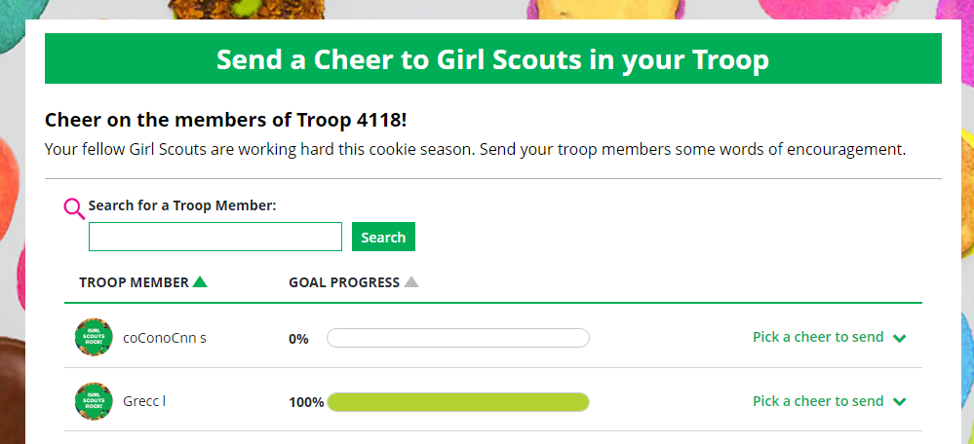
Cheers Tab
Girl Scouts can only send to other girls in their troop but can receive Cheers from customers and leaders, and other girls in their troop.
Sending A Cheer
To send a Cheer, Girl Scouts can click Pick a cheer to send next to the Girl Scout they want to cheer.
Notes:
In the Cheers module, Girl Scouts can see the other members of their troop and the percentage of sales towards them reaching their goal.
They can select the “Pick a cheer to send” drop down next to the name of the Girl Scout they wish to cheer.
Girl Scouts will see a choice of .gif images and short messages they can send. As they select the message and image they will see a preview of the cheer and then can click “Send this Cheer”
When Girl Scouts have cheers that have been sent to them, they can see how many cheers on their dashboard and from there, they can click to view their cheers.
If the cheer is from another Girl Scout in their troop they can “Cheer Back”, which will take them to a quick screen to return the cheer.
If they do not see “Cheer Back” as an option, the cheer is from a troop volunteer or customer, and they can’t send a cheer back to those supporters.

Slide 30
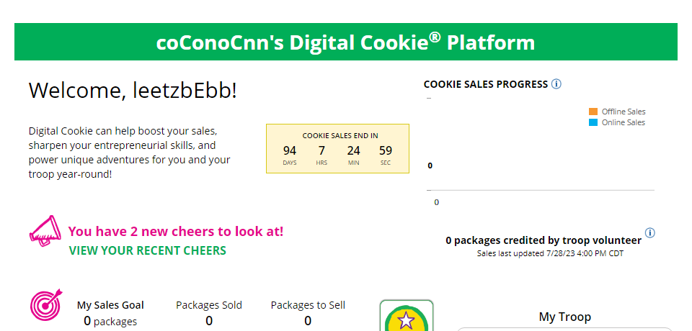
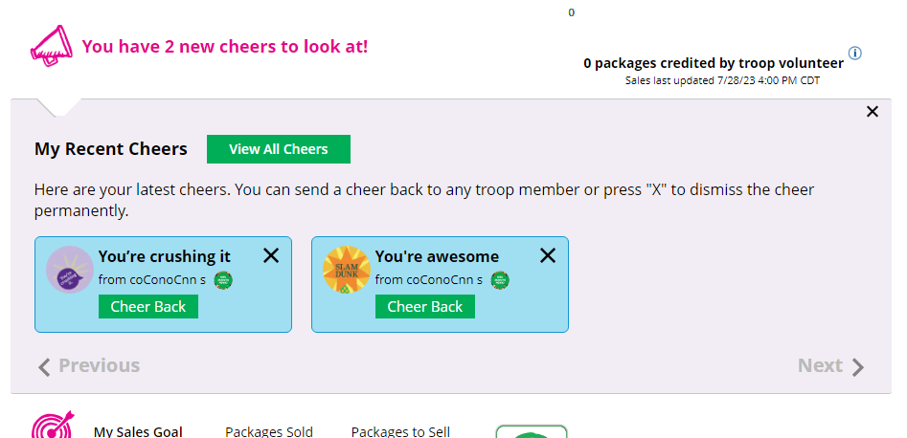
Cheers Tab
Viewing Cheers
The dashboard will alert Girl Scouts when a new Cheer has been received.
Notes:
In the Cheers module, Girl Scouts can see the other members of their troop and the percentage of sales towards them reaching their goal.
They can select the “Pick a cheer to send” drop down next to the name of the Girl Scout they wish to cheer.
Girl Scouts will see a choice of .gif images and short messages they can send. As they select the message and image they will see a preview of the cheer and then can click “Send this Cheer”
When Girl Scouts have cheers that have been sent to them, they can see how many cheers on their dashboard and from there, they can click to view their cheers.
If the cheer is from another Girl Scout in their troop they can “Cheer Back”, which will take them to a quick screen to return the cheer.
If they do not see “Cheer Back” as an option, the cheer is from a troop volunteer or customer, and they can’t send a cheer back to those supporters.

Slide 31
Customer View

Slide 32
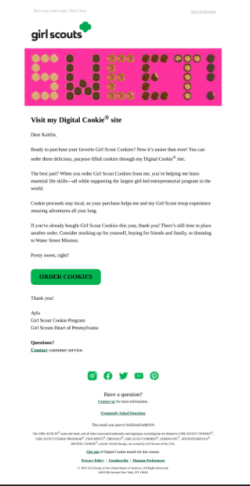
Customer View-Email
Order Cookies Link
Notes:
Customers either receive a link to a Girl Scout’s site from a mutual connection or receive a Girl Scout’s email announcing that cookie season is open.
Customers will click the “Order Cookies” link in the email and be taken to the Girl Scout’s Digital Cookie site.

Slide 33
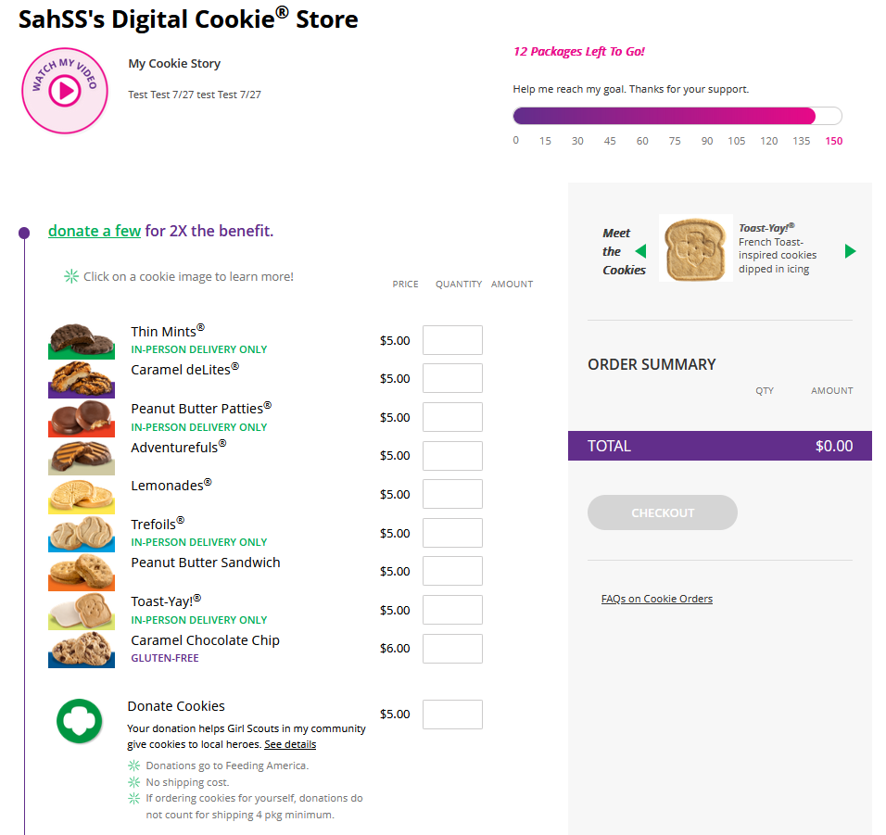
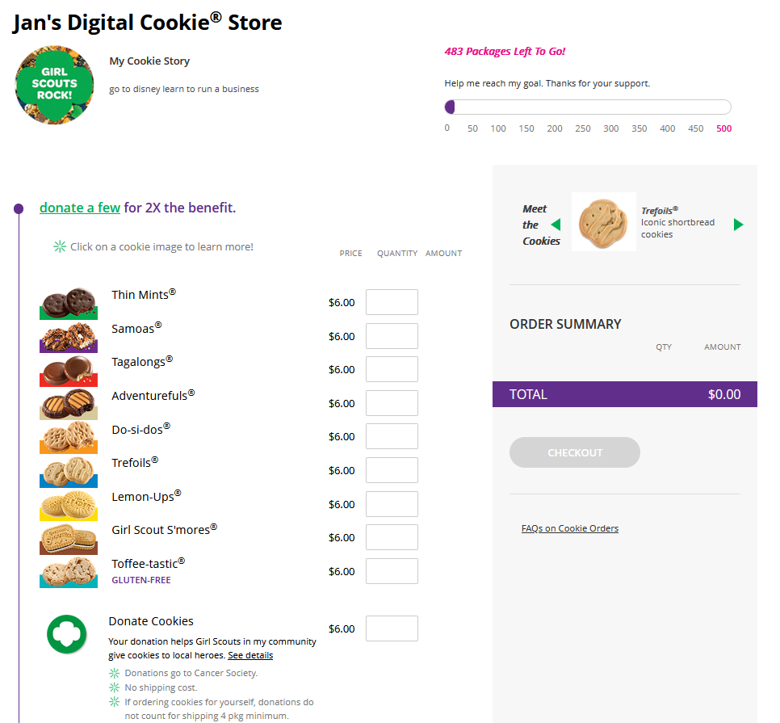
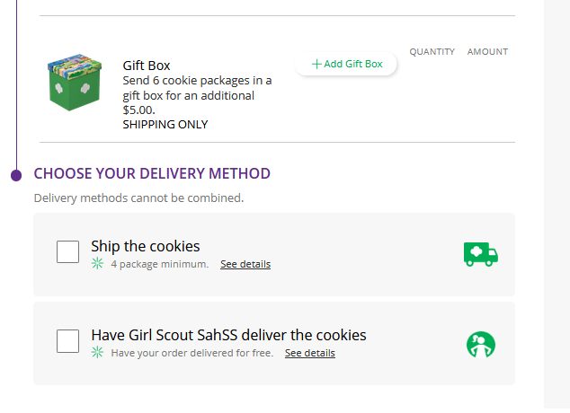
Customer View-Placing Order
Customer enters package quantity
Customer enters package quantity
Select Delivery Method
Checkout
Checkout
Notes:
Note to council: Select which image has the correct cookies and delete the other.
As customers order packages, the total amount updates.
After selecting the cookies, customers will select the delivery method
Once customers are satisfied with their order, they will simply click the “Checkout” button.

Slide 34
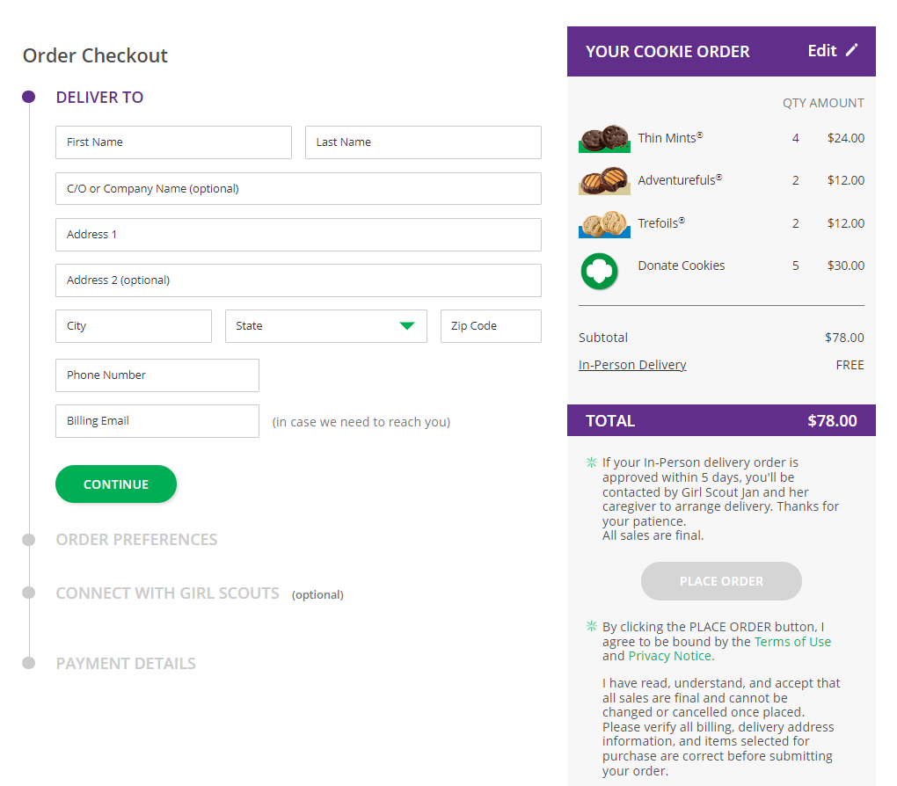
Customer View-Checkout
Notes:
Customers are then taken to a checkout screen to complete basic delivery and billing information.
The next screens (Order Preferences, Connect with Girl Scouts, and Payment Details) ask customers to:
Choose a second option if Girl Scout delivery is not approved.
Indicate if they want membership or volunteer information (optional).
Share if they were Girl Scouts (optional).
Complete credit card information.

Slide 35
Customer View-Confirmation
Send Girl Scout a Cheer
Place another order
Notes:
Once customers have completed the information and clicked continue at each step, they will click the “I am not a robot” box and the “Place Order” button
Customers then see an order confirmation screen that includes the option of placing a new order in case they want to send some to a friend!
Customers will then receive a series of emails depending on their order delivery method.
See Customer Experience tip-sheets for more details on the emails customers receive

Slide 36
Digital Cookie Shipping Fees
Package Bracket | Digital Cookie 2023-2024 Consumer Charged Flat Fee
4-8 | $12.99 (tier A)
9-12 | $14.99 (tier B)
For orders of 13 packages or more shipping is calculated as follows:
13 packages of cookies: tier B (12 packages) + tier A (1 more package) = $27.98
25 packages of cookies: tier B x 2 (24 packages) + tier A (1 more package) = $42.97
$5.00 surcharge to orders shipping to Hawaii, Alaska, Puerto Rico, APO/FPO/DPO, Guam and US Virgin Islands
Don’t make the decision for your customers, the answer is always no unless you ask.
Customers want the cookies and are willing to pay shipping
They have the option to not purchase shipped and still donate-that is more sales than not asking
Notes:
There are a lot of people who don’t know a Girl Scout and want the cookies and are willing to pay shipping to both get the delicious cookies and support your Girl Scout.
Customers can decide if they want to purchase shipped, or donate a box or two, or nothing at all.

Slide 37
Digital Cookie Help Center
Notes:
Note to councils: bring over the registration help slides from the troop cookie volunteer training if you want to review those steps with caregivers.

Slide 38
Digital Cookie Help Center
Your go-to place if you need support!
Notes:
Click Need help to log in:
If you didn’t receive your registration email and you want to check which email address is on file.
Forgot your password
Click Help at the bottom of the page to go to the Help Center for FAQs, Tip Sheets, and more.
There are also help sections built into the site.

Slide 39
Digital Cookie Help Center
Select which role and category you need support on.
Inside, each category will have detailed instructions, links to tip sheets, or even video tutorials to help you.
Notes:
Select the role you need support on and then select the category
Inside each category there are detailed instructions, links to tip sheets, or video tutorials to help the user.

Slide 40
Digital Cookie Help Center
After looking, still can’t find what you need? Contact customer support.
Click the topic you need help with and complete the form for more assistance.
Or click the Live Chat button to chat with a Digital Cookie support agent during business hours.
Notes:
Still need help? Click on the Contact customer support link
Click the topic you need help with and complete the form for more assistance
Want to talk to a live agent? Click on the Live Chat button during business hours to chat with a Digital Cookie customer support agent.

Slide 41
Thank You
Presenter Name:
Presenter Title:
Contact Info:

Slide 42
Appendix

Slide 43
Mobile App
Notes:
Additional details will be found on the Tip Sheet. Tip Sheet and updated slides will be available by the end of Sept. 2023.

Slide 44
Mobile App-Making a Sale
Select from the Girl OR the Troop persona. Troop login means the sales go to the whole troop-like at a booth.
Taking an order and viewing your orders are the main functions.
Girl enters the customer’s order on the order page.
Girl can select to “Give Cookies to Customer Now” for face to face transactions.
Notes:
Users should Download a new version of the Digital Cookie App each year.
Girl Scouts must have their site set up and approved prior to being able to log into the cookie app.
Troop must have troop site set up for the troop option to appear
Once logged in, the user will select which account to use to take the cookie sale (Girl Scout or Troop).
Then you will arrive at the home page, to create a new order click the Mew Cookie Order button.
Enter the number of cookies and varieties the customer is ordering.
At checkout select the delivery method, most likely option is “Give Cookies to Customer now” if they are making a face-to-face sale.

Slide 45
Mobile App-Viewing Orders
Click the green arrow in the section of orders you want to see more details for
Click green arrow next to customer name to see order details.
Details about that customer’s order appear including address and packages purchased
Notes:
Girl Scouts can view orders using the “All Orders” section of their app. Tapping on the “All Orders” or scrolling down will make all of your orders visible by delivery method.
To see the details for an order, click on the green arrow to view the section of orders to approve.
Select the order you want to view and click the green arrow next to the order.
The details for the order will appear and you can review the order and see the status, including shipping status.

